Slide 1


+
Welcome
Digital Transformation &
Journey Through the Modern Workplace

Slide 2


NICOLE MAILE
Channel Account Manager
ASHLEY MORETTI
Microsoft Programs Manager
+

Slide 3

LET’S TALK
PAX8
+
Notes:
AGENDA
Pax8 overview and solution
Werner Enterprises with Phil
Microsoft 365
Sales strategies
Teams
Azure
Questions

Slide 4




Pax8 Story
2012
FOUNDED
500+
EMPLOYEES
60+
VENDORS
11,000+
PARTNERS

Slide 5

SOLUTION: A MODERN CLOUD JOURNEY
WINGMAN
EXPERIENCE
CUSTOM
STACK
TECHNOLOGY
Notes:
We simplify the chaos for our Partners and Customers by providing…
A world-class platform
Excellent pre- and post-sales experience that we call “The Wingman Experience”
A custom stack of SaaS applications to future-proof a tech environment

Slide 6






































MARKETPLACE
PRODUCTIVITY
INFRASTRUCTURE
CONTINUITY
SECURITY
Notes:
This is an excellent opportunity to re-affirm the specialist and dedicated resources partners have at Pax8, while showcasing some of the more robust solutions. It's important to use this slide to recap some of the solutions uncovered when you are on the "your solutions" slide.
"If you recall, we discussed how each pax8 partner works with a full team of dedicated specialists and consultants as a part of your pre-sales support team. If you look at the top of the slide here, you will see the four categories, Productivity, Infrastructure, Continuity, and Security. Your dedicated team will help with demos, pricing, project build-outs, Q & A sessions, and will be your go-to knowledge base for wanting to learn more about specific pax8 products.
Pax8's line card is growing and has expanded rapidly in the past few years. We offer over 40 vendors that are fully vetted for MSPs and designed to be channel-friendly. I fully anticipate this number to continue to grow as we are continually adding new products and services to remain current and meet our partners' needs. Not a bad idea to throw out some examples of products (i.e., "We see a lot of partner adoption on products like Proofpoint, Ironscales, Azure, S1 ...").
Give a quick pitch on each one to see if they bite. Additionally, touch on products the partner has mentioned using as a part of their stack to build COC interest.
"I know you mentioned you were utilizing O365 via Ingram. There is some overlap there as pax8 resells; I would love to set up a call with your specialist to dive into procuring O365 via pax8 etc.".

Slide 7
LET’S TALK
PAX8 + MICROSOFT
+

Slide 8




We Know
Roadmap
Solutions
Coming soon
Beta tests
New product launch
New feature rollout
End of support
Promos &
Incentives
Core competencies
Eligibility
Co-op components
CSP Wingman
Program changes
Quarterly incentives
Rebates
Accelerators
+
+

Slide 9





CLIENT PAIN AROUND MICROSOFT PROCUREMENT
Medium enterprise clients are likely buying Microsoft products either directly from Microsoft through an Enterprise Agreement (EA) or from other CSP distributors and resellers, which can be challenging due to:
CONFUSING LICENSING
GUIDELINES
THOUSANDS OF
DISTINCT SKUs
FRUSTRATING OFFSHORE
SUPPORT
COMPLEX
BILLING
INCREASED RISK OF
MICROSOFT AUDITS
Notes:
Let’s dive into the nightmares I mentioned.
Confusing Licensing Guidelines
Licensing guidelines are extremely confusing. In fact, did you know that Microsoft changed their product names within the last few weeks? On top of that, businesses can accumulate licenses over time and who knows if their licenses are right-sized for the business as it stands today.
Thousands of Distinct SKUs
There are tens of thousands of SKUs in the Microsoft world. We constantly hear that customers don’t understand what they’re using or not using. As a result, they spending way too much time and money on procurement.
Frustrating Offshore Support
Customer support can also be really challenging. I was talking to a thousand seat enterprise customer the other day who get support directly from Microsoft through their direct relationship. We found out the customer avoided reaching out to Microsoft support because it took days for a resolution. Instead, the customer spent time figuring it out on their own by scanning tutorials and watching YouTube videos.
Complex Billing
Along with the support factor, many customers also experience a terrifying billing nightmare. Typically when adding a new license, there’s a separate bill for that single or set of licenses. We had a customer just last week send us 20 separate Microsoft bills – one for each license type.
Increased Risk of Microsoft Audits
On top of all that, companies are at risk of audits when going direct with Microsoft. Microsoft will mark SKUs as EOS (End of Support), causing customers to become non-compliant when it comes to HIPAA, PCI, FINRA, GDPR. These customers are making term commitments over a multi-year period where they have to make license and/or volume commitments. We find customers often have trouble accurately predicting what their license usage may be 6 months or 24 months from now.

Slide 10
HOW PAX8 SOLVES FOR THESE PROCUREMENT PAIN POINTS
DEMYSTIFIES
LICENSING GUIDELINES
RIGHT-SIZES &
REALLOCATES
LICENSES
PROVIDES 24/7
US-BASED SUPPORT
CONSOLIDATED
BILLING
REMOVES RISK OF
MICROSOFT AUDITS
Notes:
Let’s talk about how Pax8 solves for these nightmares.
Demystifies Licensing Guidelines & Right-sizes and Reallocates Licenses
With our deep bench of experts, we help customers navigate Microsoft’s vast sea of licensing options while right-sizing the environment for the customer’s business. In fact, we like to say we know Microsoft better than Microsoft.
Provides 24/7 US-Based Support
Instead of customers looking for help articles on their own, we provide world-class, 24/7, US-based technical support for end customer IT teams. In fact, we handle 91% of all incoming support tickets internally.
Provides MTM Consumption & Removes Risk of Microsoft Audits
We don’t expect customers to know exactly what they’re going to need over the next 36 months. We provide a month-to-month consumption model with one monthly bill, so customers are only paying for what they use. Since it’s all month to month, customers no longer need to worry about audits since those pertain to long-term commitments.

Slide 11
LET’S TALK
JOURNEY THROUGH MODERN WORKPLACE
+

Slide 12
What is Digital Transformation?
Digital transformation is the process of modernizing your client environments to deliver new, cloud-first modern workplace experiences that encourage security and collaboration while allowing work from anywhere.
2020’s health crisis drove massive acceleration of these initiatives.
“We’ve seen two years’ worth of digital transformation in two months. From remote teamwork and learning, to sales and customer service, to critical cloud infrastructure and security — we are working alongside customers every day to help them adapt and stay open for business in a world of remote everything.”
Satya Nadella, CEO, Microsoft
+

Slide 13
THE CHALLENGES OF QUICKLY
ADAPTING TO REMOTE WORK
20% of remote workers say their biggest challenge is collaboration and communication; 20% say it is loneliness
46% of employees admitted to transferring files between work and personal computers when working from home
36% of organizations have dealt with a security incident due to an unsecured remote worker
+
Notes:
Challenges of working remote are REAL
Sources:
https://openvpn.net/remote-workforce-cybersecurity-quick-poll/
https://heimdalsecurity.com/blog/cybersecurity-issues-with-remote-work/
https://lp.buffer.com/state-of-remote-work-2020

Slide 14
Microsoft Teams is the hub for teamwork
Office
applications
People
Content and
authoring
Microsoft
Teams
Everything you need for your workspace.
All in one place.
No matter where
you are.
Everyday
apps and
services
Chats,
Calls and
Meetings
Bots and
connectors
+

Slide 15
88% OF MICROSOFT TEAMS SURVEY
RESPONDENTS FELT “HAVING ALL OF
OUR SOLUTIONS IN ONE PLACE SAVES TIME”
4 HOURS PER WEEK ARE SAVED BY
INFORMATION WORKERS THROUGH
THE IMPROVED COLLABORATION AND
INFORMATION SHARING OF TEAMS
+
Notes:
**Source - https://www.microsoft.com/en-us/microsoft-365/blog/wp-content/uploads/sites/2/2019/04/Total-Economic-Impact-Microsoft-Teams-Infographic.pdf?rtc=1

Slide 16
Teams is the Fastest Growing
Business App in Microsoft History
115 million⁺
daily active users
181
44
languages supported
200M
4.1B+
meeting minutes
(April 2020)
markets
daily meeting
participants
+
Notes:
It’s working!
Teams is the fastest growing business app in Microsoft history! And has reached almost 9M monthly SMB users as of last month.
Companies are embracing Teams – In the month of October 2020 Teams usage reached 115M daily users, and in April 2020 more than 200 million Microsoft Teams meeting participants in a single day, generating more than 4.1 billion meeting minutes.

Slide 17
LET’S TALK
SALES STRATGEY
+

Slide 18
Microsoft 365 Teamwork: Where to start a conversation
Yammer
Outlook
Teams
Inner Loop
Outer Loop
People you work with regularly on core projects
Files
Sites
Content
SharePoint
People you connect with openly across the organization
Email
Ubiquitous for targeted communications
Office 365 Groups
Cross application group membership
Notes:
Talk Track:
When deciding how best to leverage our toolkit for your team needs, think about the type of work that needs to get done and the type of conversations your team needs to have.
The inner loop includes people you work with regularly, actively communicating and working on projects to deliver against important goals and deliverables. For this type of interaction Microsoft Teams is the best tool, allowing you to actively engage with your team in a shared work space where you can work on files, chat, and even host meetings.
Your outer loop includes people across your company who provide valuable information, that you openly connect with on common topics of interest. Yammer is the best tool for your outer loop, letting you openly connect across the company to solicit ideas, and share best practices on broader initiatives.
Outlook remains a tried and true tool for conversations, and is useful for teams that want to quickly share and communicate in a familiar place
Of course content and creativity is at the center of every team – the very reason teams come together to connect, whether it is collaboration on a new product strategy, a sales presentation or a key company initiative. SharePoint is the tool that keeps content at the center of teamwork, making files, sites and content easily shareable and accessible across teams and organizations. SharePoint is tightly integrated with Teams, Yammer and Outlook in order to enable seamless content collaboration across conversation experiences.
And it’s all connected through a suite-wide membership service with O365 Groups
With these tools, and more, in our universal toolkit, the breadth, depth and integration across our portfolio is something that competitors just cannot match!

Slide 19
Microsoft 365 Teamwork Use Case Guidance
Outlook
SharePoint
Yammer
Office Apps
Teams
Email
& Calendar
Intranets
& Content Management
Connect and engage across the Org
Co-Author
Hub for
Teamwork
EXAMPLE USE CASES
Upgrade a DL to a group inbox with shared notes and files
Share updates with a group in email
Keep a group in sync with a shared calendar
  Create a company intranet to share news and resources
  Customize a team site to automate document workflows and share lists
Share and work together on all files with OneDrive
  Create a community around topics of interest or areas of practice
  Drive initiatives for cross-organizational innovation
Foster two-way engagement between leadership and employees including Firstline workers
See who's in the file with you
Work together with real time co-authoring
Track what’s changed with version history
Iterate on a project with individual team
Chat, calls, and meetings for todays teams
Office 365 apps built-in
Office 365 Groups Microsoft Graph Security and Compliance
Notes:
https://fasttrack.microsoft.com/office/envision/productivitylibrary/crowd-source-new-product-ideas
https://fasttrack.microsoft.com/office/envision/productivitylibrary/work-together-on-documents-with-colleagues

Slide 20







Microsoft 365 customer value enables sales pipeline
Start the customer journey with Microsoft Teams as the hub for teamwork
Pull-through opportunities:
Extended
Opportunities
Deployment
Hub for Teamwork increases adoption
Email & Calendar
Hub for
Teamwork
pulls through
opportunities
Adoption
Create opportunities for managed services and additional workloads
Security
Sites and Files
Managed services
Creates opportunities driving business transformation
Project
Management
Meetings
and
Voice
Developer & Integration
Create contextual solutions based on Microsoft Graph and AI and integrate into LoB applications, Microsoft 365 Powered Devices and Azure.
Persistent chat
Community
Notes:
This leads us to Microsoft Teams, the hub for teamwork, and the huge opportunity this presents to partners. Starting with the hub for teamwork, employees use Microsoft Teams as a chat based workspace to collaborate with each other towards a common goal and task. However, chances are the team will have resources that need to be accessed on a regular rhythm that are outside Microsoft Teams. Users can bring those resources into Teams to access them without ever having to leave the application, and this is where the partner opportunity lies.

Slide 21
Microsoft 365 Teams sales formula
New opportunities start with Microsoft Teams
Sales formula summary
Ignite the collaboration opportunity using Microsoft Teams:
  Lead with the “hub for teamwork” to drive new collaboration opportunities. Start by telling the all-up Microsoft 365 story with a focus on the collaboration scenarios that help partners demonstrate the full value customers need.
Selling strategy
Get
started
Target
customers
Present a
solution
Present
value
Close the
deal
Drive
adoption
I understand “hub for teamwork” and collaboration scenarios
I know how Microsoft Teams can pull through solutions customers need
I present customer solutions utilizing the collaboration scenarios
I showcase the universal toolkit with Microsoft’s business value tools
I leverage Microsoft incentives and offerings to help customers
I use the Customer Success Plans to help customers realize value
What stage are you in?:
Resources for selling
Go deep in learning about Microsoft Teams and the hub for teamwork pitch, and demos. Review offerings to see how Microsoft Teams can help engage customers in new ways.
Review Unblocking Workplace Collaboration and Ultimate Guide to Chat Based Tools
Find customers with partial deployments of Exchange and SharePoint, sell the value of Microsoft Teams as key collaboration solution.
Identify solutions using Microsoft Teams for broader industry solution opportunities.
Present solutions that utilize the new scenarios, start with customer needs and expand on additionall solutions as customers needs increase.
Use the Collaboration pitch deck to position a collaboration story for the customer.
Utilize the Microsoft Business value tools on Transform.Microsoft.com to show the entire value of Office 365.
Start with the Customer Immersion Experience to demonstrate product truths and value.
Next lead customer through the Value Discovery Workshop
Utilize Customer Evidence and success stories to showcase customers leveraging Microsoft 365 collaboration and using Microsoft Teams to unlock new customer scenarios.
Drive collaboration scenarios using the Productivity Library.
Build a community of champions with the Champions Program

Slide 22
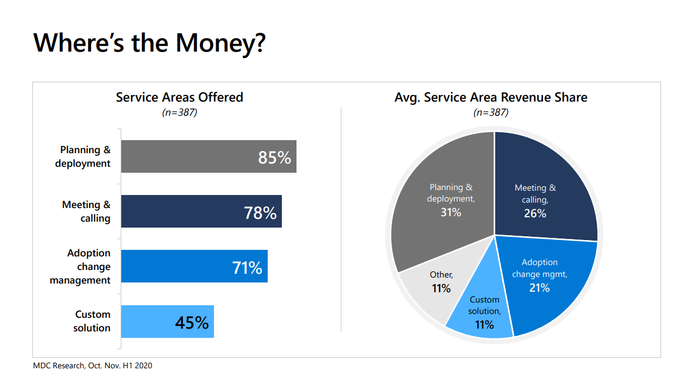

Slide 23
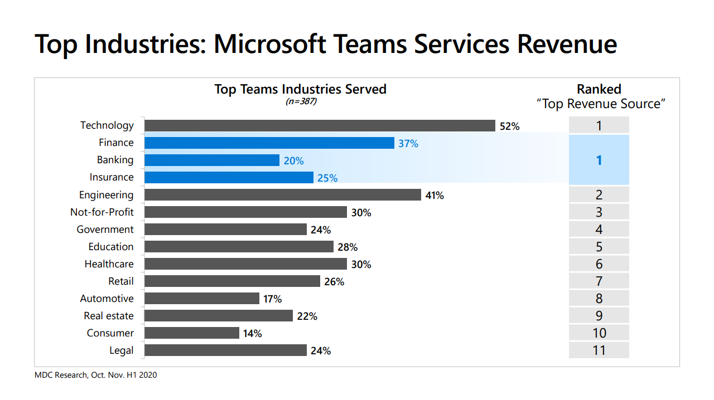

Slide 24
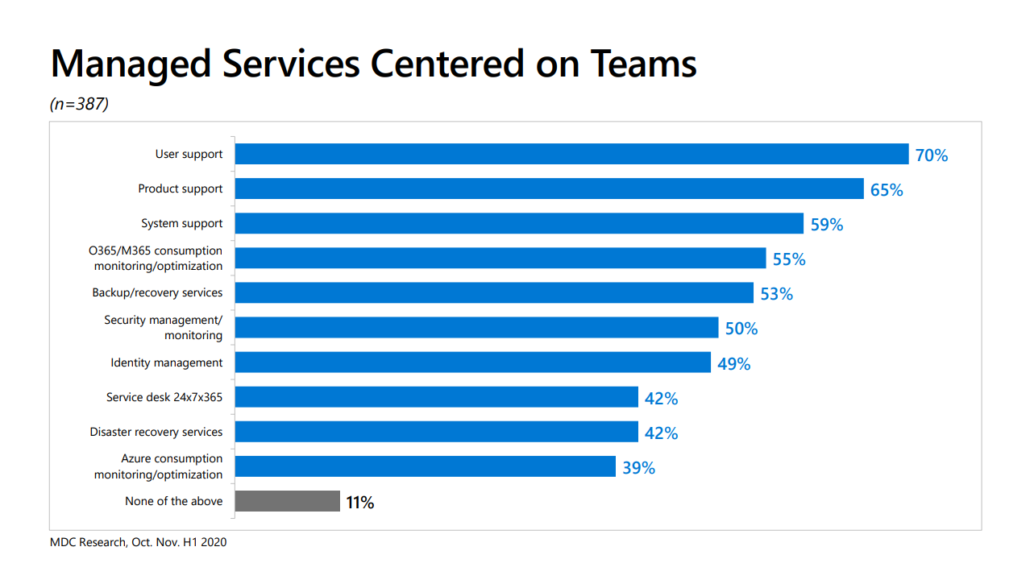

Slide 25
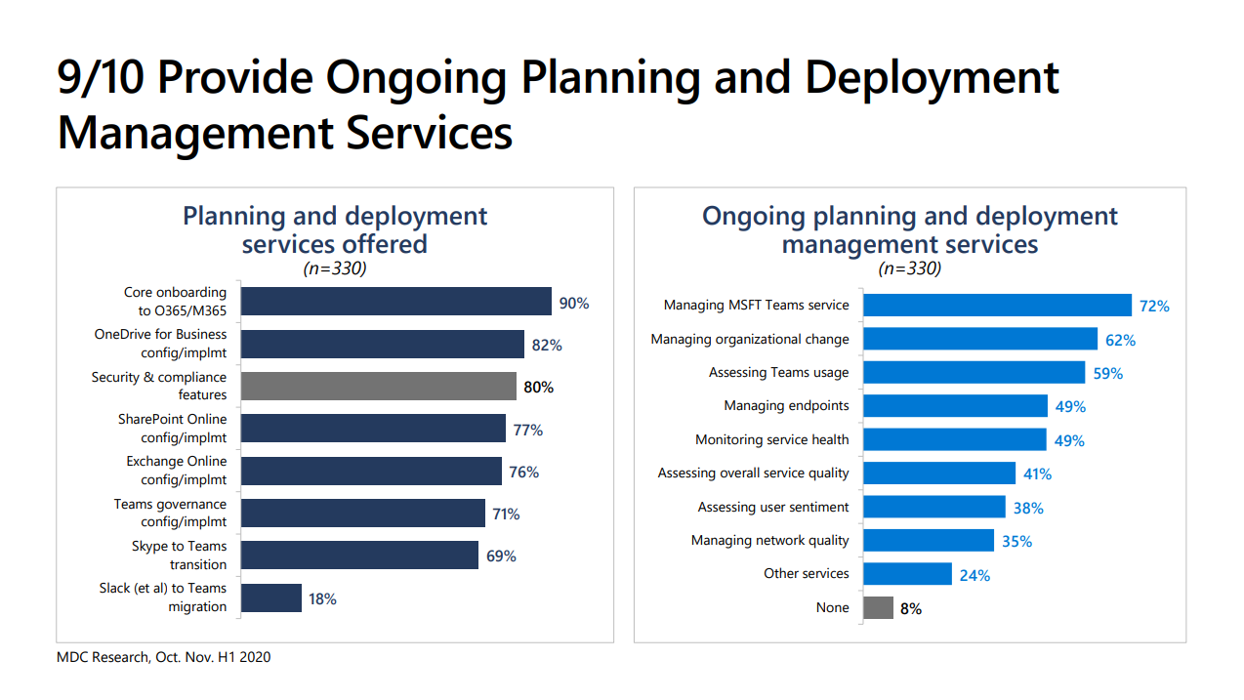

Slide 26
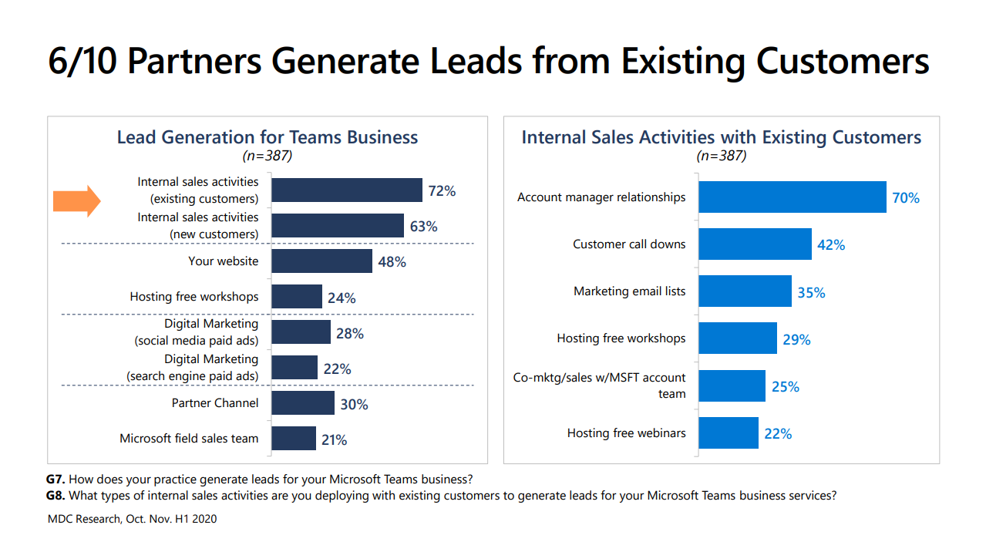

Slide 27
LET’S TALK
QUESTIONS
+

Slide 28
Microsoft 365
THANK YOU!

