Slide 1
Bering McKinley Peer Team
Building a structure for MSP success
The MTA Landscape
Results from the Survey
Share – Encourage - Challenge
Notes:
Focused on Client Experience today and we are going to start off with some benchmarks
Thank you for filling it out, people who didn’t you know who you are…..Garrett, Josh, Dan
Quick Question around the room – What do you love about your company?

Slide 2
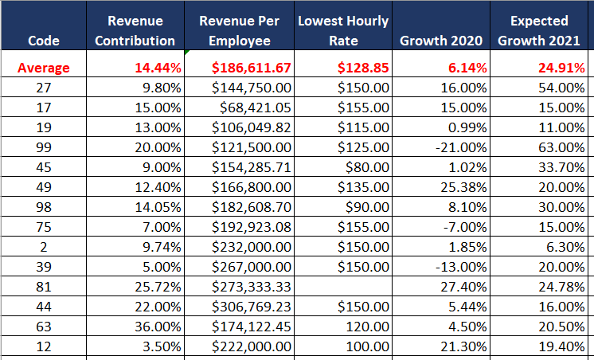
Bering McKinley Peer Team
Building a structure for MSP success
MTA Alignment
Company Metrics
Growth, Focus, Team Size
Share – Encourage - Challenge
Notes:
Rev Contribution – nothing crazy here, just something to see
Rev per employee – 1st, if you use an outsourced helpdesk half this number
SS:SR 33% so how much SERVICE (this is everything) revenue for a 50k person?
Lowest HR: 80/90/100…come on
2020 vs 2021 a lot of ballers in here

Slide 3
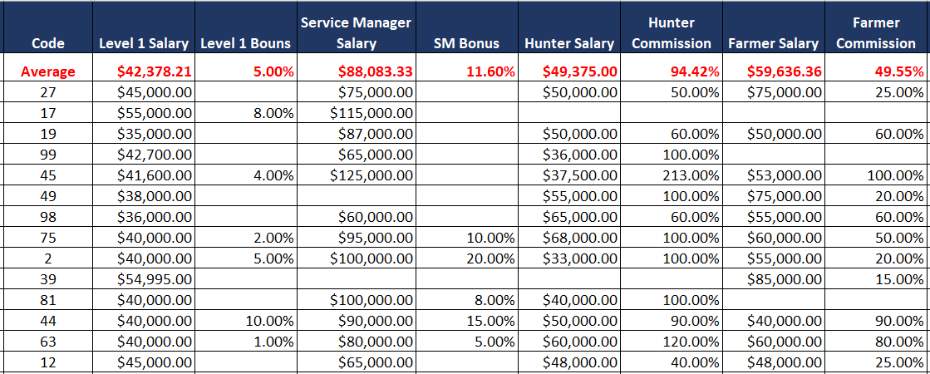
Bering McKinley Peer Team
Building a structure for MSP success
MTA Alignment
Salaries
Level 1, Service Leader, Sales
Share – Encourage - Challenge
Notes:
Don’t want to hear 1.5 bullshit…. Or my region.
For those that give a bonus….
Service Manager – 3 Responsibilities….not gonna get that for 75k
Hunter Average Comp = 100k @ .5 Commission = 1mil
Farmer Avg Comp = 90k @ .25 Commission = 1mil

Slide 4
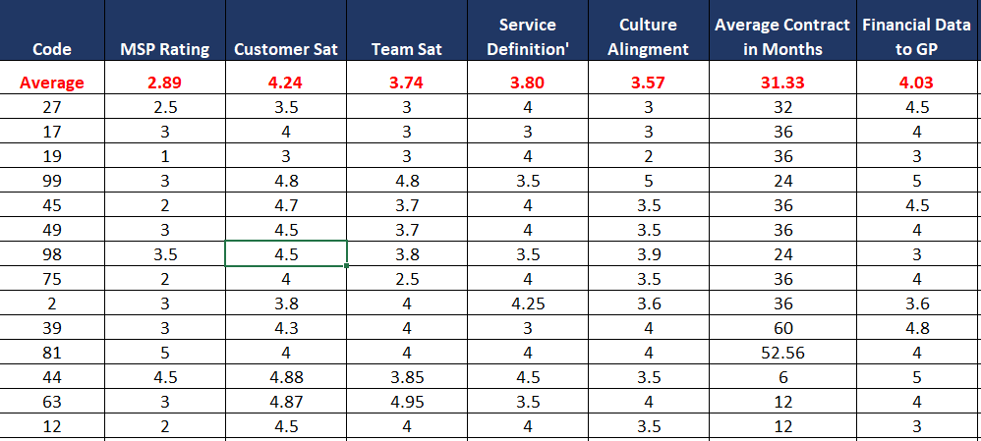
Bering McKinley Peer Team
Building a structure for MSP success
MTA Alignment
Real Drivers
How do you stack up?
Share – Encourage - Challenge
Notes:
Remember that – “What do you love about your company?” Is that reflected here?
Meeting your MSP goals, 2.89 sucks and I hope we find the problem in Big Dials
CSAT – 4.5 is the floor
TSAT - 4.5 is the floor
Around the room – higher / lower than Core business?
Team Sat – Culture Alignment – higher / lower conversation
Financial Data needs to be a 5 to Gross Profit.

Slide 5
Bering McKinley Peer Team
Building a structure for MSP success
MTA Alignment
How to use this information
Average is an ok starting point
It’s not where this team want’s to be
What’s awesome about all of this?
Changing any one of these metrics is single decision.
Share – Encourage - Challenge
Notes:
Your market is not special
Your team is not unique
Your MSP should not be average
I hope you saw something you didn’t like
I don’t think anyone in this room got here being afraid to make a change

Slide 6
Bering McKinley Peer Team
Building a structure for MSP success
Big Dials for Client Experience
Identify areas of change for high client engagement and happiness
Share – Encourage - Challenge
Notes:
In a minute I will be asking for some examples of great CE so get ready

Slide 7
Bering McKinley Peer Team
Building a structure for MSP success
Big Dials
What are big and small dials?
Big Dial
Small Dial
Big Change Needed
More than 25% outside of goal
Bold and challenging
Fast Execution
Change in Course
Out of alignment with goals, values, or personal happiness
Minor Adjustments Needed
With-in 25% of goal
Looking to step into change
Small changes
Slower pace
Change degree
Right direction, right path, wrong degree of application.
Share – Encourage - Challenge
Notes:
Real quick intro to Big Dials / Little Dials

Slide 8
Bering McKinley Peer Team
Building a structure for MSP success
Big Dials
What are some examples of a great client experience?
MTA CSAT Average: 4.24
Share – Encourage - Challenge
Notes:
Pick on a few to give a great experience story

Slide 9
Bering McKinley Peer Team
Building a structure for MSP success
Big Dials
What does a great Client Experience look like?
Fast Response
Correct Aptitude
Pleasant Attitude
Provides Closure
Follows Up
1
2
3
4
5
Share – Encourage - Challenge
Notes:
They pay us to be there
We apply the right resource
People are cool
We complete the work
We follow up, not every single time, just when we know we need to

Slide 10
Bering McKinley Peer Team
Building a structure for MSP success
Big Dials
What are some common challenges?
Delays in response
Delays in delivery
Broken promises
Not caring
Not being polite
Share – Encourage - Challenge
Notes:
Ask the team for common challenges to a great Client Experience
Finding your big dials will revolve around finding your challenges. You know what they are

Slide 11
Bering McKinley Peer Team
Building a structure for MSP success
Big Dials
#1 Biggest Fault for a great Client Experience
Everything leads back to Communication
Share – Encourage - Challenge
Notes:
Know, if you don’t’ have this, it’s a big dial

Slide 12
Bering McKinley Peer Team
Building a structure for MSP success
Big Dials
Where do we apply action?
Fast Response
Correct Aptitude
Pleasant Attitude
Provides Closure
Follows Up
1
2
3
4
5
Consider Service Delivery Change
Review Dispatch Process
Customer Service Training
Review Service Delivery
Update Survey Process
Review Dispatch Process
Update Education
Set Clear Expectations
Update ticket requirements
Consider % of direct follow up
Adjust staffing
Consider Service Delivery Change
Measure and report findings
Easy Comp Calculations
Review ticket / project flow
Share – Encourage - Challenge

Slide 13
Bering McKinley Peer Team
Building a structure for MSP success
Big Dials
Identify your Big Dials right now
You know what they are and who can turn it around
Changing the Big Dial items will only be difficult if you let them be difficult
Everyone will support you changing direction
Share – Encourage - Challenge
Notes:
Ask a few people what their big dials would be? Hard or easy

