Slide 1
5 Simple Shifts to Upgrade Your Clients’ Cybersecurity
Without Investing in Building
Your Own SOC or
Relying Solely on Automated Tools
Notes:
5 Simple Shifts

Slide 2
Who This is For
MSP Business Owners and Service Managers who are expected to keep up with all the latest security threats, vendors, and trends but are already running ragged trying to maintain their day-to-day tickets, client requests, and running their businesses
If you make your living running a Managed Service company providing support to businesses, this is for you.

Slide 3
Outcomes For This Session
How to offer enterprise cybersecurity solutions with vendor diversity without having to invest in, learn, and manage relationships with multiple software vendors
How to utilize cybersecurity to expand your offering, revenue, and profit per seat without adding to staff load
Why cybersecurity protection has gone beyond rudimentary firewall efforts and how utilizing out of the box solutions alone is leaving you open for attack

Slide 4
Outcomes For This Session
How to adapt to the ongoing work from home environment profitably and securely without sacrificing client efficiency
How to show that you’re keeping your customers safe and making a business base for cybersecurity protection to avoid the “what have you done for me lately” question from clients
AND How to do all of this without investing in building your own SOC or relying solely on automated tools

Slide 5
Our Promise to You:
A Step-by-step game plan to address escalating cybersecurity threats for your clients without a major investment

Slide 6
Does this sound like you?
Do you cross your fingers and hope every time you try to sell your cybersecurity offering knowing that you haven’t had the time or energy to keep up with all the threats out there, let alone all the vendors claiming to alleviate those threats?
Do you have one or two people in your NOC that are cyber-centric, but secretly you know that is not enough to truly implement all the security and compliance protocols you need to have in play?
Do you lay awake at night worrying what security threat is going to hit your clients next and hoping that you’ll have a clean enough back-up to be able to recover for them?

Slide 7
Are you just hoping and praying that the next major security breach won’t be targeted at your MSP, a vendor you use, or your clients because you don’t want to be the headline?

Slide 8
The Real Problem:
You Haven’t Made the Shifts.

Slide 9
Once You Make Them…
You can focus entirely on running your MSP, rather than spending time deciphering the latest threat.
You will be able to sleep soundly at night with absolutely no concern about the security of your clients.
Recovering from a backup will no longer be your first resort if your client encounters some sort of malware/ransomeware.

Slide 10
Once You Make Them…
You will be able to increase revenue (and profitability) from current clients, as well as increase the value of endpoints for future clients without increasing your staff/workload.
AND you’ll be able to do all of this without investing time and money in a multitude of enterprise-level cybersecurity solutions that are complex to deploy, time-consuming to maintain, and difficult to prove the value on your own.

Slide 11
Who We Are
Started in 2006 as an MSP
Pivoted in the last 5 years to focus solely on cybersecurity
The majority of our team have armed forces backgrounds with years of dedicated service to our country’s security
Notes:
Prevention Focused

Slide 12
Discovering the Shifts
There are 5 key shifts every MSP needs to make to be able to offer effective, efficient, top of the line cybersecurity services without overtaxing their team or budget.
We’re going to go through all 5 of those today.
Notes:
Rango

Slide 13
Shift #1: Operate with Integrity and Candor.
80% of organizations wish they had a stronger team in place to detect, investigate, and respond to security incidents
79% cite hiring is a challenge
54% of IT teams can’t take full advantage of EDR Solutions
Notes:
Core Values

Slide 14
Shift #1: Operate with Integrity and Candor.
Example MSP A:
Refuse to make the shift.
“I’ve kept my cybersecurity costs the same for the past 8 years and have no intention of raising them for my clients. My toolsets have protected them for this long, why change?”
Example MSP B:
They’ve made the shift.
“I’m willing to have a difficult conversation with my client around the rising costs of cybersecurity because I want to continually improve the protection placed around their business. If I tell my clients, I am certain about their cybersecurity while using aged and insufficient tools, I know deep down I’m not being truthful. Budgeting for cybersecurity prevention is far healthier for a business’s growth than suffering from a ransomware incident that leads to the demise of 1 in 5 small businesses.”

Slide 15
Shift #1: Operate with Integrity and Candor.
BOTTOM LINE: If you aren’t willing to have a candid conversation with your clients surrounding the changing cybersecurity landscape, and you’re not fully equipped with a team that can manage all of these challenges, you’re going to have an emperor’s new clothes moment.
Notes:
The conversation is going to happen one way or another – up front in planning and prevention, or after with lawyers guns and money

Slide 16
Shift #2: Transition with the Times
70% of organizations use a public cloud service – 70% of these suffered a security incident in the last 12 months
Example MSP A:
Refuse to make the shift.
“I’ve asked my users to spend at least 10 minutes a month on the cybersecurity awareness videos I have provided to them. Security is just as much their responsibility as much as it is mine as their provider.”
Example MSP B:
They’ve made the shift.
“With teleworking and e-learning entering the end user’s life without their consent, I need to do what I can as their provider to take excess steps off their plates when it comes to cybersecurity. The more I can do to leverage security toolsets that focus on prevention will lead to lower the attack surface and push the perimeter of protection that further out for my clients. This both optimizes the time they spend at work and keeps them safe.”
Notes:
SMB adoption of Cloud and associated risks

Slide 17
Case Study #1
Ran out of time
Began seeing failure points and fatigue in the team
Recognized that security wasn’t what it used to be and the endpoint count was too high to not do something about it

Slide 18
Case Study #2
One of our clients has reduced their incident response overhead and operational costs surrounding IT spend. (FortiGate edge)
This is directly attributed to reduced account take-overs, phishing emails, and malware delivery to the mailbox. (425k monthly emails; 6% malicious)
They have not had to perform a single workstation image due to malware or crypto-type attack since going live; previously, they performed an average of 2 per week. (Endpoint protection – Trend Micro)
Working from home users have a piece of mind knowing they will not be accessing malicious payloads via web-client; reduced complaints of home user's malware delivery.

Slide 19
Shift #3: Understand the Full Landscape
COMPLETE VISIBILITY
REDUCE ATTACK SURFACE
STOP KNOWN THREATS
BLUEPRINT FOR PREVENTION
PREVENT UNKNOWN THREATS
AUTOMATION WITH HUMAN VALIDATION
Notes:
Blueprint for Prevention

Slide 20
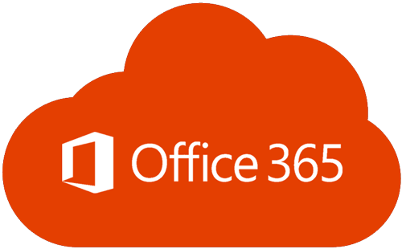
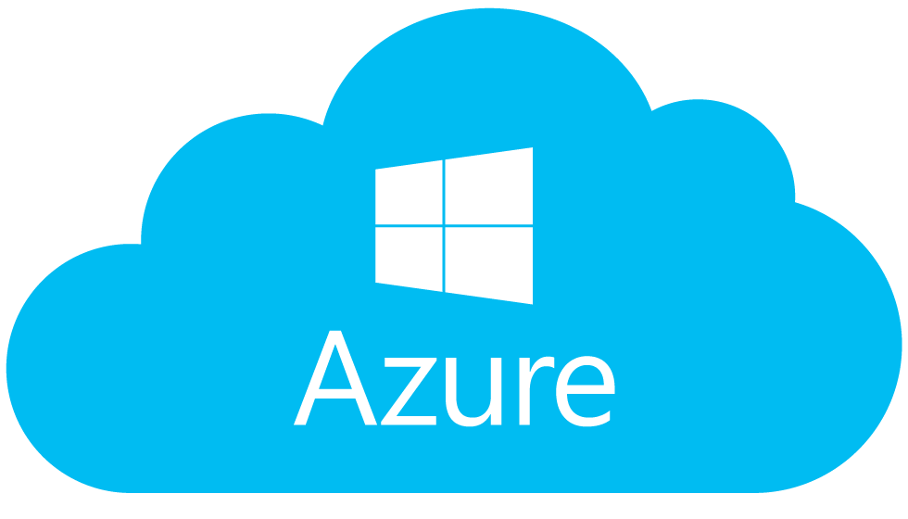
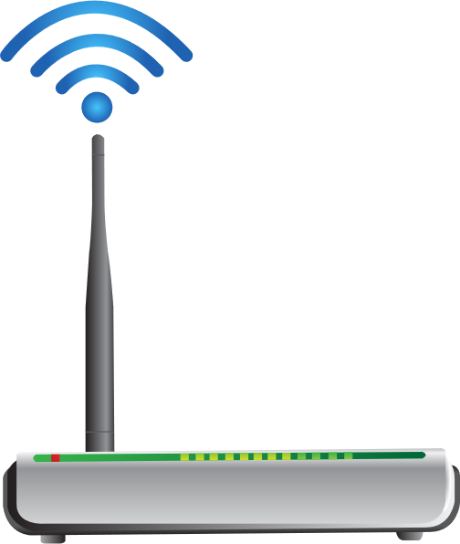
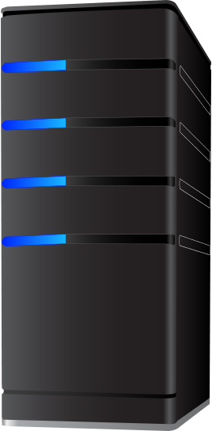
Cloud Services
Internet, Azure, O365, Web hosting
Edge
Firewalls, Broadband Gateways, Modems
Network*
Switches, Routers, Access Points
*Structural Edge, Security Endpoint
Endpoint
Workstations, Servers, Tablets, Mobile, Laptops
AD

Slide 21
Case Study #3
There was a rogue machine sitting on the network for 30 days
An executable was able to inject malware and exfiltrate 2.4 TB of data from this machine
Successfully encrypted VMs, which had to be restored from snapshot
Every machine that had advanced cybersecurity tools prevented the attack
Likely an admin team compromised account is to blame
Notes:
May Incident Response Example

Slide 22
Shift #4: Have a Plan
Let’s talk about the Colonial Pipeline hack.
Notes:
Summertime fuel costs

Slide 23
Shift #4: Have a Plan
When MSPs neglect to invest in managed security services, they often resort to recovering from backups after a security incident due to lack of tools or experience. This reactive security method does not remediate the root cause and results in lost trust with the client over time.
Example MSP A:
Refuse to make the shift.
“I’ve supported my clients for years, some of them being with me since I started my business. I can’t ask them to pay more for security since they have always assumed I have included this in their support subscription. Most of all, none of them have had a breach, so I will keep them fed and happy while focusing my energy on new client growth and acquisition.”
Example MSP B:
They’ve made the shift.
“I know enough has changed in the threat landscape to acknowledge I need to do more when it comes to cybersecurity. My clients all have well documented fire response plans, active shooter plans, and business continuity plans, however, none of them have documented cybersecurity incident response plans. Rather than wait for that day to come, I will make it a goal in 2021 to meet with each of my clients to review our incident response plan in the event a cybersecurity event arises.
Notes:
Pucker Factor

Slide 24
Case Study #4
MSPs are taking hits.
Many don’t know how to respond, so they are forced to close their doors.
Notes:
Importance of having a plan

Slide 25
Shift #5: Invest in an Effective Partnership
Hiring your own 24/7/365 security team requires you find a minimum of 6 full-time, security educated, SOC Engineers. Once a team is assembled you still need to train and retain the SOC engineers for the lifetime of your security offering.
Handling the massive amount of detected security events is not sustainable for the MSP and will inevitably lead to stunted growth. DIY fatigue sets in, complacency follows, and the client is more exposed to the risk of a breach.
Just as you tell your clients to let you focus on their IT so they can focus on their business, you shouldn’t be spending all your time and energy learning how to be a cybersecurity firm.
Notes:
Core Values and partner selection based on alignment

Slide 26
Notes:
Conflicting outcomes

Slide 27
Today we promised…
How to offer top of the line cybersecurity solutions with vendor diversity without having to invest in, learn, and manage relationships with multiple software vendors
How to utilize cybersecurity to expand your offering, revenue, and profit per seat without adding to their staff load
Why cybersecurity protection has gone beyond rudimentary firewall efforts and how utilizing out of the box solutions alone is leaving you open for attack
Notes:
Commitments kept

Slide 28
Today we Promised…
How to adapt to the ongoing work from home environment profitably and securely without sacrificing client efficiency
How to show that you’re keeping your customers safe and making a business base for cybersecurity protection to avoid the “what have you done for me lately” question from clients
AND How to do all of this without investing in building your own SOC or relying solely on automated tools

Slide 29
What You Need to Win
Operate with integrity and candor.
Transition with the times.
Understand the full landscape.
Have a plan.
Invest in an effective partnership.
These five shifts alone are enough to upgrade your cybersecurity solution for all of your clients and put fear of a breach behind you for good.
Notes:
Simplified bullets

Slide 30
Now You Have a Choice…

Slide 31
How We Can Help
Our team has set aside some time next week to speak to you personally about how you can apply these ideas to your business starting TODAY.
Whatever your biggest challenges are, we’ve seen them and know how to overcome them.

Slide 32
How We Can Help
On this session, we will review how you can apply these concepts to the cloud, edge, network, and endpoint… AND ensure you completely understand the shifts in the threat landscape and how you can effectively protect your clients while also maximizing revenue and profitability.
The cost? Absolutely FREE.

Slide 33
Who This is For
MSP owners who are ready to become the best cybersecurity practices in addition to top-level MSPs.
MSP owners who understand the importance of cybersecurity, but are also willing to take a hands-off approach so that they can focus on their businesses
Businesses that understand the importance of adopting cybersecurity best practices on all their client’s endpoints, as well as those willing to sell those services to their clients aggressively leading to quick adoption

Slide 34
Why We’re Doing This
We love helping MSPs address the most pressing and potentially fatal concern in today’s environment: cybersecurity
Plus, we know that you might want our help to adopt these practices long term. If so, we can discuss it and see if it’s a good fit for both of us. If not, that’s fine too.

Slide 35
BLOKWORX.COM/MTA
Spaces are VERY LIMITED. Sign up NOW!

Slide 36
Notes:
Rob’s fundamental bloks

Slide 37
At BLOKWORX, giving back to the community is in our DNA.
Starting in Q4 2020, a portion of our proceeds go to support Operation Underground Railroad. Their mission is to put an end to child trafficking and child slavery for good.
We Defend. We Protect. You Grow.
Notes:
Be the example

