Slide 1


Hybrid Office Movement
Chris Atha
VP Global Field Sales
May 20, 2021

Slide 2



Intermedia at a Glance
Leading Unified Communications & Cloud Business Applications Provider
Financials
Go-To-Market
Customers
$260M
Run-Rate Revenue
40+
Cloud Business Apps
7,000 Partners
85% of New Bookings from Partners
122,000
Accounts Globally
~1%
Monthly Revenue Churn
> 1,200
Employees Globally
All metrics are as of EOY 2020 / full-year 2020.

Slide 3
Remote + Office
=
Hybrid

Slide 4


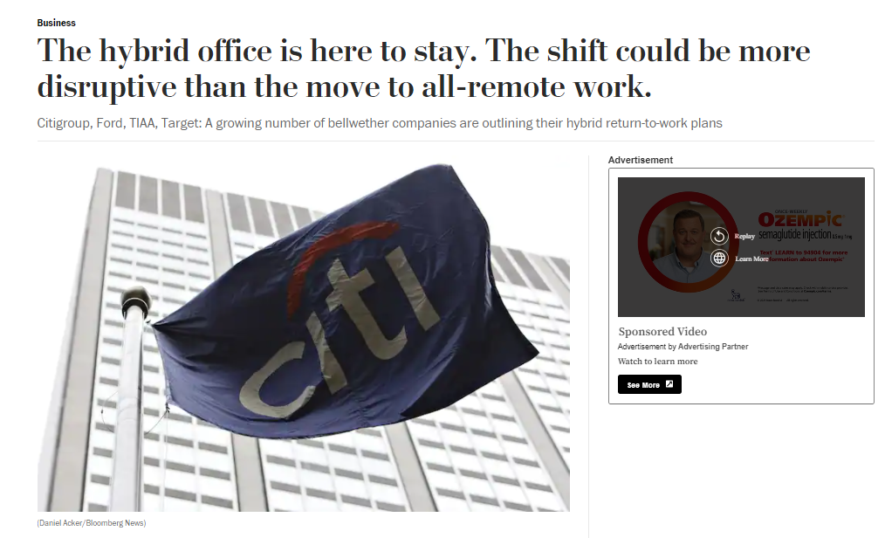









Leading Companies are Overhauling Workforce Practices
4
Notes:
Ford is not alone in redesigning its employee operations
While there was a solid trend toward more companies adopting flexible work environments, the pandemic forced nearly all companies to operate with a remote model for some amount of time.
And after some level of pain for many during the transition, it turns out that businesses were able to adjust.
As the world begins shifting to a post-pandemic world, many leading companies have decided to operate differently
The majority are designing for the long term with operational models that are neither office workers only or remote workers only – but hybrid working
Why is this important for us? Because just as Amazon changed consumer expectations for the retail experience and Uber changed expectations for transportation
These companies are bellwethers for what the employee base will ask for and expect from companies that employ them.
More info:
https://www.washingtonpost.com/business/2021/03/30/hybrid-office-remote-work-citigroup-ford-target/

Slide 5
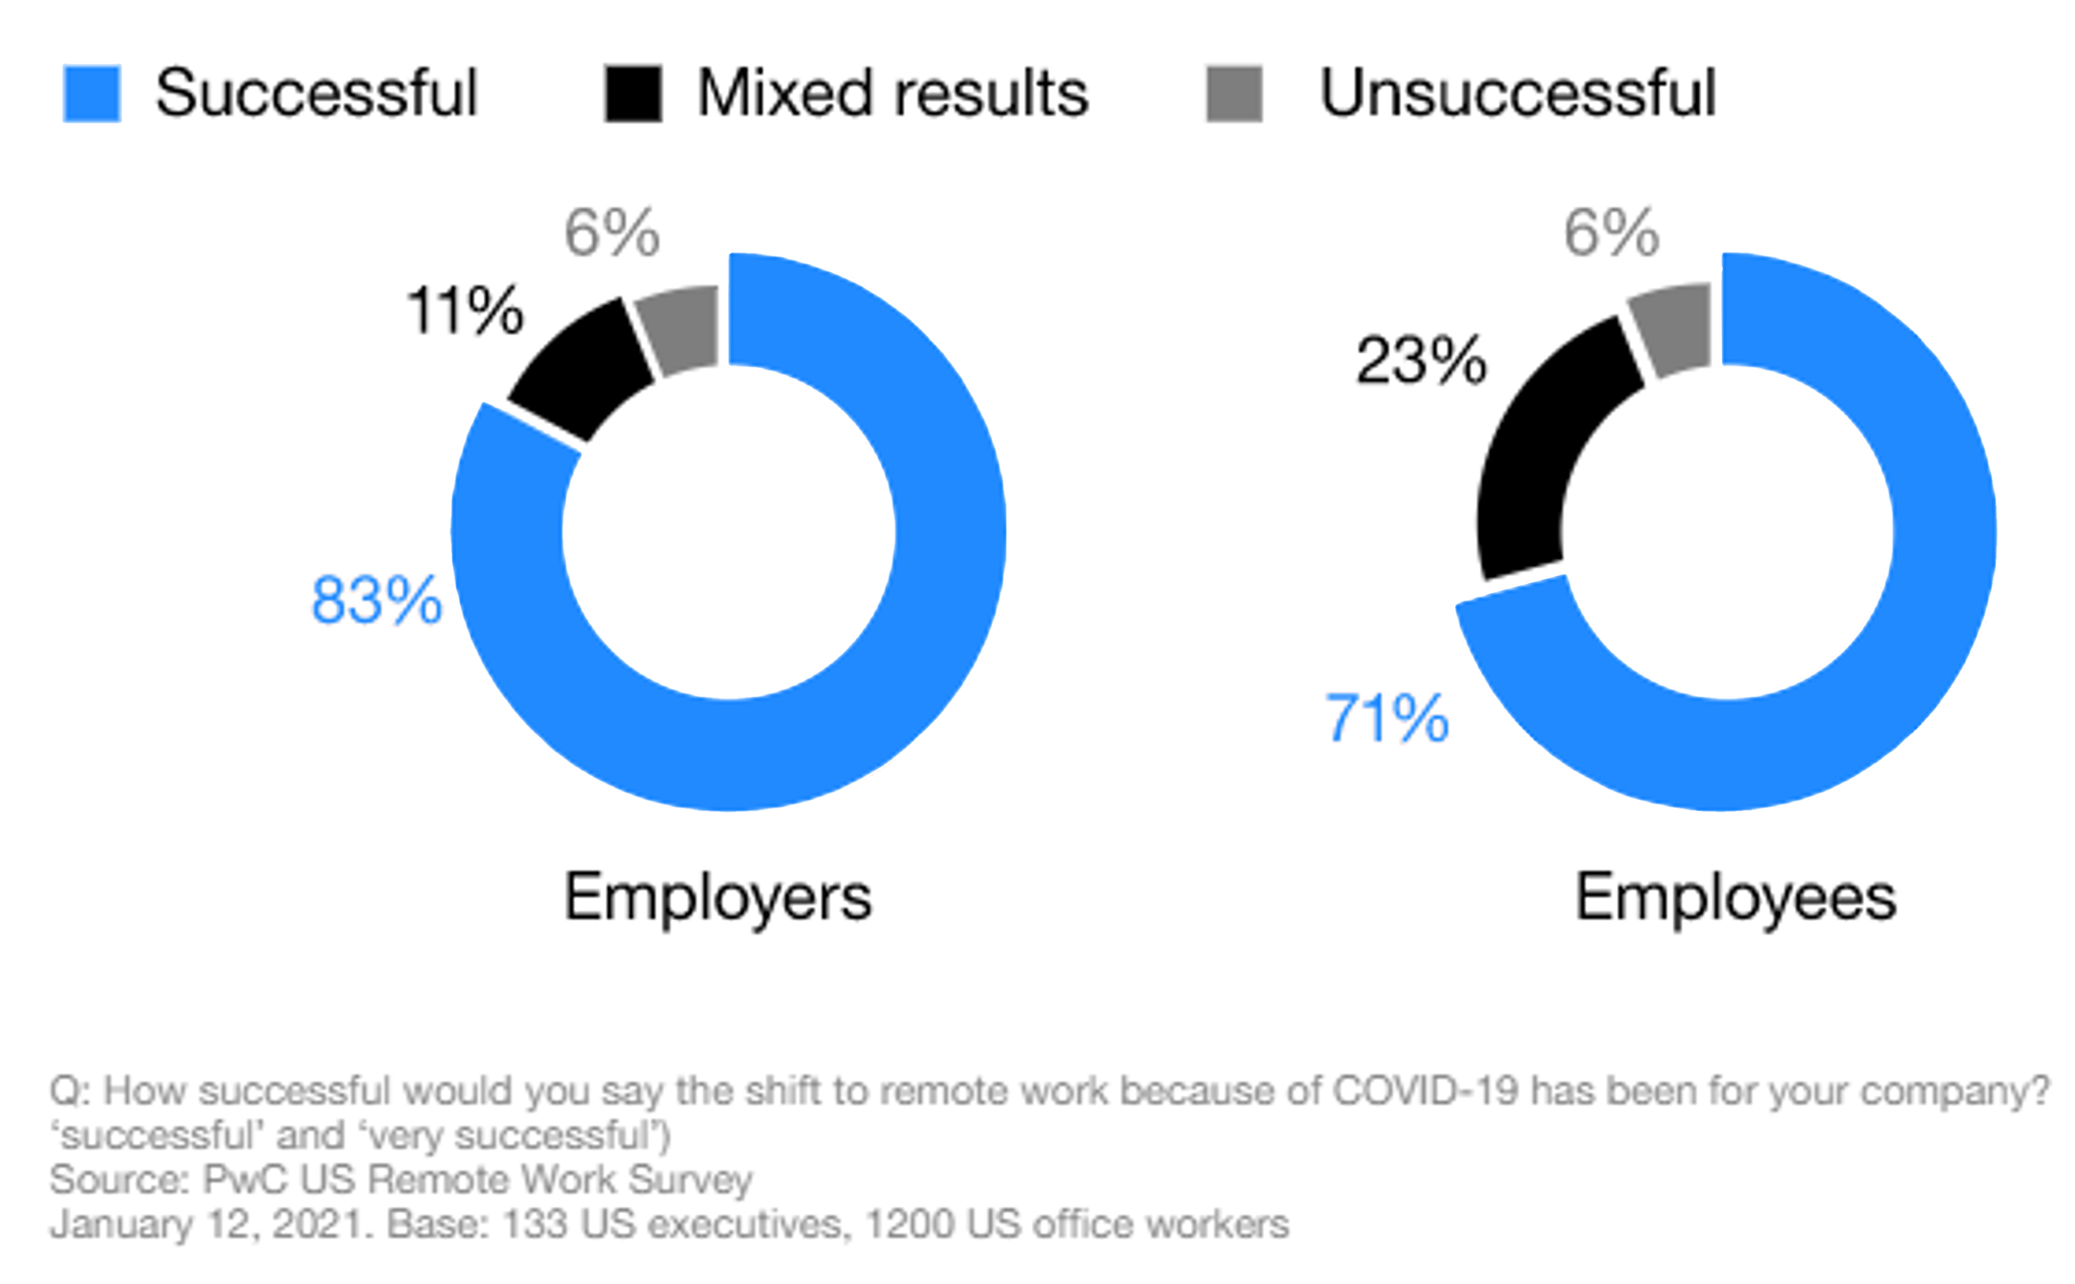
Why change?
We learned a lot during COVID. It turned out that remote work was productive
The results are in:
Remote work rated a success by both employers and employees
Productivity increases with employees working longer hours, less distractions
Decrease in unnecessary travel expenses and right-sizing in real estate expenses
Remote work has been a success
* Source: PwC US Remote Work Survey – January 12, 2021
5
Notes:
More info:
https://www.pwc.com/us/en/library/covid-19/us-remote-work-survey.html

Slide 6
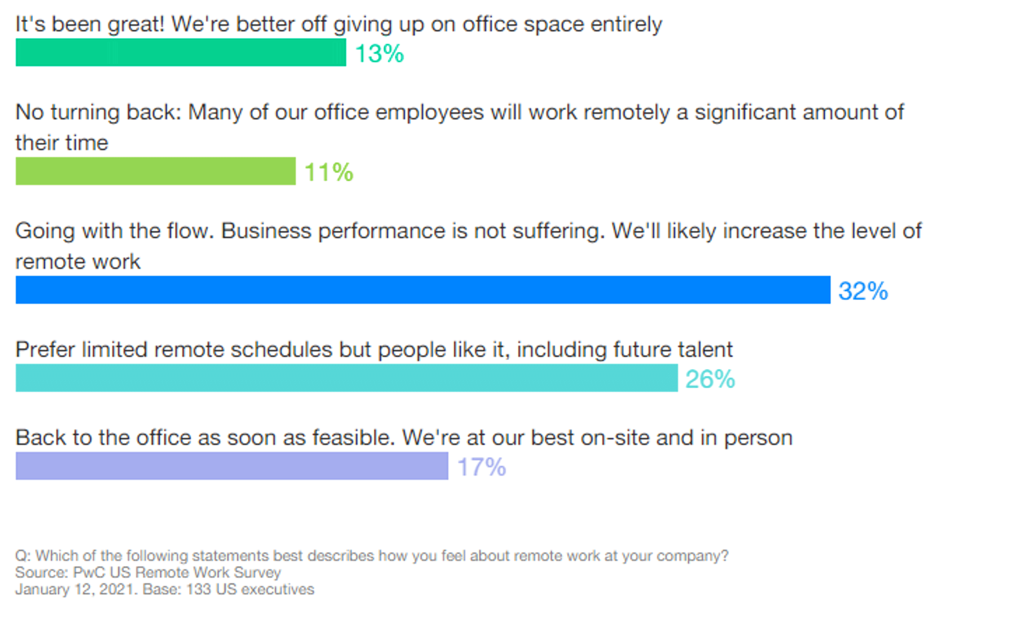
The Hybrid Working Model is on the Rise
By design or default, most US companies are heading toward a hybrid office workweek
When surveyed, both managers and employees lean toward continuing with remote work
56% are for remote or
hybrid work models
Another 26% prefer limited remote models
* Source: PwC US Remote Work Survey – January 12, 2021
CONFIDENTIAL
6

Slide 7





Why Not Bring Everyone Back to the Office?
Competition for employees:
the hybrid trend is in motion
Employee satisfaction
Employee productivity
Longer-term employee retention
Cost-savings: Labor, real-estate, travel
Opens much broader labor pool
Access to lower cost labor geographies
7

Slide 8

Why Not Go 100% Remote?
Not all jobs can be completed
from home
Humans as social beings
Customer engagement
Cultural alignment
Unfavorable remote work
environments for some
Training and modeling
8

Slide 9
Each organization will have a different blend of worker types which will likely be constantly shifting:
Fulltime office workers
Fulltime home workers
Workers who are parttime office and parttime home
Workers transitioning to or from the office or home

Slide 10
Flexibility is Key:
Regardless of where employees work or what’s happening in the world, businesses must enable modern communication solutions
internally and with customers

Slide 11




The business needs to ensure it is the hub of all communications
m
HOME
THE BUSINESS
OFFICE
m
HOME
THE CUSTOMER
11

Slide 12















Comprehensive Product Portfolio to Enable Hybrid Office Environment
UCaaS
Business Cloud
ANYMEETING®
VIDEO CONFERENCING
EXCHANGE EMAIL
VOICE
MICROSOFT 365
CONTACT CENTER
AI EMAIL
PROTECTION
EMAIL
ENCRYPTION
CHAT
OUTLOOK
BACKUP
DESKTOP
SIP TRUNKING
PRESENCE INDICATOR
a
EMAIL
ARCHIVING
FAX
MOBILE
SECURISYNC® BACKUP & COLLABORATION
APPID
IDENTITY MANAGEMENT
12

Slide 13
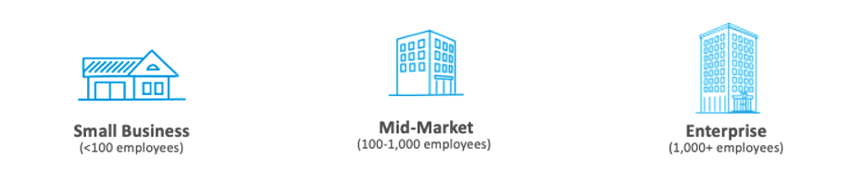
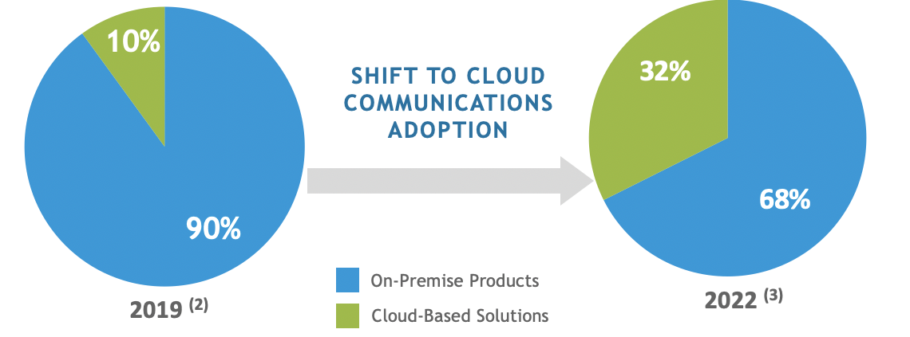
Move to the Cloud is Accelerating
100+ M opportunity by 2022(1)
Why take advantage of this mass migration?
UC/CCaaS market is estimated at $55B
UC/CCaaS industry is growing at a 30%
90% of all SMB customers will move to UC/CCaaS by 2030
UC/CCaaS adds $25-$100 monthly ARPU
Intermedia Partners realize average
40% Gross Margins on UC/CCaaS practice
UC sales are easier than other IT solutions
Intermedia makes it easy to Move Up to the Cloud with:
1. Partner business models optimized for maximum growth.
2. Program and Campaigns designed make it easy for customers to move the cloud.
13

Slide 14
Thank You

Slide 15

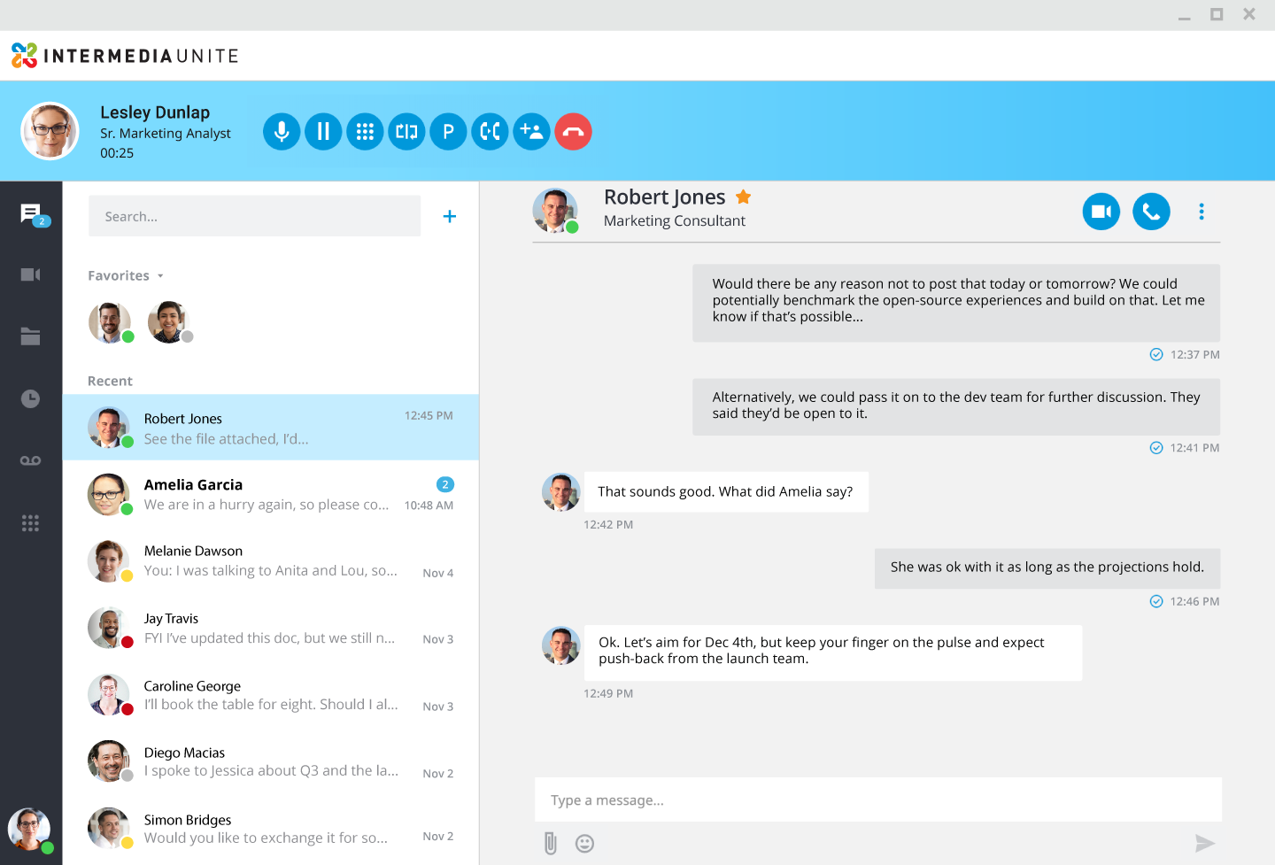


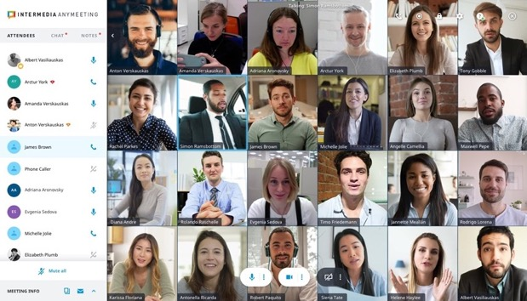
Enabling Remote Working
Unite Desktop
Phone with
caller ID, hold, park, flip, transfer, conference & more
Group chat
Start meetings, place calls, search in chat, add participants to any chat
Video conferencing
File sharing & collaboration
HD-quality
video conferencing, screen sharing, recording & transcription, annotation, notes &
AI virtual assistant
Call history
Transcribed voicemails
Contact Center
Integrated
company directory
Dial pad/
Receptionist view
Presence

Slide 16
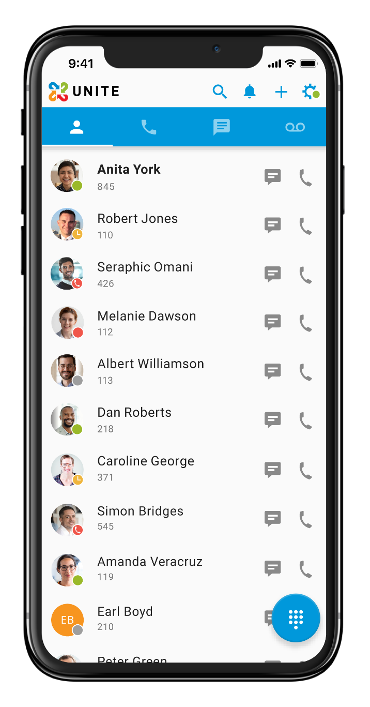
Your Office Goes Where You Go
Unite Mobile
Transcribed voicemail
All company contacts
Team chat
Place and receive business calls
Real-time presence
Siri and Apple watch integration
Phone with hold, park, transfer, conference and flip

