Slide 1

The
Renaissance
2021
March 12, 2021

Slide 2

Thank you for the honor to speak with the prestigious CDA Group!
My opinions are my own and I do not sit in the Board Rooms of the OEM’s and I do not have a crystal ball. But I do have access to great financial information and many friends in the industry which does provide for many great discussions.

Slide 3
The Renaissance 2021
Overview and update for the current state of the Imaging Channel
OEM’s
Private Equity and dealer activity

Slide 4
OEMs
Financials Update
Japanese OEMs
HP
Xerox
Note: Stramaglio Consulting has compiled the financial numbers publicly available in several sources for this report.

Slide 5
9 Months (Apr-Dec 2020) YoY Comparison
Revenue
Operating Profit
Net Income
-$10.6B
-$4.6B
-$2.5B
Note: The following currency exchange rates (JPY/US$) have been applied to convert to the above dollar numbers for the Japanese OEMs
Apr-Jun: 107.78, Jul-Sep: $105.59, Oct-Dec: 103.20
*HP numbers … From 5/1/20 through 1/31/21

Slide 6
Japanese
OEMs
9 Months (Apr-Dec 2020) YoY Comparison
Note: Sharp’s Q3 results will not be announced until 3/15/21 so their Q2 numbers have been used for Q3 in this report.

Slide 7
Revenue
Total YoY Change
-11%
-1,263B JPY
Note: Sharp’s Q3 results will not be announced until 3/15/21 so their Q2 numbers have been used for Q3 in this report.

Slide 8
Operating Profit
Total YoY Change
-49%
-312B JPY
Note: Sharp’s Q3 results will not be announced until 3/15/21 so their Q2 numbers have been used for Q3 in this report.

Slide 9
Net Income
Total YoY Change
-39%
-195B JPY
Note: Sharp’s Q3 results will not be announced until 3/15/21 so their Q2 numbers have been used for Q3 in this report.

Slide 10
Good News Is ...
Note: Sharp’s Q3 results will not be announced until 3/15/21 so their Q2 numbers have been used for Q3 in this report.

Slide 11
3 Months (Oct-Dec 2020) YoY Comparison
(M US$)
(M US$)
(M US$)
Revenue
Operating Profit
Net Income
+3%
+19%
+26%
Note: The following currency exchange rates (JPY/US$) have been applied to convert to the above dollar numbers for the Japanese OEMs
Apr-Jun: 107.78, Jul-Sep: $105.59, Oct-Dec: 103.20
*HP numbers … From 11/1/20 through 1/31/21

Slide 12
3 Months Forecast (Jan-Mar) YoY Comparison
Japanese OEMs
Net Income
Note: 9 Japanese OEMs excluding Canon and Sharp

Slide 13
However, ...
Note: Sharp’s Q3 results will not be announced until 3/15/21 so their Q2 numbers have been used for Q3 in this report.

Slide 14
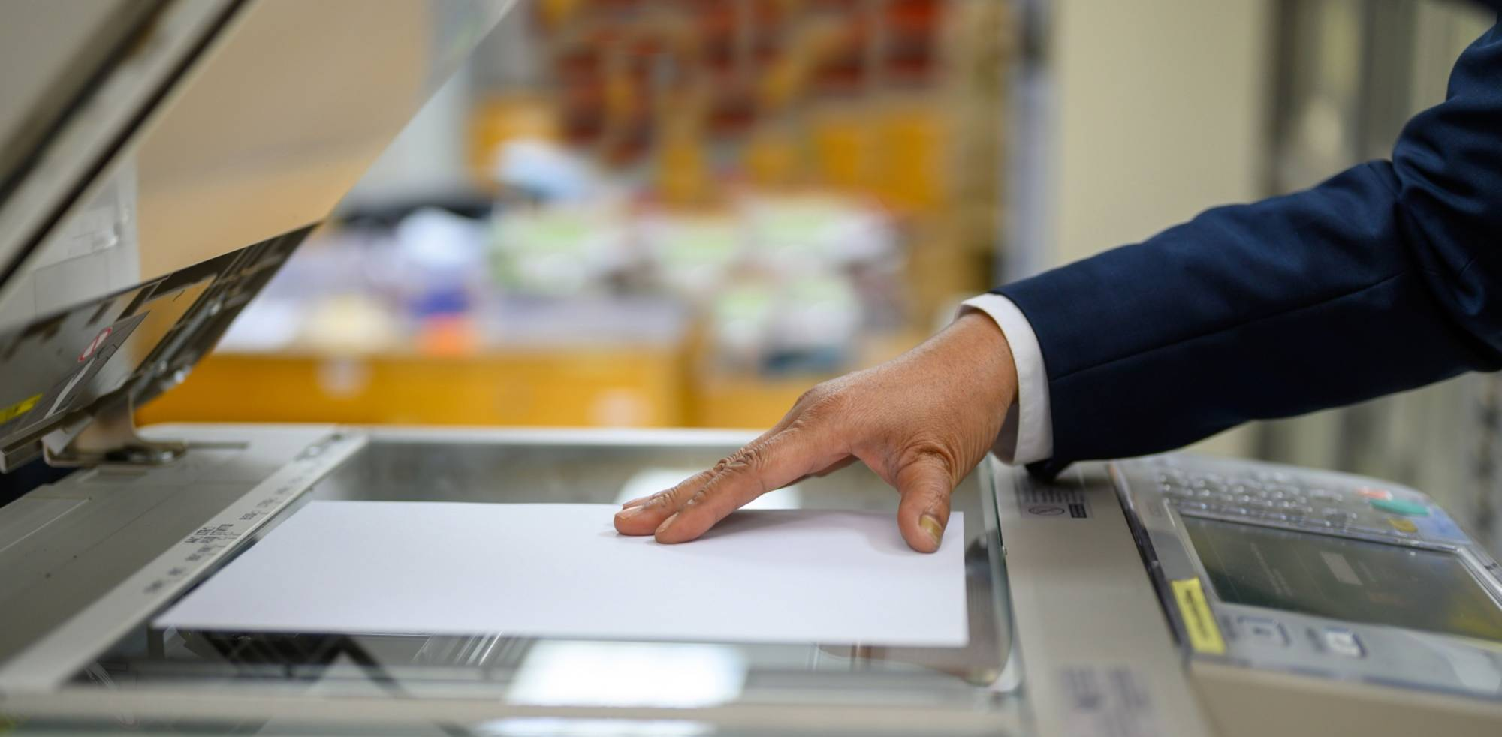
Is print dead? With a shift to digital, office-equipment giant Ricoh votes yes.
Japantimes.co.jp

Slide 15
Compared it to the Platformers
11 Japanese OEMs vs. GAFA+M
9 Month Net Income
Imaging Channel Needs the Renaissance!
1:59

Slide 16
OEMs to Watch

Slide 17
FY2020 Forecast
Revenue
Net Income
Industry Business (sensing, image IoT solutions, etc.) is the only business segment that is forecasted to make profits (15.5 B JPY), which represents 14% in the total revenue.
Stock price is recovered from the bottom in October 2020 (250 → 558*).
Geographically, North America is the worst in recovery in revenue ... -14% YoY in Q3 compared to +9% (China) and +7% (Japan).
Started selling some branches in the US
New Leadership in KMBS USA
vs. FY2019
-13%
Increased Loss
For 14.9B JPY
Print/Document Business
Contribution to Operating Profit
19%
of the total loss
*As of 3/8/2021

Slide 18
FY2020 Forecast
Revenue
Net Income
Increase Office Services operating profit to 54% of the company total in FY2025 (43% in FY22)
Stock price jumped up 16% after the mid-term management plan announcement on March 3 that includes the plan to buy back their stock as much as 100 Billion JYP (967 → 1,117*).
Projected 54 billion JPY expense reduction in Office Printing segment in FY21 and FY22
North America accounts only 2.4% of the planned increased operating profit from Office Services business in FY21-FY22 (0.5 billion JPY out of total 20.5 billion JPY)
Change to Digital Service company focusing on Office Services
Increase OEM business sales in Office Printing for 100 billion yen by FY25 __ Including A3 Color MFP
-17%
Turn to Red
-76 Billion JPY YoY
Print/Document Business
Contribution to Operating Profit
5% _Print
Print vs. Office Service
(Apr-Dec 2020)
*Closing price as of 3/4/21

Slide 19
FY2020 Forecast
Revenue
Net Income
vs. FY2019
FY2020 annual net Income revised upwards to a RECORD HIGH of 160 Billion JPY (up 35 Billion JPY)
Document Solutions business suffered by COVID for the YoY revenue decrease of 14.3% while operating margin ratio recovered steadily (Q1: 6.8%, Q2: 7.0%, Q3: 8.6%)
Watch their Mid-term Management Plan “Vision 2023” which is schedule to be announced in mid-April 2021
-8%
+28%
Print/Document Business
Contribution to Operating Profit
44%

Slide 20
FY2020 Forecast
Revenue
Net Income
Q3 (Oct-Dec) operating profit increased for 13.5 Billion JPY YoY thanks to:
- Expansion of strategic products
- Increased ink sales with continued demand WFH prints
- Maintained selling price
- Thorough expense control
Operating profit for total of Wearable Products and Visual Communication business segments is forecasted 1 Billion JPY compared to 100 Billion JPY for Printing Solutions business Segments.
vs. FY2019
-6%
+133%
Print/Document Business
Contribution to Operating Profit
99%

Slide 21
FY2020 Forecast
Revenue
Net Income
vs. FY2019
Retail Solution business generated operating profit of 8.5 Billion JPY in the 9 months of FY2020
Printing Solution business posted operating loss of 5.3 Billion JPY in the 9 months of FY2020
Toshiba Corporation still positions TTEC as a key subsidiary to keep.
-17%
-87%
Print/Document Business
Contribution to Operating Profit
-62%
Pushed down the profit*
*For 9 months (Apr-Dec 2020)

Slide 22
FY2020 Forecast
Revenue
Net Income
vs. FY2019
Forecasted decreased revenue and operating profit in most of their diversified business segments.
Document Solution business’s contribution stays almost the same as FY2019 in percentage while the company forecasts 4.5 Billion JPY YoY decrease in its operating profit.
Will reorganize the current 16 primary businesses and subsidiaries to 3 business segments in April 2021: Core Components, Electronic Parts and Solutions which includes Kyocera Document Systems.
-6%
-18%
Print/Document Business
Contribution to Operating Profit
9.5%

Slide 23
Private Equity and Dealers

Slide 24
M&A Landscape in the channel
Dealers | PE partners
DEX Imaging | Staples/Sycamore Partners
Marco | Norwest Equity Partners (Wells Fargo)
Flex Technology Group | Oval Partners
UBEO Business Services | Sentinel Capital Partners
Visual Edge Technology | Multiple investors (seems inactive)
Novatech | Trivest Partners
Kelley Connect | (Independent)
TBD | Gridiron Capital
Major Players

Slide 25
My Message to CDA Friends

Slide 26

Obvious ...
Print/Copy is NOT business as usual
Business Agility demands new tools, new thinking and yes new partners and people
Mergers and Acquisitions will continue at every level
Post Pandemic world has accelerated everything which is good
CEO’s must aggressively seek information and uptick their own strategic thinking, planning and activity
OEM’s are NOT going to lead you to the “next”

Slide 27

I believe our industry is in a fantastic position for a great Renaissance
And we will find significant financial growth, client expansion and the ability to do such much more via technology vs headcount!

Slide 28




Business Agility
Imperative and Unforgiving!
SENSE
ANALYZE
RESPOND
Conversational AI
AI/ML
IoT
Intelligent Enterprise

Slide 29
3 Types of Dealers Today
Will not invest and will go away or join a fire sale
Independent and will continue to invest and grow
Successful Dealer who seeks to sell

Slide 30

Dealers must partner with innovation partners that allow them to be a client and a reseller
E-Commerce and Portals are on a wish list but on a MUST list and you are already late
DEX/Staples and Office Depot are already implementing plans that are incredible
Everything must lead to greater valuation and greater multiples!
Multiples are greater if you have a successful stream of new business

Slide 31
About Us

Slide 32
Stramaglio Consulting
Focused Areas
Technology
New products, new technologies, IT and security, data, AI and business intelligence
Innovation
Partner expansion and new or expanded distribution strategies
Professional Services
Business consulting, acquisition services, education

Slide 33





A Think Tank to Bring Business Agility to the Imaging Channel
Technology and business services
FORZA - Industry ERP built upon SAP B1
Tax compliance automation software
People Performance visualization
Industry Media Supporters
Digital Transformation with SAP B1
Finance services / Collaborance
Strategic investment to the channel
PIVOT Dashboard
MPS/Predictive service solutions
Net New Sales solutions
Business development and performance management
Toner Reducer software

Slide 34


AI For Supply Chain
Applied AI to Your Supply Chain
Inventory
Warehousing
Distribution
Packaging
Executive Insights/ Business Intelligence
Data warehouse for most functional pillars
Standardized BI reporting real time across most functional pillars

Slide 35

And lastly ...
Your support is very much appreciated!

Slide 36
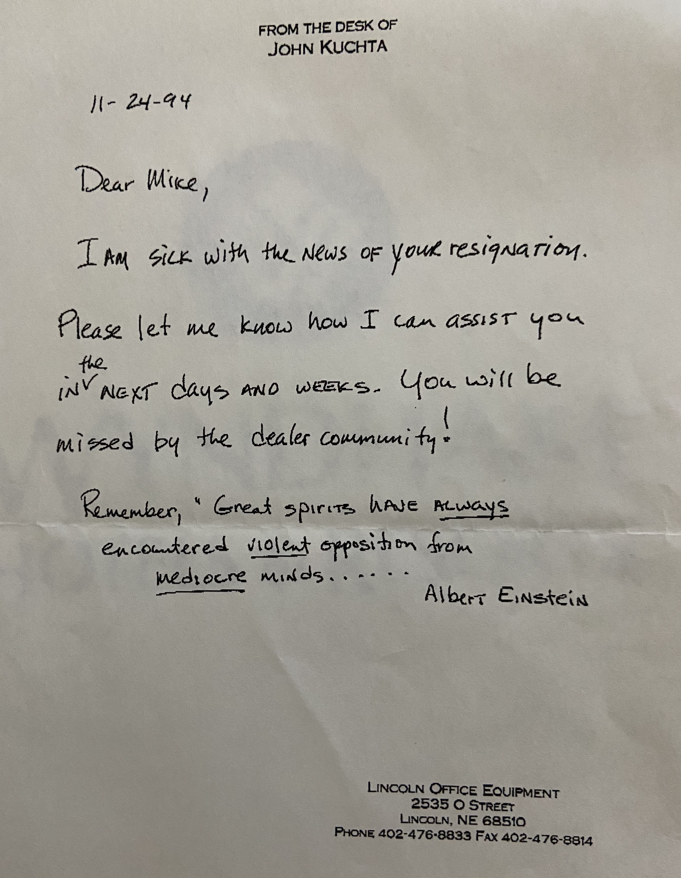
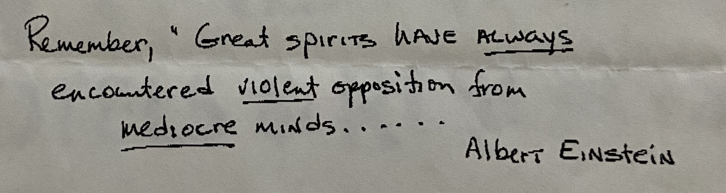
Thank You!

Slide 37
Mike Stramaglio
mike@stramaglioconsulting.com
M: 650.888.9645
Hiro Ueda
hiro@stramaglioconsulting.com
M: 480.819.6515
URL: https://stramaglioconsulting.com/

