Slide 1



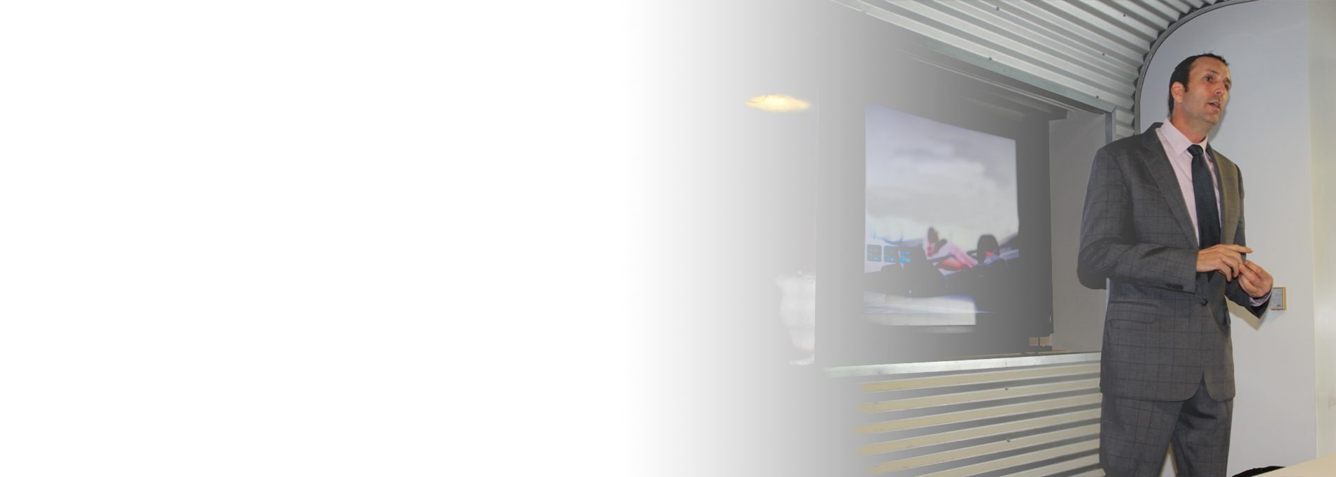
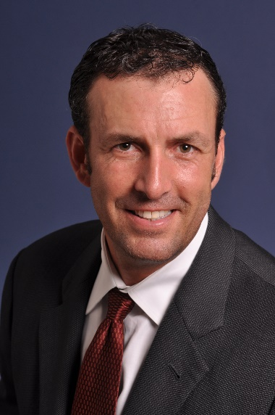
Introduction
Let's Get Started
Alex Rogers
CEO CharTec, CEO ARRC
http://www.linkedin.com/in/alexatarrc
Notes:
Click twice to advance this Slide

Slide 2
Managed Services Is Not Sexy!

Slide 3
Managed Services Is Not Desirable!

Slide 4
People do not want to afford it!

Slide 5

How Many Offerings Do You have?
Platinum
Gold
Silver
Lead?
Notes:
How many offerings do you have?
Ask these Questions:
How many of us have a standard offering?
Is it the traditional Gold, Platinum, Silver, Lead??

Slide 6
An Effective Brand Building Strategy
Solution
=
____________________________________________________
Problem
=
____________________________________________________
Alternative
=
____________________________________________________
Notes:
What an Effective Brand Building Strategy Is
PAS not SPA
Regular Updates
Syndication vs. Original Content
Multiple Mediums (Rule of 3)

Slide 7
Marketing Message / 1st Interaction
1st Appointment
Research
Get the Discovery
Perform the Discovery
Get the Presentation Appointment
Create the Presentation
Perform the Presentation
Present the Solution
Get the Check /Follow up Appointment
Notes:
Sales People are notorious for being all over the board! A Process is their for a reason. A process Is a Series of Steps to be performed in a chronological order! Sales people either don’t have a process or don’t follow the correct process. The only thing that keeps a sale moving is curiosity!

Slide 8
Non-Credible & Shit Questions
Are You Happy With Your IT Guy?
What is your budget?
What do you like about him?
What keeps you up at night?
Is Everything running ok?
Is Profitability Important?
Can you tell me about your business?
Most Open Ended questions!

Slide 9
Iceberg of Awareness…
Problems Known to Executives
Problems Known to Team Managers
Problems
Hidden From
Senior
Management
Problems Known to Team Leaders
Problems Known to Staff

Slide 10
Perceived Value
CEO
Sales
Manager
CFO
Front Line
Employees
Office Manager
COO

Slide 11

Five Prerequisites of a Sale

Slide 12
A Recognized Need
Need
Need
Notes:
Unfortunately, IT services is not a real Desirable product. Like an eighty-inch TV or Luxury car or boat. Where common sense and facts are overtaken by desire to have and want. Let's face it! Our Products are not that sexy. Nobody gets excited about IT services. So with that being said, in our industry
Every purchase decision represents a buyers attempt to satisfy a need. Needs are what initially motivates them to investigate potential solutions and motivates them to buy. Prospects will only buy your products or service if they recognize a need for it. So the more needs you can identify the more reasons you give them to buy. So what are the needs of all the individual Influencers? They all should have different individual needs that you need to have identified

Slide 13
A Viable Solution
Solution
Notes:
Now in a Managed Service product we have many features. And this is where get beat! We pride ourselves on having all these options included with our managed service offering but we fail to show why the client needs all these features and options. Therefore creating the myth that they are over buying and paying for things they do not need. Remember people do not want to have to afford what we are selling. The less they can get by with the better. We actually end up setting the bar for what a cadalic is versus a Chevy! N obody wants a cadilac tech support plan unless it is proven why they need it.

Slide 14
Value Justifies Cost
Value
Cost
Notes:
Cost justification is the basis for every single decision. Its also a pre-requisite for closure. By itself, the existence of a need is never enough to justify a purchase. Likewise, just because you offer a viable solution doesn’t mean prospects can justify the expense. ( a top objection - let me run some numbers and get back with you ). To purchase your product or service, the perceived value of your solution must exceed its cost. Keep in mind that the greater the value the easier it is to cost justify a purchase. If you do not have an answer to: That is a lot more then we spend now? You are fried

Slide 15

A Sense of Urgency
Notes:
Long sales cycles exist because sellers fail to show why it is urgent to change now!
Without compelling and discernible reason to make a decision, its always easier to maintain Status quo. Let's face it switching IT providers, equipment and software solutions is not easy. Until your prospect feels a sense of urgency, they are not likely to buy your product or services. Many times when solving latent needs we fail to show the urgency. It is very important that we have identified urgency for all the influencers. And keep in mind they may all have a different idea of what is urgent and what is not as it relates to their job.

Slide 16
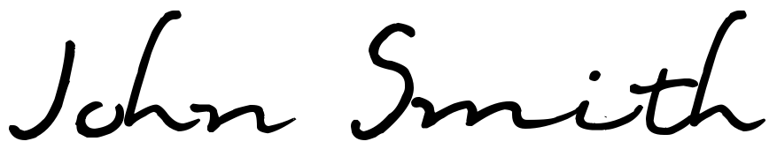
Authority to Buy
Notes:
Needs, solutions, cost justification and a sense iof urgency all rolled together still aren’t enough to close a sale. Your prospect must also have the authority to make the decision. This does not just include the CEO or owner. Many times the Owners or CEO must consult his influencers, his right hand people. So it is very important to have as many influencers in your presentat5ion as you can possibly get. Otherwise you will always be left with the excuse “looks good let me run this by my team.” 1-2-3-5 weeks later maybe they get back with you!
If all five of these pre requisites for closing have been satisfied, meaning the prospective influencers, managers and executives recognize the existence of a need or needs specific to each of them and the viability of your solution, they have the authority to make a decision and a sense of urgency to move forward now, then closing the actual sale should be a breeze. At that point, all you have to do is offer encouragement and ask for the order.
If one or more of these prerequisite conditions is not in place, however, then the opportunity may not be ready to be closed. That’s when sellers must either push harder to trey to force a sale, or step back and figure out how to address any outstanding issues. As you may have already guessed these next two days are going to be about how to Identify and present these Five prerequisites and the closing strategies that follow.

Slide 17
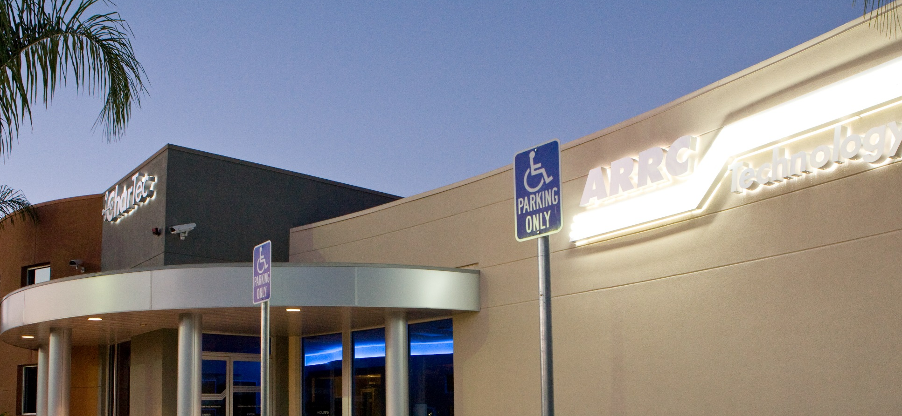
https://chartec.net/academy-registration
May 19th -20th

Slide 18
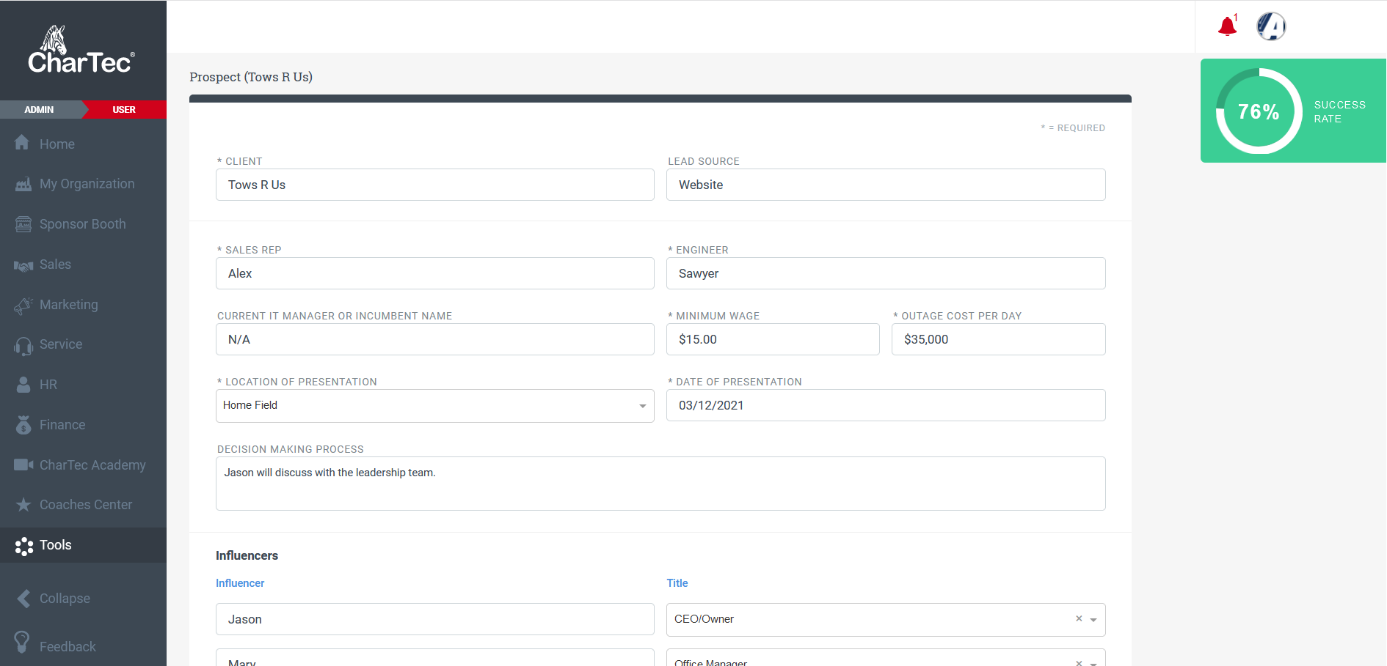

Email: membership@chartec.net
Subject: Crystal Ball

Slide 19
Two Kinds of Objections
Welcomed
Failure
Don’t Spend that Much Now
Don’t Spend that Much Now
That’s a Cadillac Offering…
I Want to Think About it
Status Quo
Don’t do Long Term Agreements
Can You Break out the Pricing
Need to Buy Our Own Equipment
Can you Take this Piece Out?

