Slide 1


Cybersecurity
Jay Ryerse, CISSP
VP, Cybersecurity Initiatives
Jay.Ryerse@ConnectWise.com

Slide 2
Cybersecurity
Agenda
Awareness
Plan of action

Slide 3

Video

Slide 4
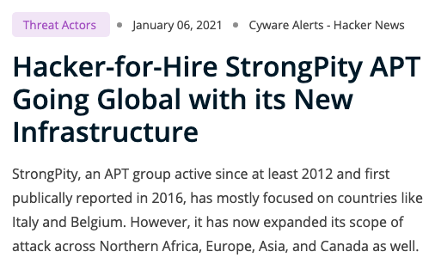

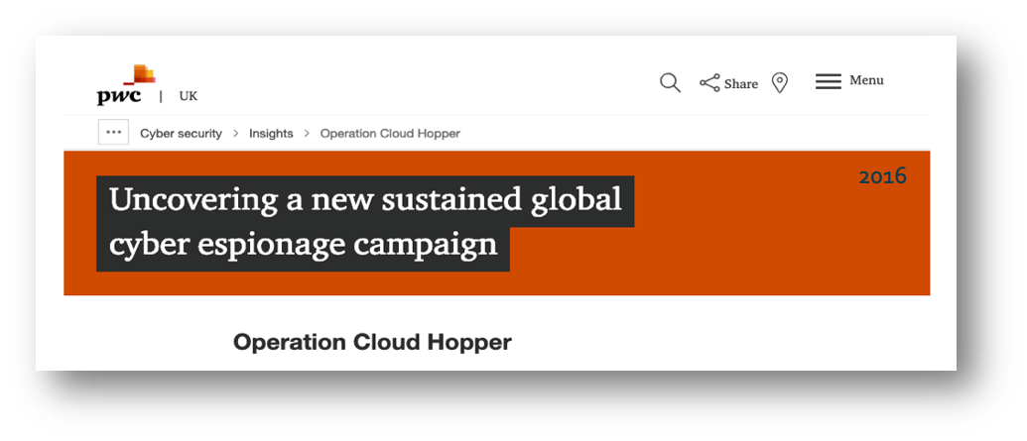
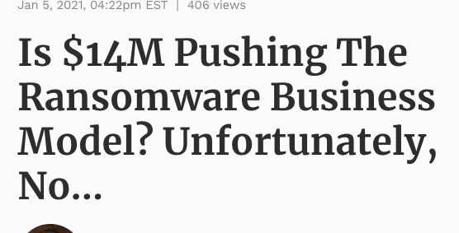
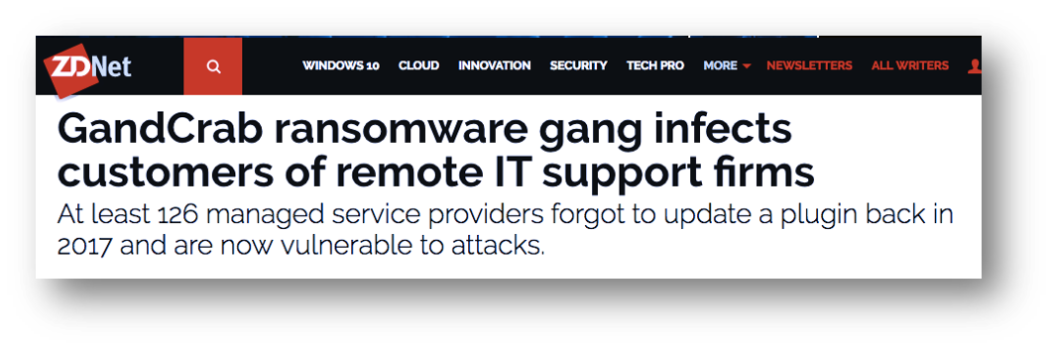

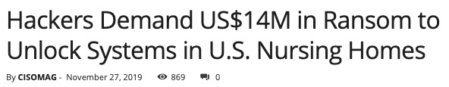
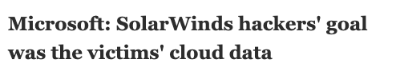
Current Landscape
Notes:
Here are 2 of recent attacks to businesses in Wisconsin - that have been publicly disclosed.
Wisconsin Mattress company leaked 387,000 customer records in an online database that lacked password protection
What would have happened if they had the appropriate password policies and measures in place?
Ransomware shut down internal computer systems, like email, in Oshkosh and Racine
What would happen to your business if you could not access your emails or could not go back to your saved emails.
Incidents like these are happening all over the country and world and have likely affected many of you personally – like data breaches at major superstores, banks and websites.
The 3rd stat is from a study that ConnectWise partnered with Vanson Bourne on. It says that over a 3rd of SMBs rank cybersecurity as their top priority and almost 90% put it in their top 5 priorities.

Slide 5
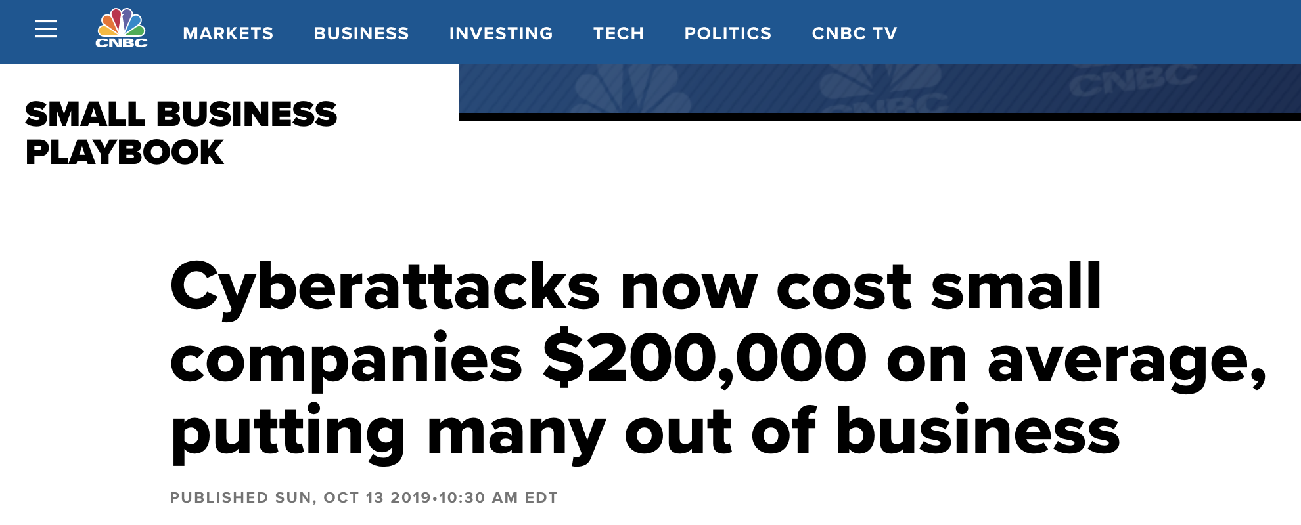

Slide 6

Business Email Compromise
FBI: BEC Scams Accounted for 50% of Cyber-Crime Losses in 2019
Average loss per BEC scam amounted to nearly
US $75,000, per complaint!
Estimated at US $1.77 Billion in losses
Notes:
Now Business Email Compromise – more stats from the FBI internet crime complaint center (IC3)
1. Business Email Compromises accounted for 50% of Cyber Crime loses in 2019.
The average of these crimes amounted to $75,000
Keep in mind -those are just the ones that call the FBI.
Most small business are not telling the FBI.
Example: death by a thousand cuts, ex-admin who fell for an iTunes gift card scam via email.
How do we handle this?
-Training and education: commonly hit departments/departments at the most risk: Accounting departments, HR Departments, Execs, admins

Slide 7

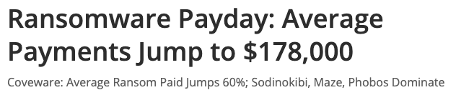
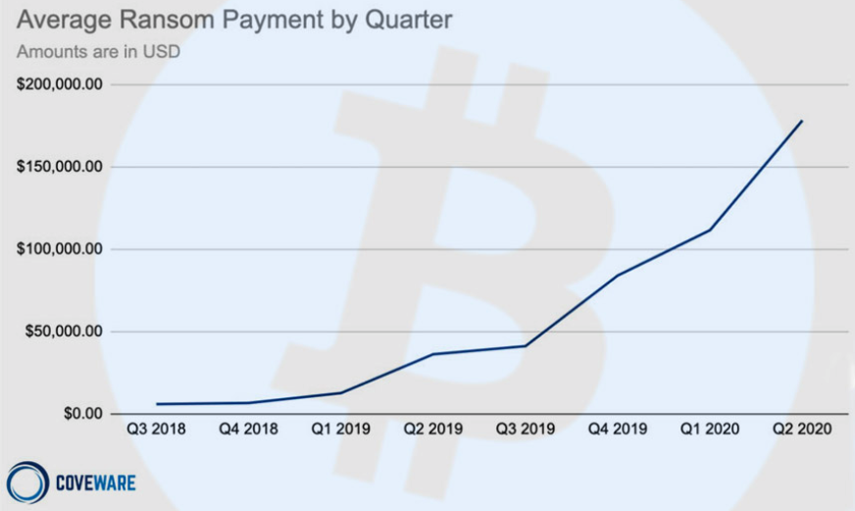
$178,000
Cost of Ransomware Attack
The average ransom paid by a victim increased by 60%, rising from
US $111,605 to $178,254.
Excludes the cost of downtime, recovery efforts, breach reporting, and reputation.
*Source: Mathew J. Schwartz • August 18, 2020
Notes:
The average ransom paid by a victim - when they paid - increased by 60% from earlier this year, rising from $111,605 to $178,254.
Keep in mind: This number excludes cost of downtime, recovery efforts, breach reporting, and reputation, which could add up to so much more.
Also more recently – the threat actors are getting more sophisticated. They are not only encrypting the data – they are taking the data as well. This allows them to continue to demand payment from those who had measures in place to get back online without having to pay the ransom to decrypt the encrypted files. This allows them to threaten to leak the data if they don’t make payment.
Unfortunately, this strategy appears to be working. "Data exfiltration resulted in ransom payments from companies even where ransomware recovery from backups was possible,.
While the financial hit is tough – a Ransom payment is least of worries once you fall victim to an attack. Your reputation and staying in business ranks high among the areas to worry about.

Slide 8
Web Tour

Slide 9
Plan of action

Slide 10

Protect Your House

Slide 11
“How would you break into your company network?”

Slide 12




Get Your House in Order
People | Process | Technology
People
Process
Technology

Slide 13



Cybersecurity for MSPs
People | Process | Technology
People | Process | Technology
…
MSP+ CSF & Playbooks

Slide 14









ConnectWise Cybersecurity
Your clients are 5x more likely to ask you about cybersecurity services than other solutions
Partner Program
Worldwide SOC
Marketplace
Notes:
ConnectWise is investing in programs to support revenue teams and drive partner success. Cybersecurity
Tools
Education
Services
Partner program

Slide 15

Introduction to the
ConnectWise Partner Program
*April 6 Launch, currently recruiting early adopters

Slide 16


Build
Trust
Establish Relationships
Show the Path Forward
Notes:
Cybersecurity Partner Portal is Key to Success
Josh for project manager
Cristelle: Assets, events, lead gen;
Moved to SFDC from IMPartner; Need to review and decide
Mindmatrix is an option
Keith Graham; PRM; Distribution
CW Partner Home with Craig Fulton
IMPartner went away with salesforce; place on salesforce to house assets; VAR/Disty is SFDC; collaborate on PRM
Webinfinity is CW engage
Repository for sales / partner playbooks and toolkit assets
Partners can access from recruit, through enablement, lead gen
PDMs can access to guide partners
Integrate with ITN on demand content/LMS
Track partner program benefits: Deal reg, MDF, Business Plan
Partner marketing automation platform; Campaign templates
Evaluating options: Mindmatrix, IMPartner, SFDC, Webinfinity

Slide 17
Partner Development Manager (PDM)
for Cybersecurity
1
Deliver White Glove Service
2
Team Up to
Sell w/ Partner
Key to program and partner success
Guides partner through cybersecurity practice building journeys
Partner point of contact to access ConnectWise cybersecurity experts
Sales and marketing assessment
Selling to your clients and prospects
Partner secures sales calls, brings PDM in
PDM brings in CW Cybersecurity SMEs
Help you build pipeline, win deals
Accelerate partner growth!
Notes:
Partner Development Manager for Cybersecurity
15k avg deal size, 1.3m quota; 86 trx; 7 per month; 3 trx per year (ignore perch and stratozen flow) add 250EPs per qtr; 50 ep avg end users, 5 new customers per qtr; 1250x12=15k; 30 productive partners; just EP,
White Glove treatment by PDM for Cybersecurity will be a key reason behind achieving partner growth objectives
Cybersecurity Partners sign partner development agreement (PDA) to work with PDM when landed or expanded
PDM collaborates with partner, guiding them through Cybersecurity journeys on way to maturity
PDM sells with partner, bringing in CW experts to help win early opportunities with partner until they are self sufficient
29 PDMs (20 NA, 9 INT) ramp up to sell with 50 partners each (1,450 total), managing 1.2m ACV

Slide 18
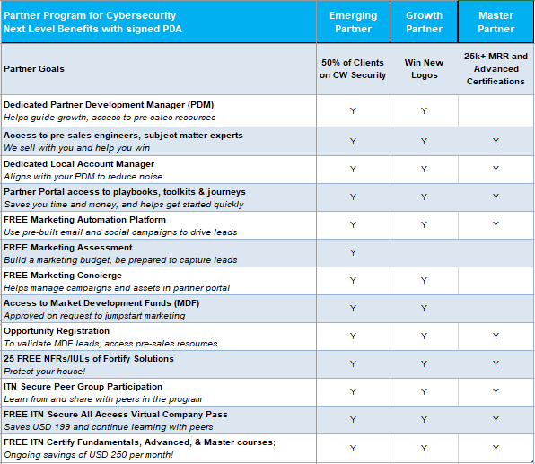
Partners in the Program Realize Next Level Benefits!
Start here
Solid ROI for Partners in the Program
Notes:
Partners in Program Realize Next Level Benefits
Scott can help
Refresh yearly; MDF, COOP;
Joe Alomonte
3 programs with Marketopia
1,000/ 6x

Slide 19

We Provide NFRs for Internal Use
Saves Partners USD 100’s, 1,000’s on implementing Fortify Across Business!
ConnectWise Fortify Assessment Package - Standard
Identify
Assessment Standard
Endpoint
Network Threat Detection
Protect
Ongoing Risk Reviews
Risk Score Report
Third-Party Risk Assessment / Reporting
Vulnerability Scanner
Dark Web Reports
- Incl. 15 Monitored Domains
- Unlimited Dark Web Scans
Pre-sales Risk Report
24x7 Analyst Review
SOC Analysis
Threat Containment
3rd Party Item(s) + Logs
24x7 Automated Alerting
24x7 Analyst Review
Noise Reduction
Visualizations
SOC Customizations
  Rules/Dashboard
IDS (VM)*
Threat Feeds
30-Day Log Retention
24x7 Risk Reporting
Requires ConnectWise Command
powered by

Slide 20
1) Get Your
House in Order
2) StartNOW
Journey
3) Grow with
New Logos
4) Master
Partner
*April 6 Launch, currently recruiting early adopters
Notes:
ConnectWise Partner Program Objectives
Outcome is stronger Cybersecurity psoture
Improve the Partner Experience (a.k.a. NPS) affecting gross and net retention (Geoffery wilison for ‘21 NPS)
Build a more strategic relationship with partners starting with a targeted group of Cybersecurity partners
Improve cross sell opportunities
Improve probability to land, expand with Cybersecurity-
Accelerate partner growth, and support sales hitting plan
a thing aimed at or sought; a goal.
"the system has achieved its objective“
Typically, two companies form a strategic partnership when each possesses one or more business assets or have expertise that will help the other by enhancing their businesses. This can also mean, that one firm is helping the other firm to expand their market to other marketplaces, by helping with some expertise
Growth rates not commensurate with costs
Selling with is cheaper
Net revenue retention, cross sell; what is current state
What is NPS now? Why is it bad?
Do Cybersecurity NPS scores across product, where is the problem, what is driving that;
Anyone with SOC has high NPS, so sell more of that;

Slide 21
Partner Program
Practice Building Journeys
Get Your House in Order
- PDM sells with partner
- ID opportunities in client base
- Drive awareness
- Engage with partner clients
- Support 3-5 client wins
- Partner builds muscle memory
- Target 50% penetration
Grow with New Logos (Growth)
- PDM guides growth
- Support 3-5 leads & wins
- Partner can access MDF
- Earn COOP funds, rebates
- Partner will register deals
- Becomes self sufficient
- Continuous growth on way to Master
Master
- Partner grows MRR 25k
- Continue practice building
- Working towards advanced certifications
- Lead gen programs
- ‘StartNOW’, ‘Grow with’ readiness
- Set education and certification path for partner
- Execute internal assessments
- We help partner protect house
- Deploy CW Cybersecurity stack
- Partner utilizes NO Cost IULs
- Pricing & bundling security
StartNOW Selling to Clients (Emerging)
Scheduled kickoff call after partner signs PDA, meets minimum spend
PDM Guides Partner Growth
IT Nation Secure Practice Building Education and Certification
Notes:
Prep, GYHIO
Protect your house
Certifications
Marketing readiness could be going on same time
Sales readiness
Operations
SMB Cybersecurity Partner Practice Building Journey
Live monthly certify courses, January for on demand
45m in certify for engineers, secure on boarding process, how to bring new clients on
Outperfrom, lunch and learns, webinars,
Land 300 fortify assessment product; dark web vulnerability, 10 licenses of each product
Hot site client on boarding option; hotsite option (fasttrack when client has pain)
What about partner that needs compliance; needs ot meet HIPAA audit; need help checking the
Elearning
Option a) cram 1 day certify, b) or do 8 weeks (small MSP); can have client conversation in 10 days (first 2 sessions, 1.5 hour tech session)
JR suggests land with $300 pkg, in 6 months can get to 4x
Landing 20-25 CS partners per month; Joe Kita
How much can we do without raising risk level for Todd
Foundation pack do something cheap and ez to test it;

Slide 22
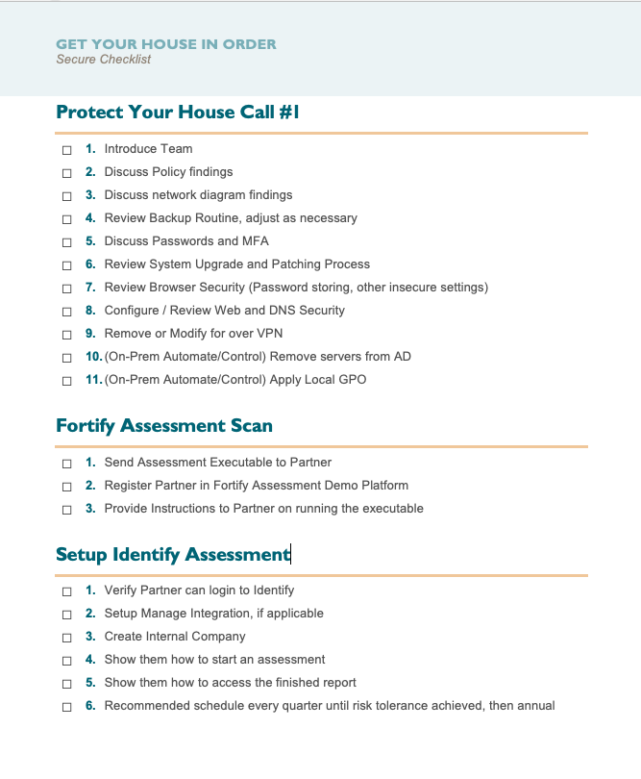
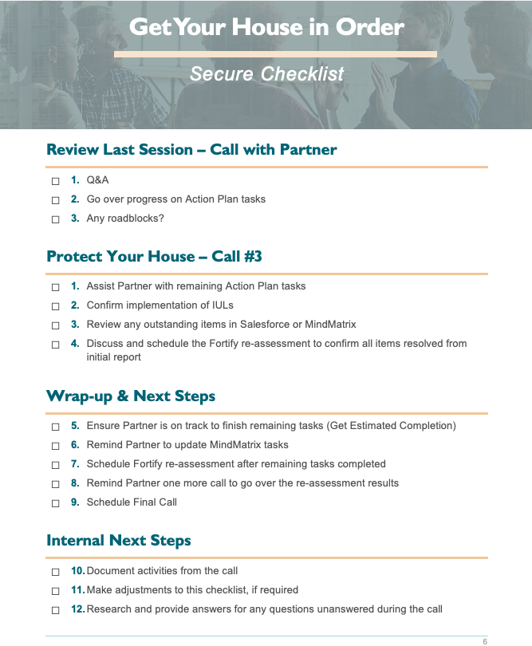
Get Your House in Order
Assist onboarding team with Fortify implementation
Analyze the partner’s existing security
Implement the right security with the partner
Sets the partner up for cyber success as they move into the next stage of the Partner Program
Positions ConnectWise in the leadership seat with
our partners as they Protect Their House
Process runs in sequence with Fortify Onboarding Process
Notes:
Jay

Slide 23
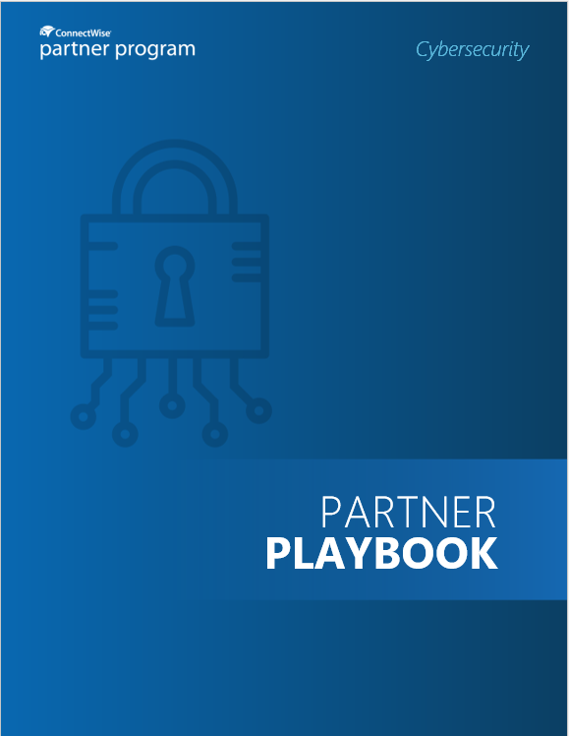
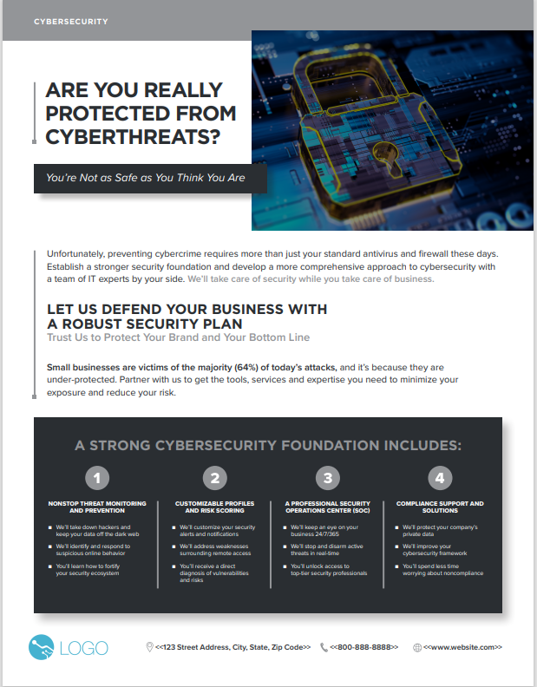
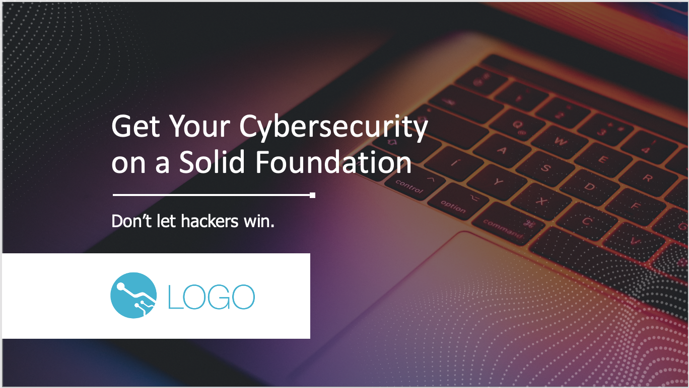
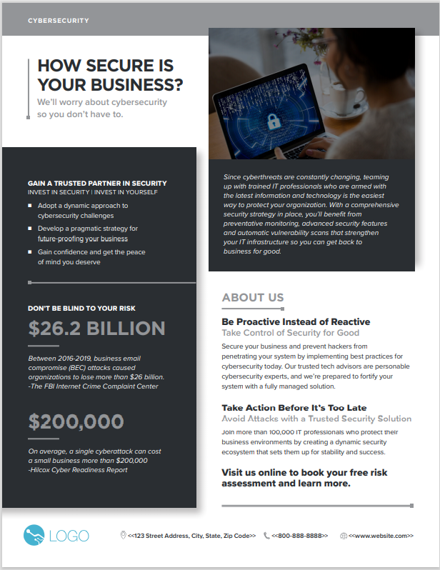
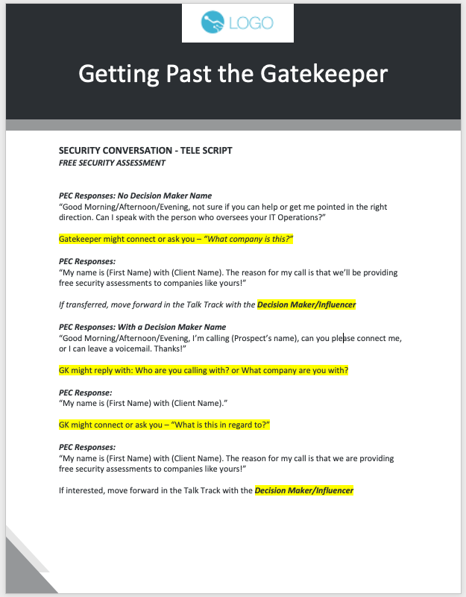
Playbooks in Partner Portal Guide Growth
Partner Toolkit Includes Sales, Marketing, Service Delivery Assets
Notes:
Partner Playbooks Guide Partner Growth
Assets, events, lead gen
Program office, enablement, marketing
Partner Playbooks for target markets (SMB, Healthcare, etc.)
Focused sales, marketing, service delivery best practices
Partner Toolkit contains sales, marketing, service delivery assets
Self guided or PDM led if partner is under a PDA
There are CW sell specific quotes that can be iported
Partner SKO PPT
Marketing playbook
Versus sales and marketing playbooks
From left to right: Parter Playbook, Front of SMB Security Sell sheet, back of SMB Security Sell Sheet, Brandable Partner Sales Pitch ppt

Slide 24
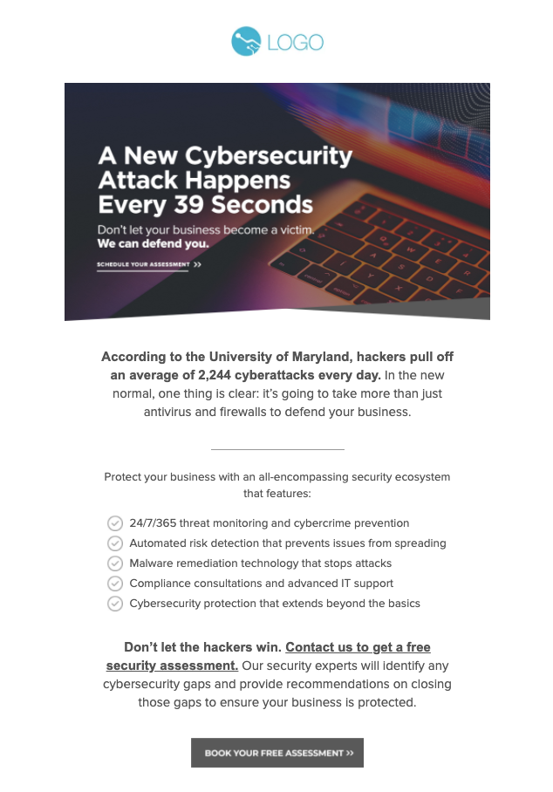
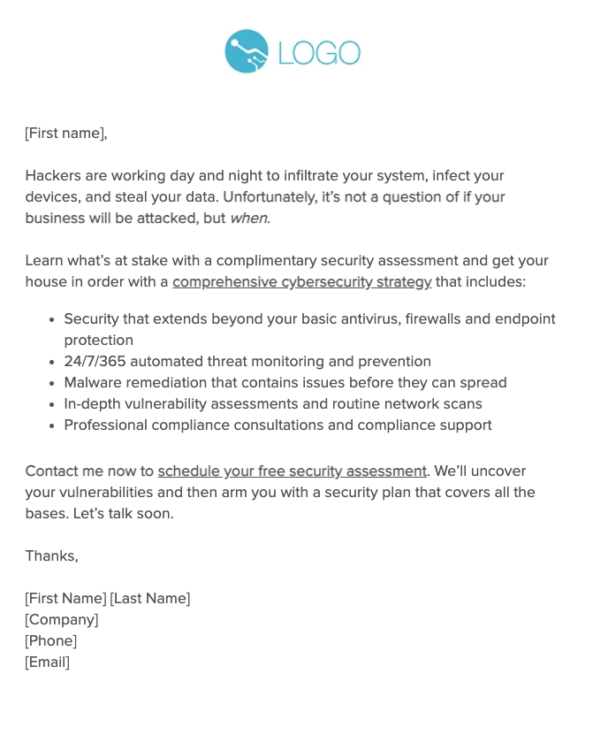
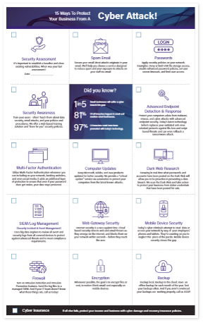
Partner Toolkit Assets Help
Drive Awareness
Notes:
From left to right: SMB Call Script, SMB brandable email nurture campaign, Brandable email template to use in portal and 15 ways to protect yourself from a cyber attack

Slide 25
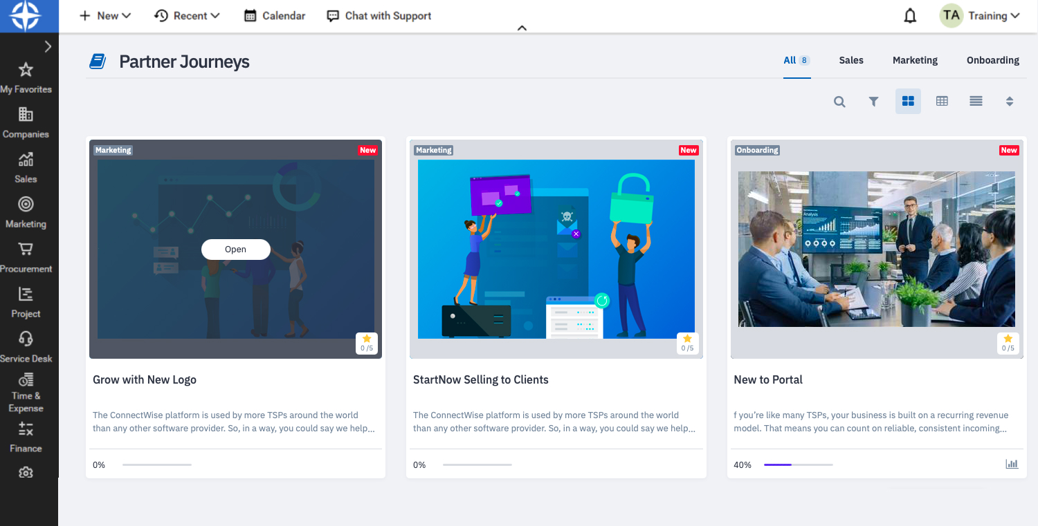
Partner Launched in Partner Portal
Notes:
Left to right: StartNow Journey steps, Grow With New logos Journey Steps, Dashboard showing both playbook journeys

Slide 26
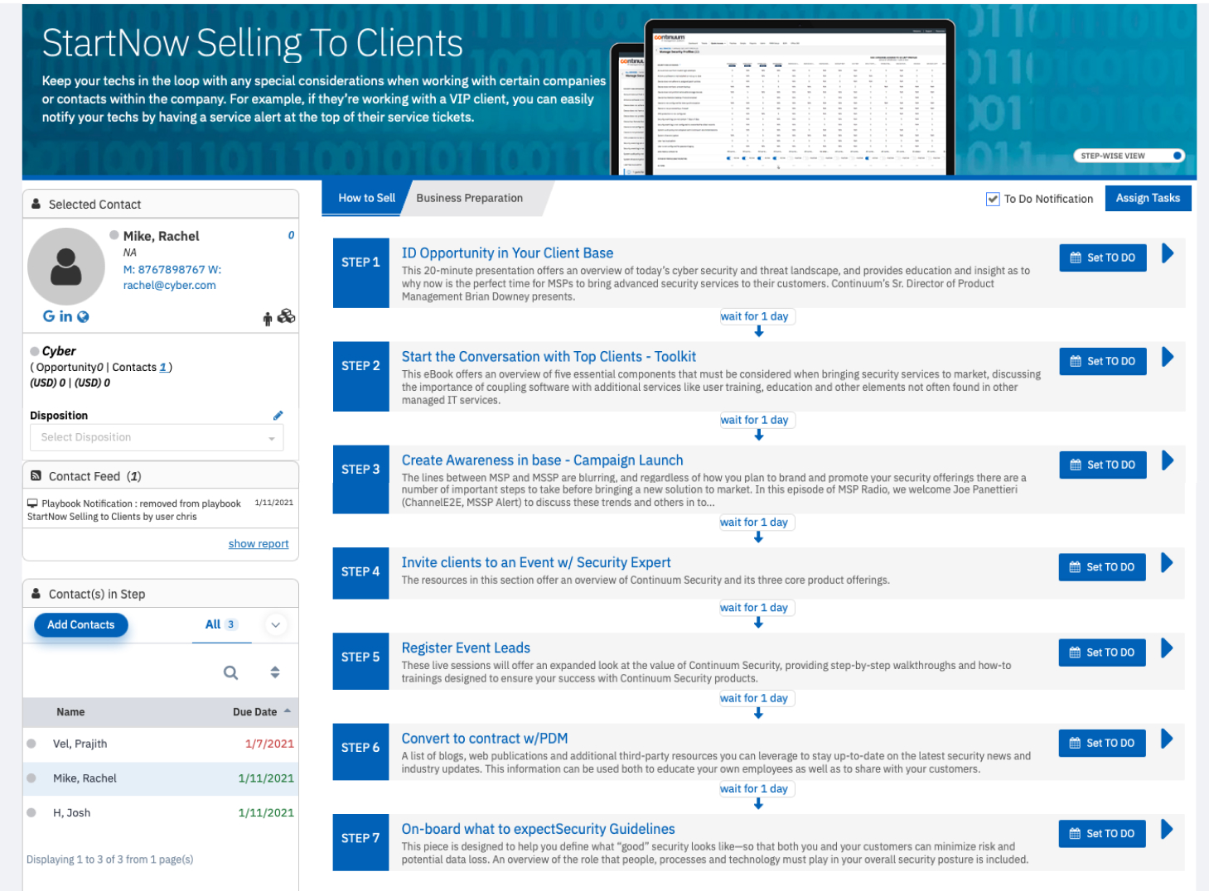
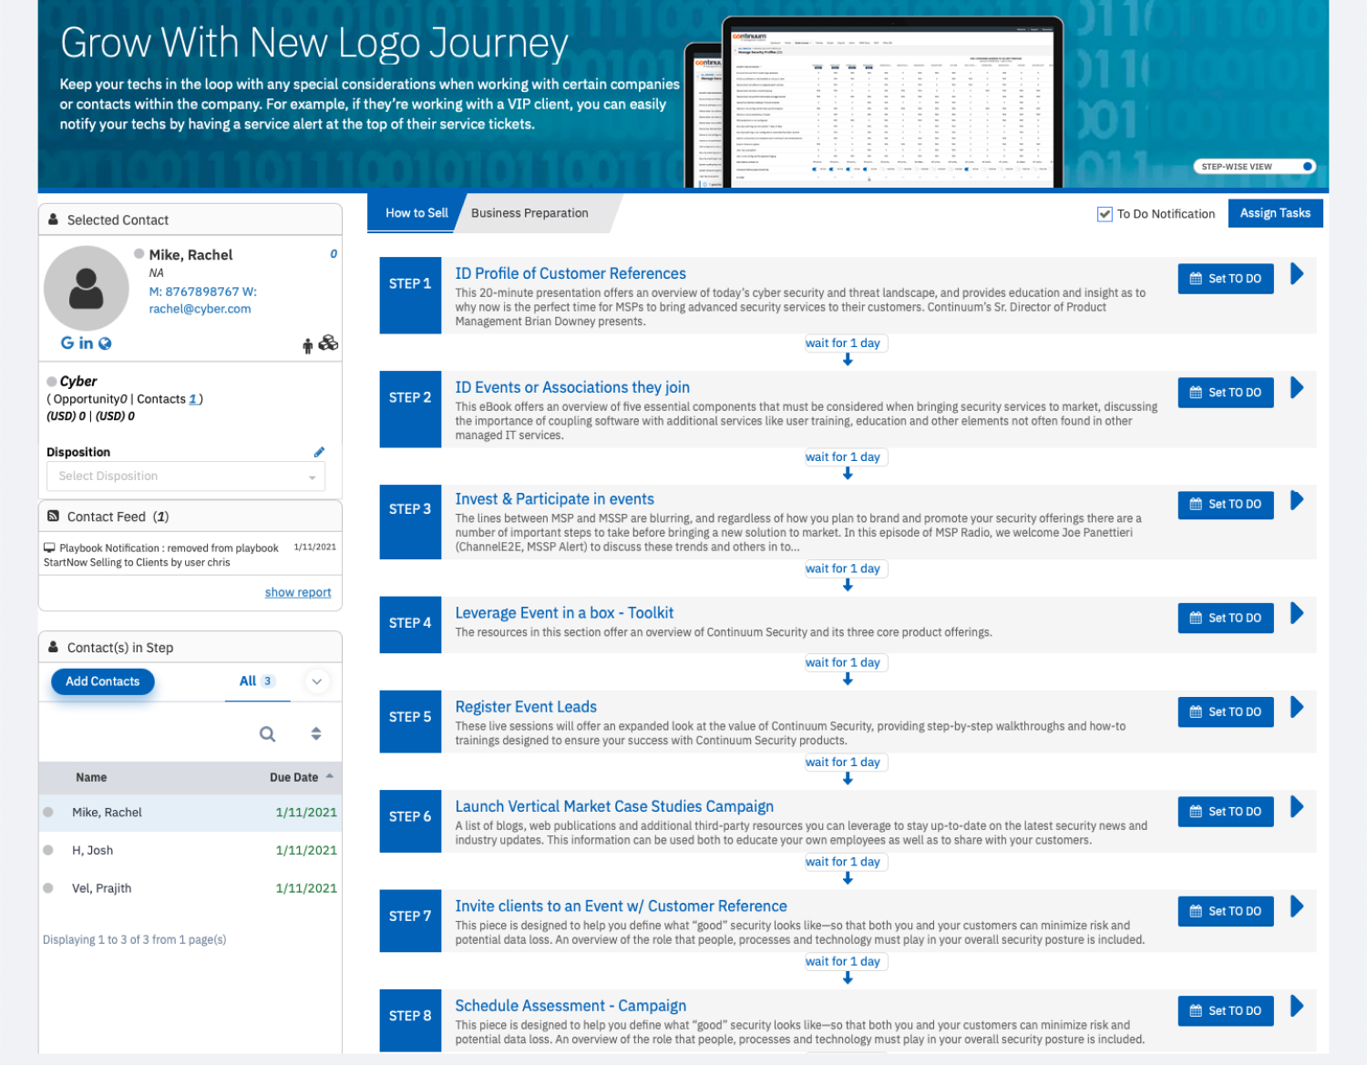
Partner Playbooks Guide
Repeatable Sales Enablement Journeys
Notes:
Left to right: StartNow Journey steps, Grow With New logos Journey Steps, Dashboard showing both playbook journeys

Slide 27
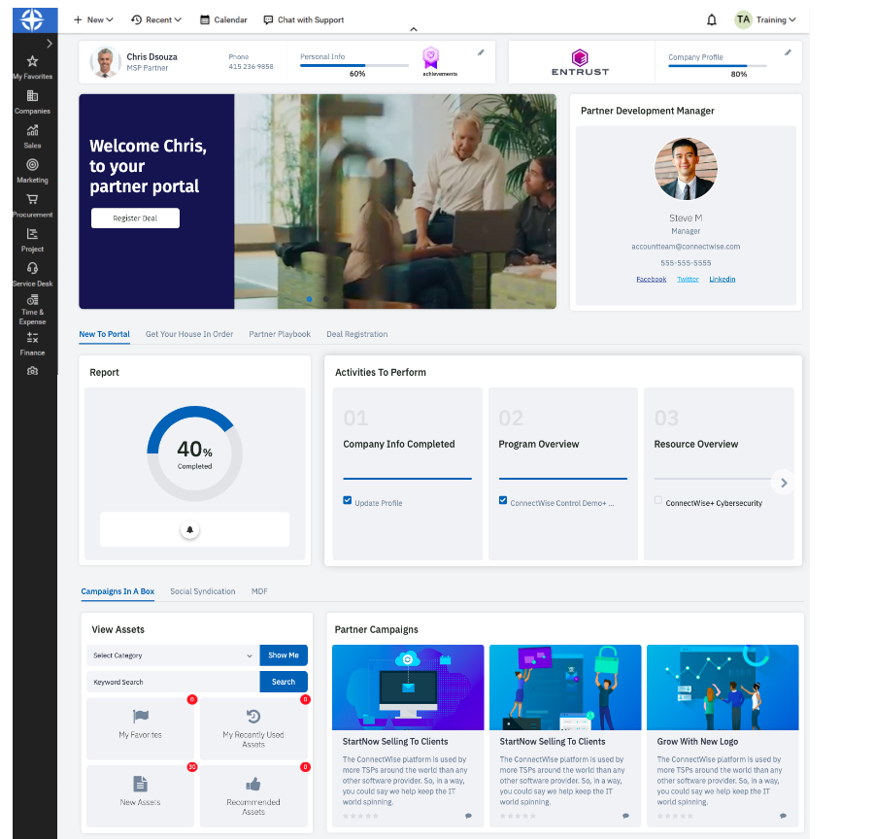
Partner Dashboard Shows Progress
Notes:
Partner dashboard views.

Slide 28
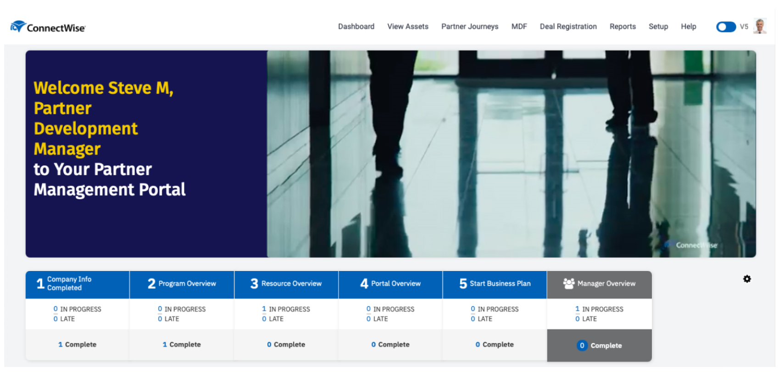
PDM Can Shadow Partner Progress
Notes:
Partner dashboard views.

Slide 29
Minimum Profile for Early Adopters
Executive buy in, sign Partner Development Agreement (PDA)
Have 500+ endpoints / users under management
Can dedicate and certify a sales & engineering resource(s)
Willing and able to execute marketing activities inside portal
Has a PSA or ticketing system
New cybersecurity partners commit to minimum Fortify spend
Existing cybersecurity partners may meet minimum spend
Notes:
Minimum Cybersecurity Partner Profile for PDM Support
Profile, target and recruit a select group of UMM/BMS customers to expand w/Cybersecurity
Profile, target and recruit current Cybersecurity partners with room to grow
Identify net new Cybersecurity partners for PDMs based on minimum profile
Some VARs don’t want tech resource
Not a good target unless we want to work with their client’s internal IT
Josh mkisic, brian troy, quota vs market;

Slide 30
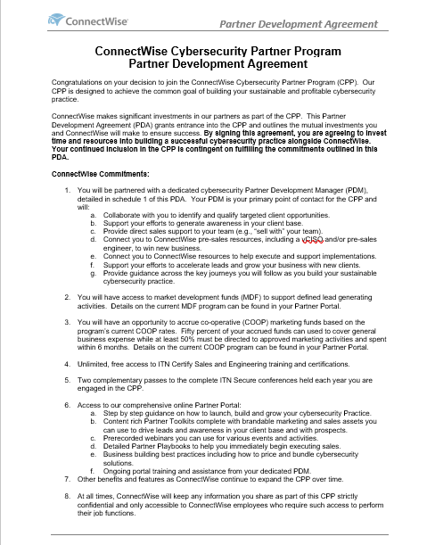
The Partner Development Agreement (PDA) for Cybersecurity
Engages Partner with a PDM to Accelerate Growth of Cybersecurity Business
Partners sign a PDA to join the program
PDA Outlines how partner and ConnectWise work together
Set growth goals and we work together to meet and exceed
Partners gain access to FREE ConnectWise pre-sales resources
Notes:
The Partner Development Agreement for Cybersecurity

Slide 31
Next Steps
1
2
Let us know you are interested in early adopter status
We will contact you to confirm interest, understand your goals & share more details on the program
3
4
You decide to join the Partner Program by signing PDA & purchasing minimum spend products
Demo and trial our solutions
5
Launch your Cybersecurity Journeys and Get Your House in Order!
Notes:
Next Steps

Slide 32
Email: John.Schweizer@ConnectWise.com
Subject: CPP
Body: Best contact info
Interested in early access?

Slide 33
Thank You
Jay Ryerse, CISSP
VP, Cybersecurity Initiatives
Jay.Ryerse@ConnectWise.com

