Slide 3
Time Entry equals Profit
Presented by : Josh Peterson, CEO
Bering McKinley
josh@beringmckinley.com

Slide 4
We know you.
We know your tools.
We know your people.
“you will not find a better wealth of applicable knowledge and the ability to implement those solutions”

Slide 5
5 Ways Time Entry Improves Profitability
Accounting for all time naturally increases BILLABLE UTILIZATION
Agreement Gross Profit Margin reporting is more accurate
Project Profitability reporting is more accurate
Cost of time spent by engineering doing non client billable work is more visible
Management increases ability to determine staffing requirements

Slide 6
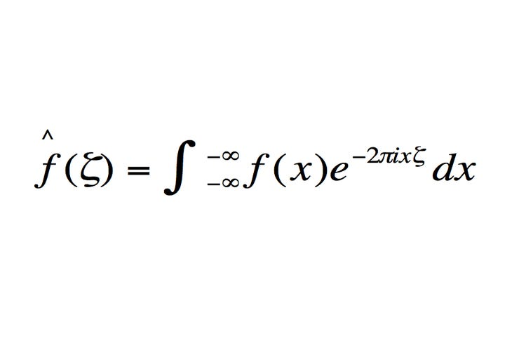
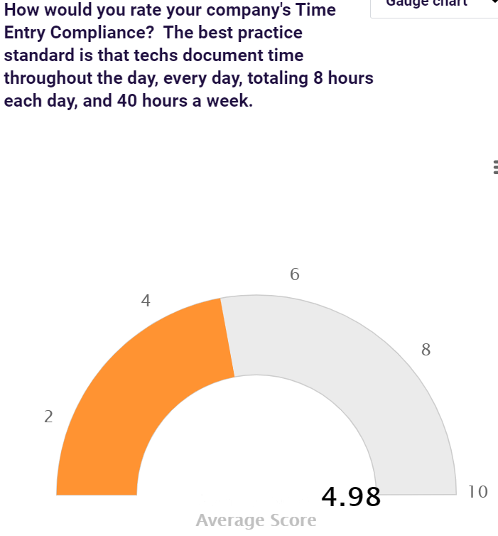
The PROOF is in the Numbers

Slide 7
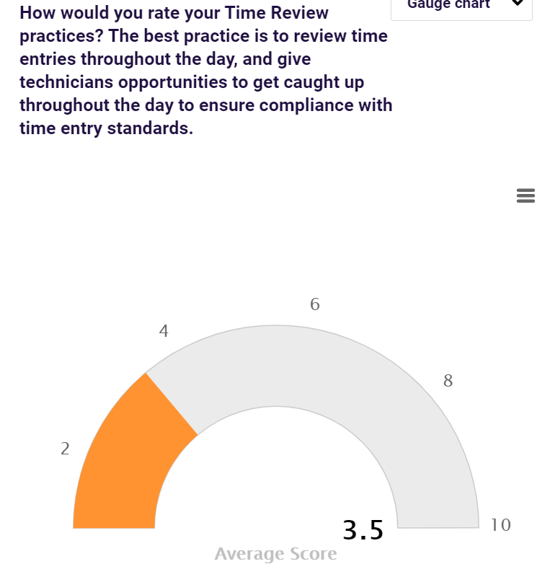
The PROOF is in the Numbers

Slide 8
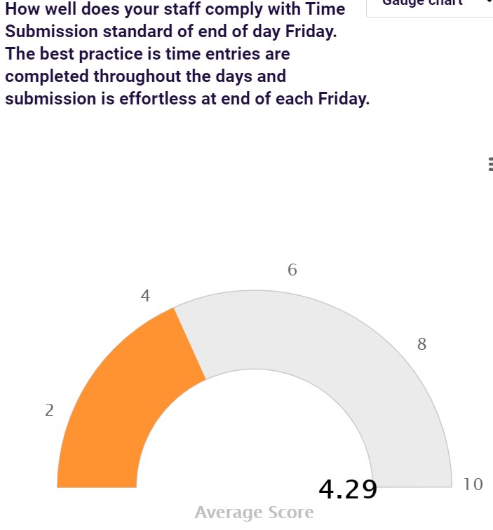
The PROOF is in the Numbers

Slide 9
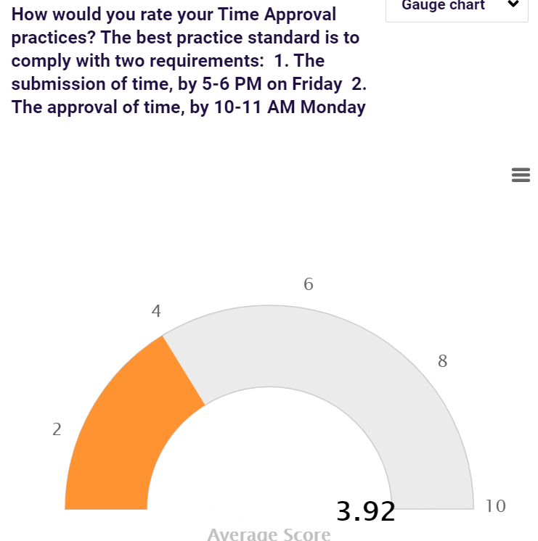
The PROOF is in the Numbers

Slide 10
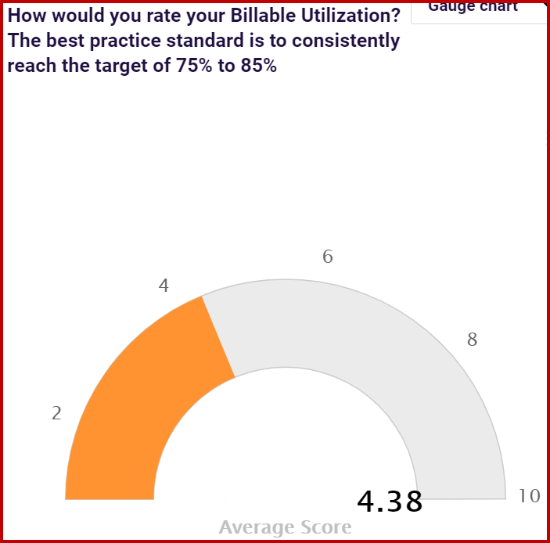
The PROOF is in the Numbers

Slide 11
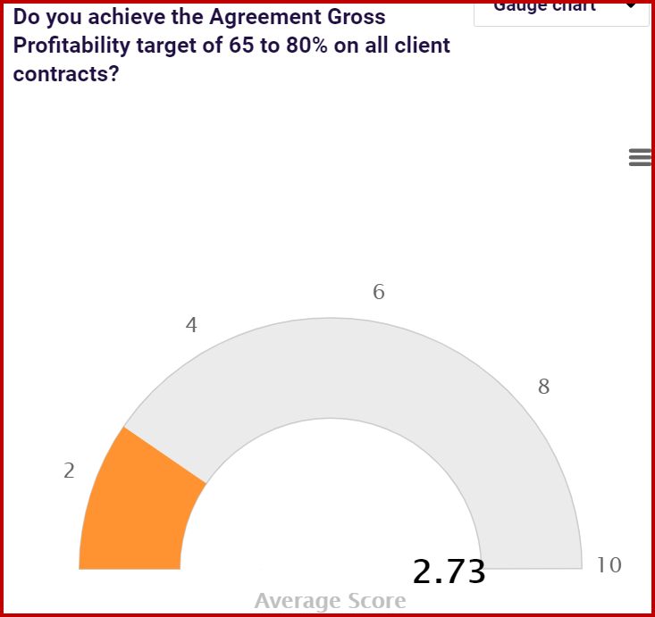
The PROOF is in the Numbers

Slide 12
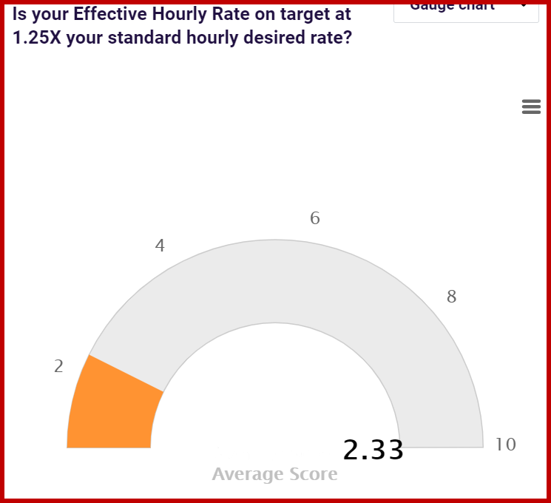
The PROOF is in the Numbers

Slide 13
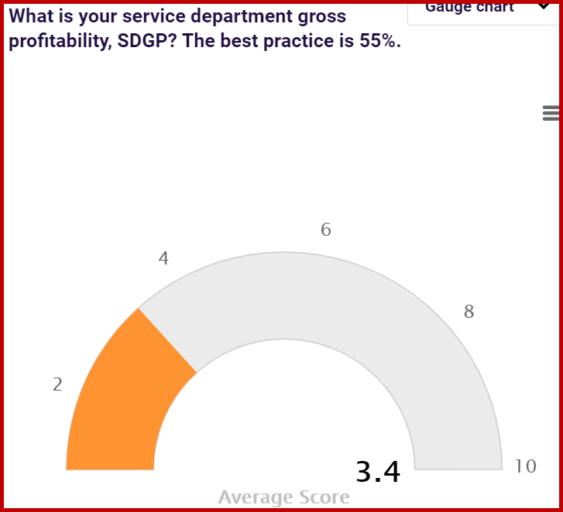
The PROOF is in the Numbers

Slide 14
Why don’t they just enter their time?
Engineers not entering their time DOES NOT MEAN
They are bad people
They are bad employees
They reject authority
They think the request is unrealistic
Engineers not entering their time MEANS
You have lame standards
You are inconsistent
You tolerate a lot of nonsense
You’ve put the weight of the department on their shoulders

Slide 15
5 Time Entry Standards
Enter 8 hours every day
Only perform work with the service ticket or project ticket open
Start the time entry as you start the engagement
End the time entry once you end your session notes
Do not start another ticket until current ticket status is accurately adjusted

Slide 16
1 Time Review Standard
Inspect at the same rate you expect
10am
1pm
4pm
What questions are you answering for yourself?
Is all time entered up to the point of inspection?
Is the correct work role, work type, billable status selected?
Is the correct agreement attached?
Do the notes serve the client and/or fellow technicians or management?
Are next steps documented?

Slide 17
1 Time Submission Standard
Time sheets must have a designated submission time and day of week
Friday 6pm
What questions are you answering for yourself?
Is my PSA configured correctly? Week starts on Saturday, ends of Friday
How reliant am I on utilizing PSA time entries for payroll?
Why did I choose the current time submission date?

Slide 18
1 Time Approval Standard
Time sheets must have a designated approval time and day of week
Monday 1pm
What questions are you answering for yourself?
Who is approving time sheets?
Are they serving their department AND accounting?
How will I handle rejections of time sheets?
Do we need layers of approval? (Hint – account managers not allowed)

Slide 19
Josh Peterson, CEO
Right now – call Jacklyn, set a time to chat
jacklyn@beringmckinley.com

