Slide 1
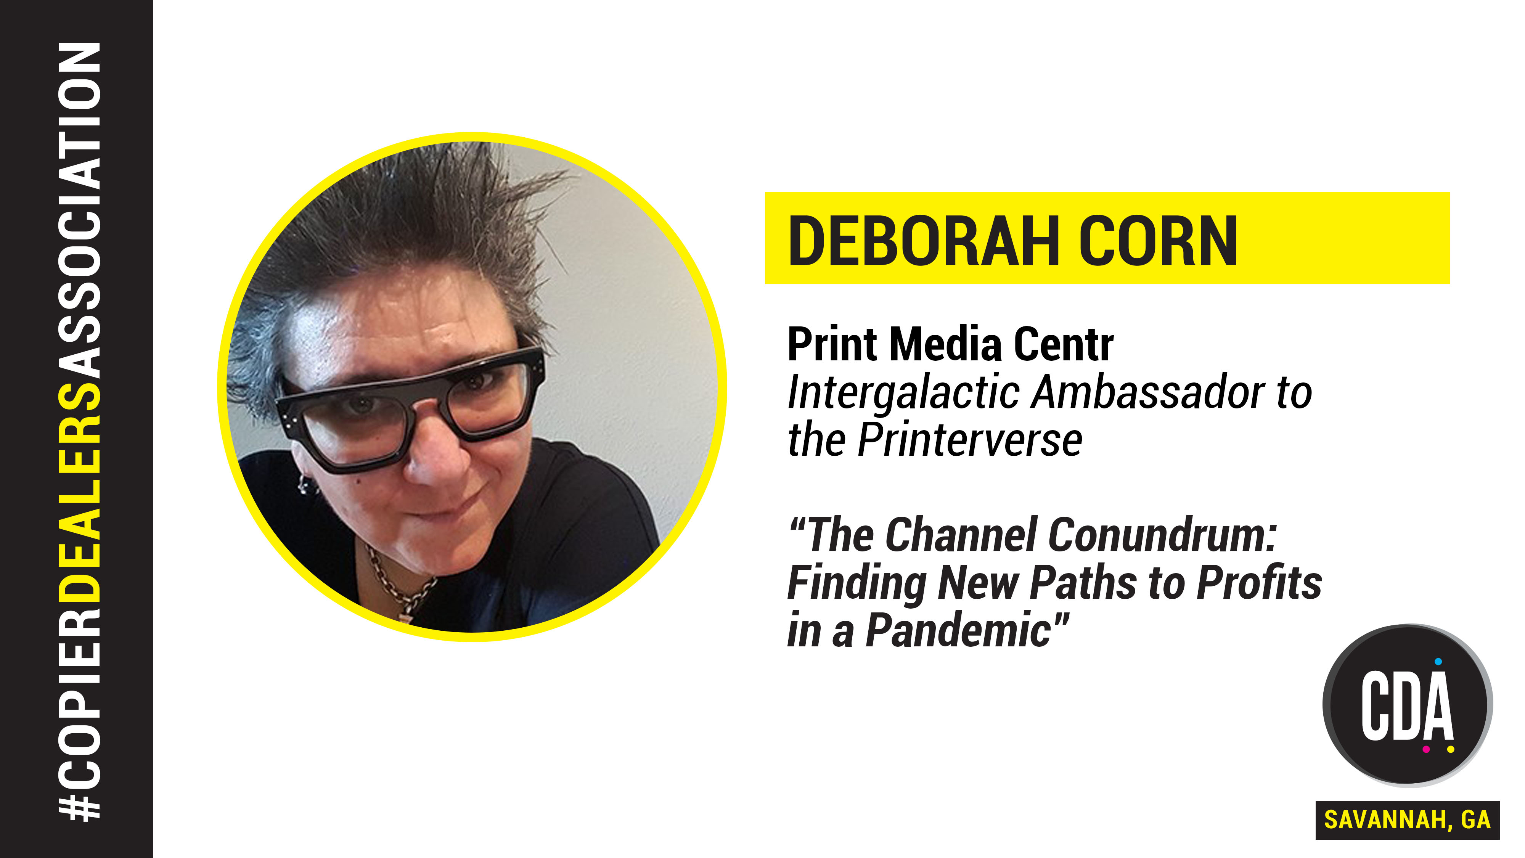

Slide 2


Slide 3
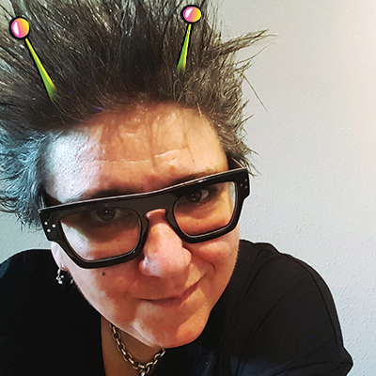
WHO AM I?
Print Buyer 25+
Print Production Professionals
Print Media Centr
Project Peacock
Girls Who Print
#PrintChat
Podcasts From The Printerverse
International Print Day
Elevate Print
Deborah Corn • Print Media Centr

Slide 4

Deborah Corn • Print Media Centr

Slide 5
PROJECT PEACOCK
2017-2018
IN-HOUSE AGENCY/BRAND SHOW & TELL
PROGRAM:
EDUCATE • ENLIGHTEN • PRINTSPIRE
PRESENTED TO 1000+
BUYERS • CREATIVES • MARKETERS • STUDENTS
Deborah Corn • Print Media Centr

Slide 6

PROJECT PEACOCK
FCB HEALTHCARE NYC • SHOWTIME • VIACOM • GIGANTE VAZ
ADLER BRANDING AND MARKETING • FCB GLOBAL CHICAGO
ARC WORLDWIDE / LEO BURNETT • THE KRAFT / HEINZ COMPANY
ALBELSON TAYLOR • FCB WEST SAN FRANCISCO • NOISE 13
SEAGATE • ORACLE • ZOOKA CREATIVE • ART INSTITUTE OF AUSTIN
MCGARRAH JESSEE • GSD&M • CHARLES SCHWAB • CONCIERGE
AUCTIONS • PROOF ADVERTISING • AETNA • APCNYC • OLE MISS
Deborah Corn • Print Media Centr

Slide 7
PROJECT PEACOCK
FCB HEALTHCARE NYC • SHOWTIME • VIACOM • GIGANTE VAZ
ADLER BRANDING AND MARKETING • FCB GLOBAL CHICAGO
ARC WORLDWIDE / LEO BURNETT • THE KRAFT / HEINZ COMPANY
ALBELSON TAYLOR • FCB WEST SAN FRANCISCO • NOISE 13
SEAGATE • ORACLE • ZOOKA CREATIVE • ART INSTITUTE OF AUSTIN
MCGARRAH JESSEE • GSD&M • CHARLES SCHWAB • CONCIERGE
AUCTIONS • PROOF ADVERTISING • AETNA • APCNYC • OLE MISS
Deborah Corn • Print Media Centr

Slide 8
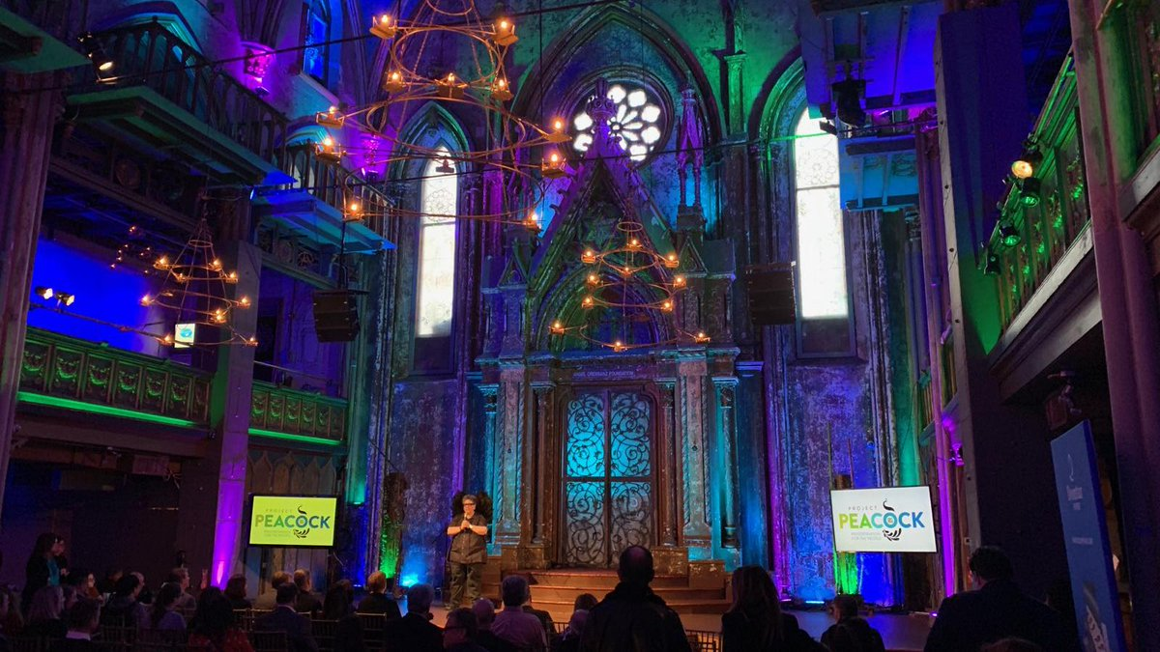
PROJECT PEACOCK
PRINT FAIR 2019

Slide 9
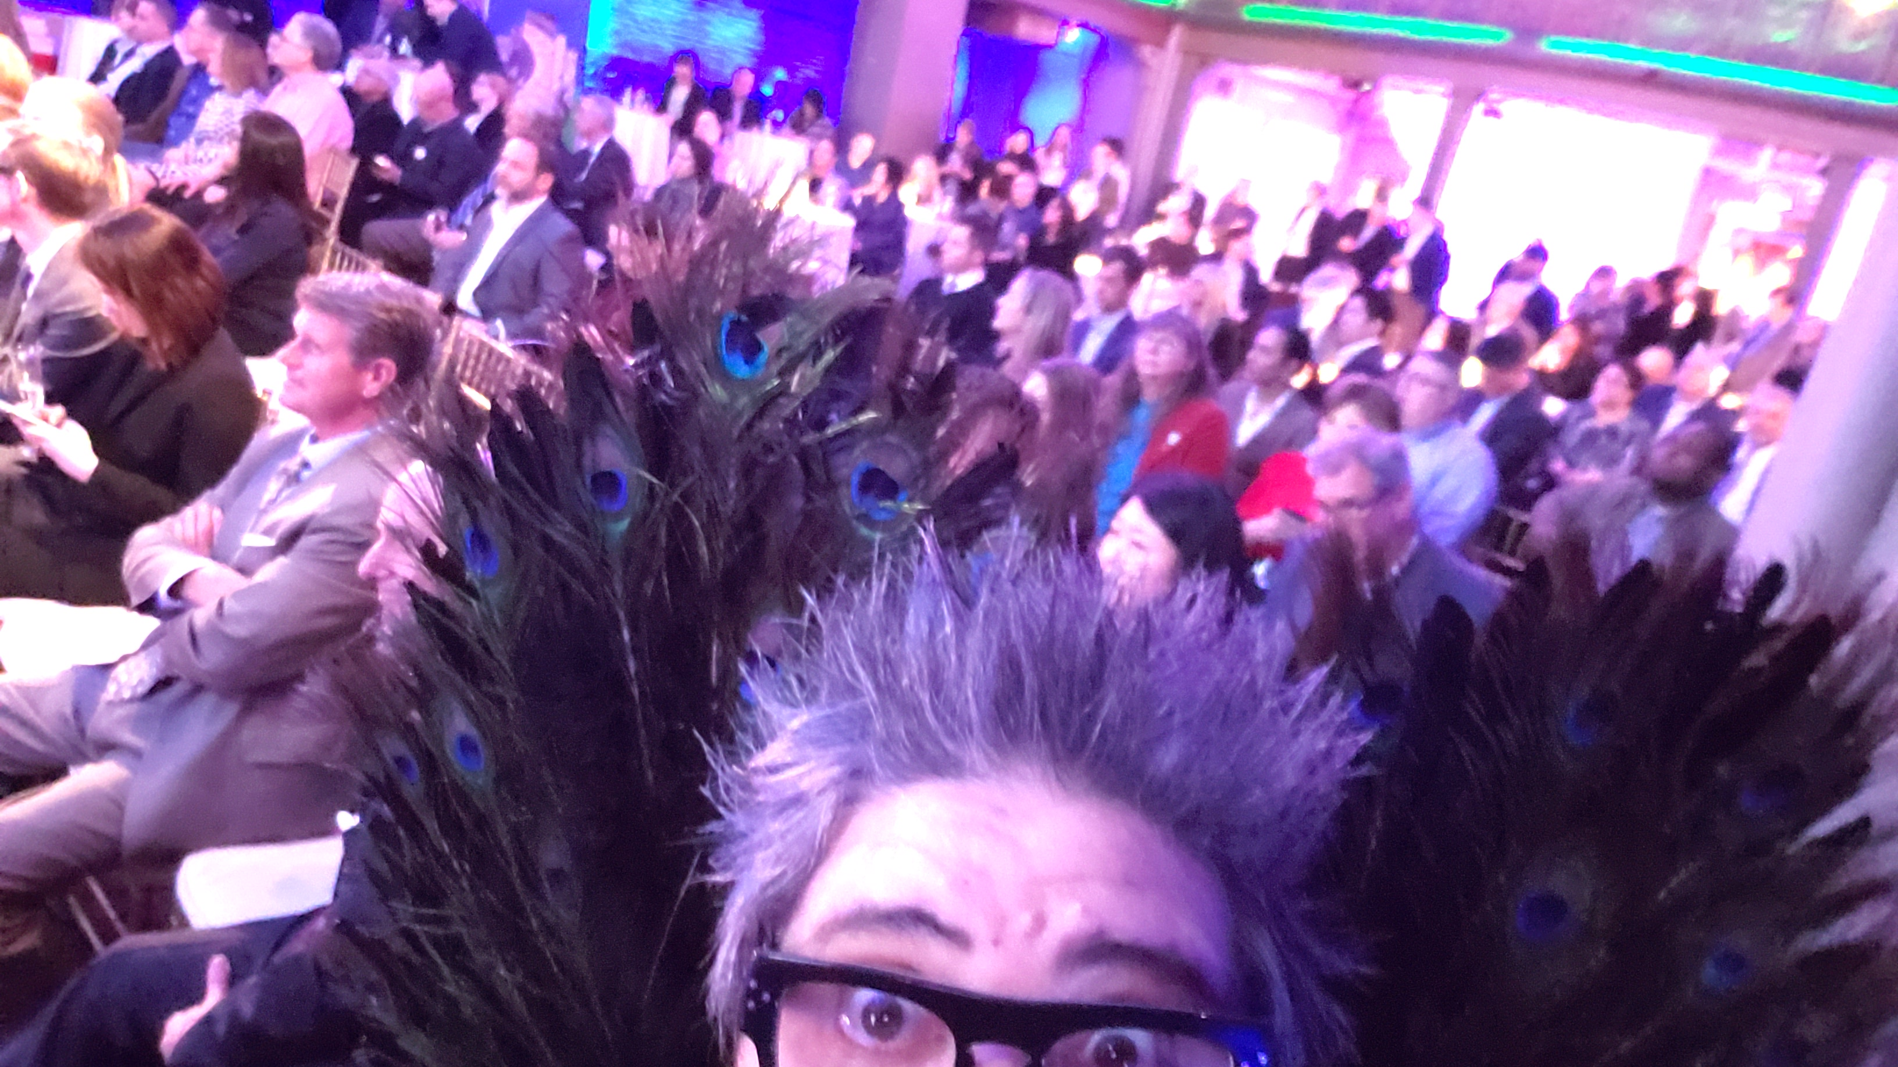
PROJECT PEACOCK
PRINT FAIR NYC
MARCH 14, 2019

Slide 10
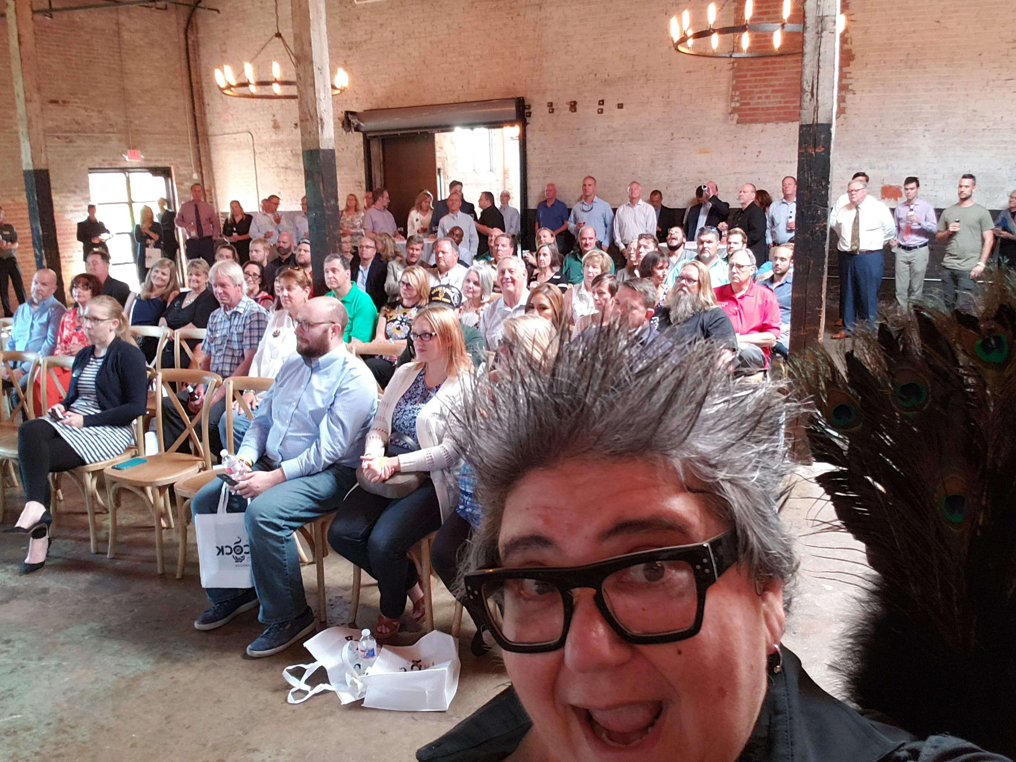
PROJECT PEACOCK
PRINT FAIR DALLAS
JUNE 27, 2019

Slide 11
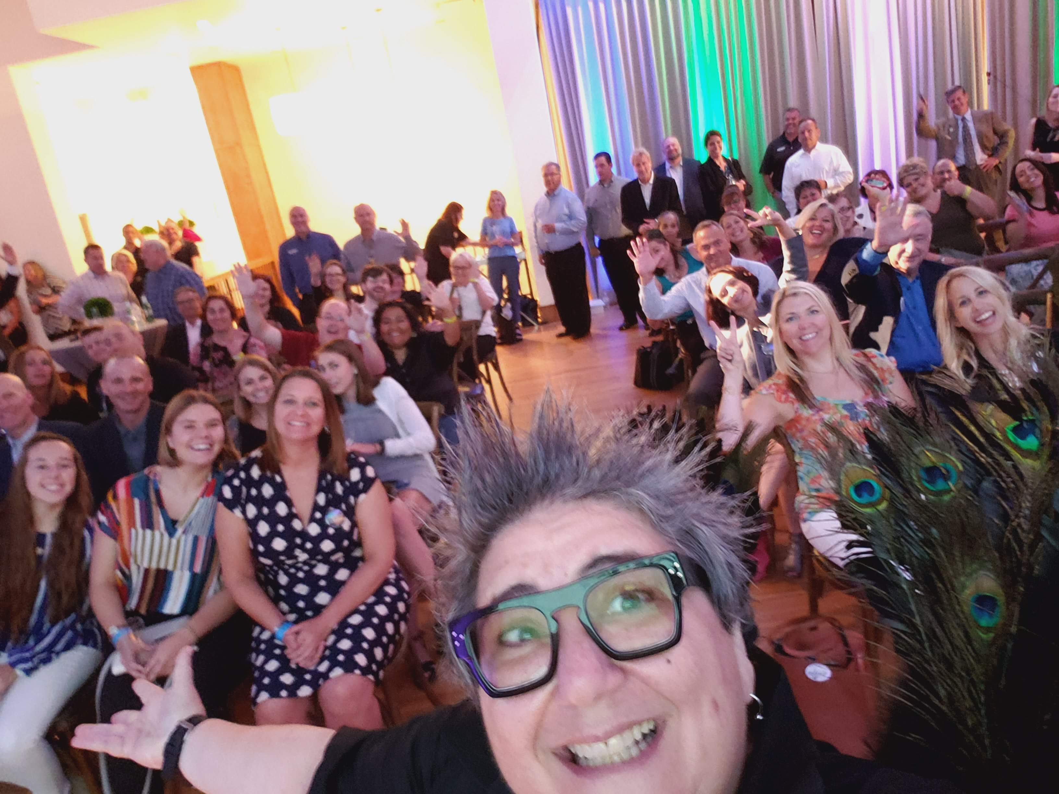
PROJECT PEACOCK
PRINT FAIR CHICAGO
AUGUST 1, 2019

Slide 12
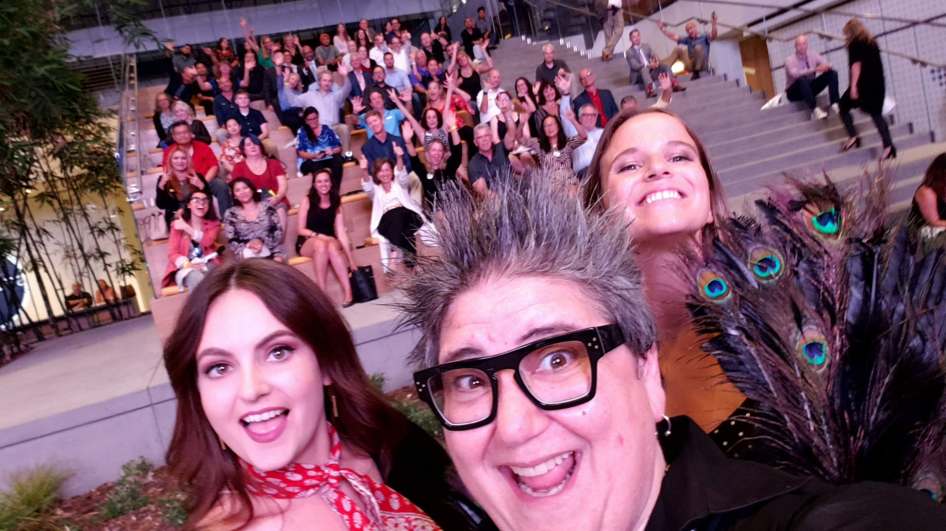
PROJECT PEACOCK
PRINT FAIR LA
SEPTEMBER 14, 2019

Slide 13
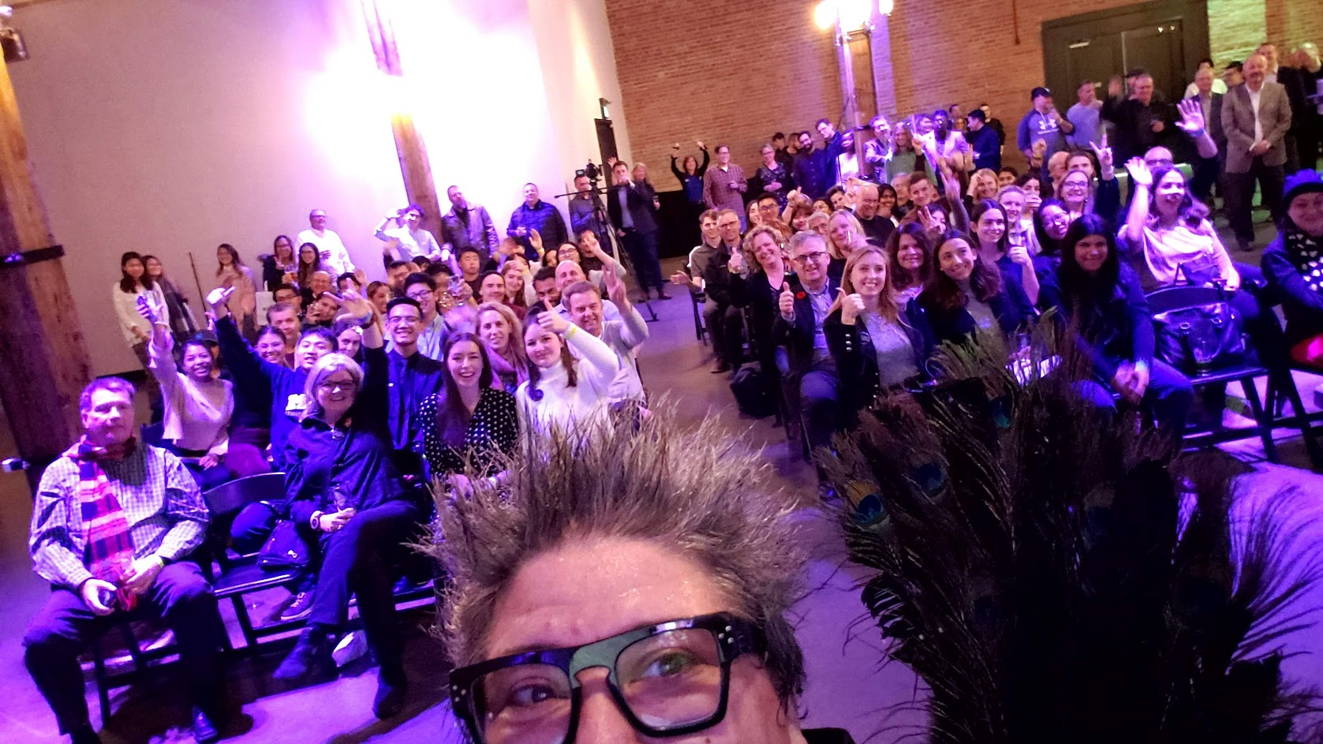
PROJECT PEACOCK
PRINT FAIR TORONTO
NOVEMBER 7, 2019

Slide 14
PROJECT PEACOCK HAS REACHED
2000+ ATTENDEES
…AND COUNTING
(WE WENT VIRTUAL IN 2020. 2021 VIRTUAL + LIVE?)
Deborah Corn • Print Media Centr

Slide 15
PROJECT PEACOCK:
RESULTS
I DIDN’T KNOW THAT WAS POSSIBLE
THAT WOULD BE PERFECT FOR MY COMPANY / CLIENT
CAN I HAVE A LIST OF VENDORS
WHO CAN HELP ME?
Deborah Corn • Print Media Centr

Slide 16
WHY
DO WE NEED A
PEACOCK?
Deborah Corn • Print Media Centr

Slide 17
WHERE
RELATIONSHIP
HAVE WE GONE
RELEVANCE
RESPONSIVENESS
WRONG?

Slide 18
WHAT
IS IT ALL
ABOUT SALES?
HAVE YOU DONE FOR ME
LATELY?

Slide 19
ARE YOU A PRINT
PARTNER
OR ARE YOU A PRINT
PUSHER?

Slide 20
THE TOMATO
CONNECTION

Slide 21
SHOPPING
ON PRICE

Slide 22
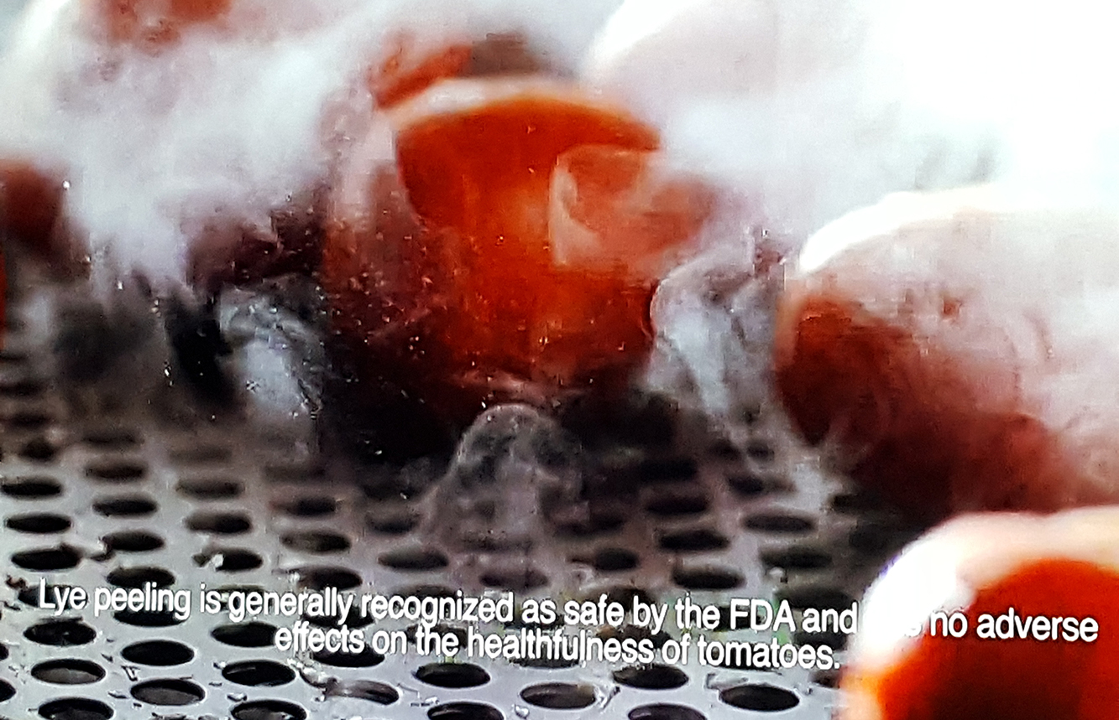
Lye peeling is generally recognized as safe by the FDA and has no adverse effects on the healthfulness of TOMATOES.

Slide 23



Slide 24


Slide 25
?
WHY ARE
YOU
DIFFERENT?
PRICE/QUALITY/SERVICE

Slide 26
!
YOU
UNDERSTAND:
YOUR BUSINESS
YOUR MARKET
YOUR CUSTOMERS

Slide 27
!
YOU
UNDERSTAND:
THEIR BUSINESS
THEIR MARKET
THEIR CUSTOMERS +

Slide 28
?
DO YOUR
CUSTOMERS
HAVE HOLES IN THEIR
WINE LIST

Slide 29

?
?
?
?

Slide 30






Slide 31
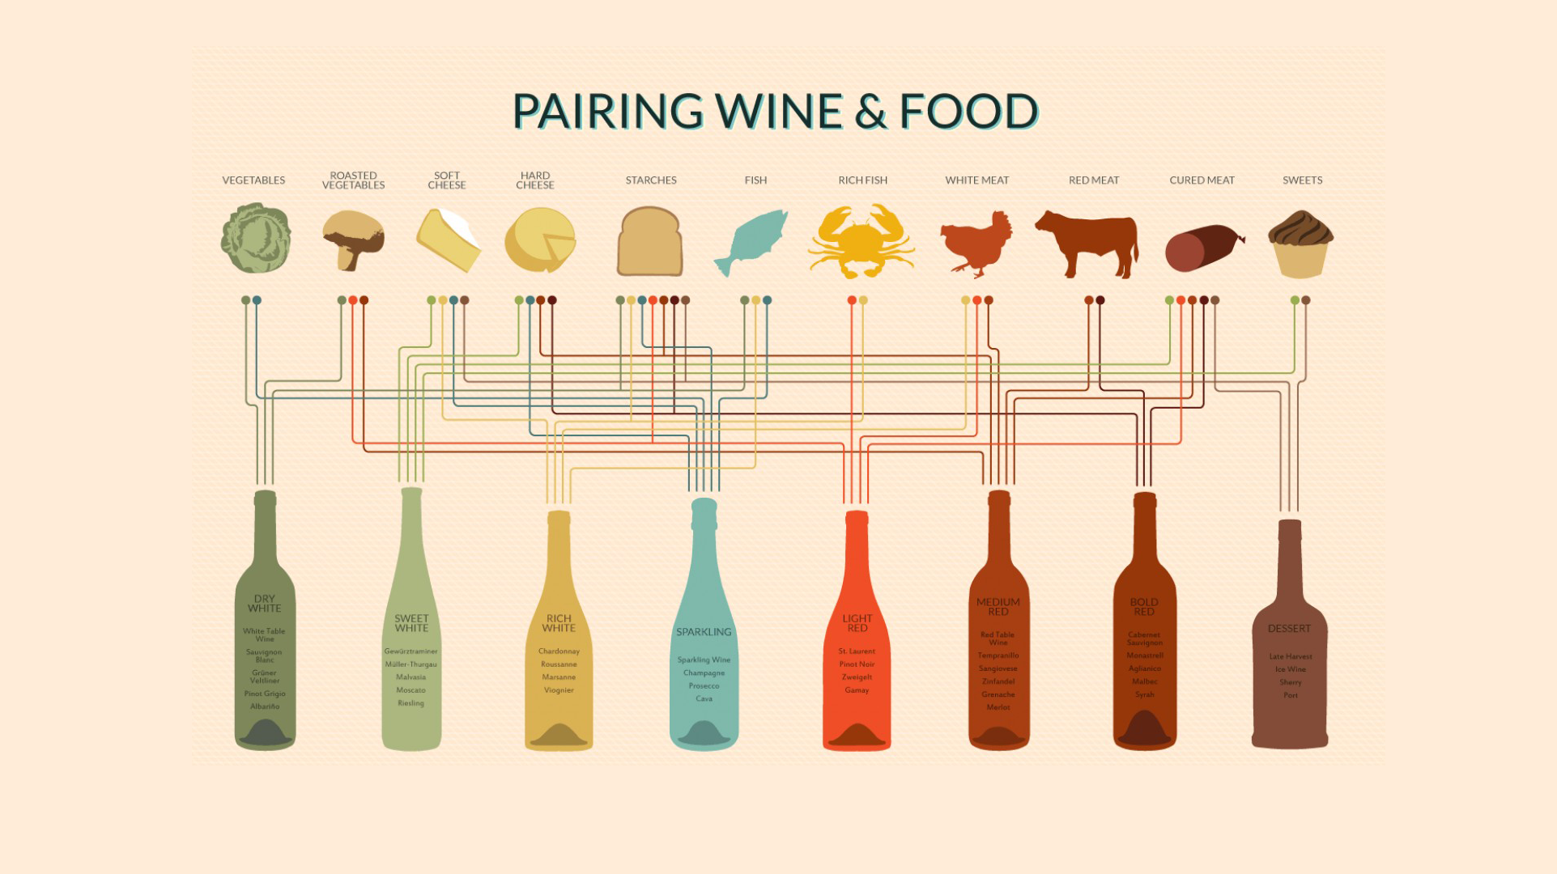

Slide 32
STAND
STOP
OUT
SELLING!

Slide 33
CHANGE THE
GAME

Slide 34
CREATE A
NEW
OPPORTUNITY

Slide 35
SELLING THE
END-USER
Deborah Corn • Print Media Centr

Slide 36
THE END-USER
AGENCY • BRANDS • SCHOOLS
Deborah Corn • Print Media Centr

Slide 37
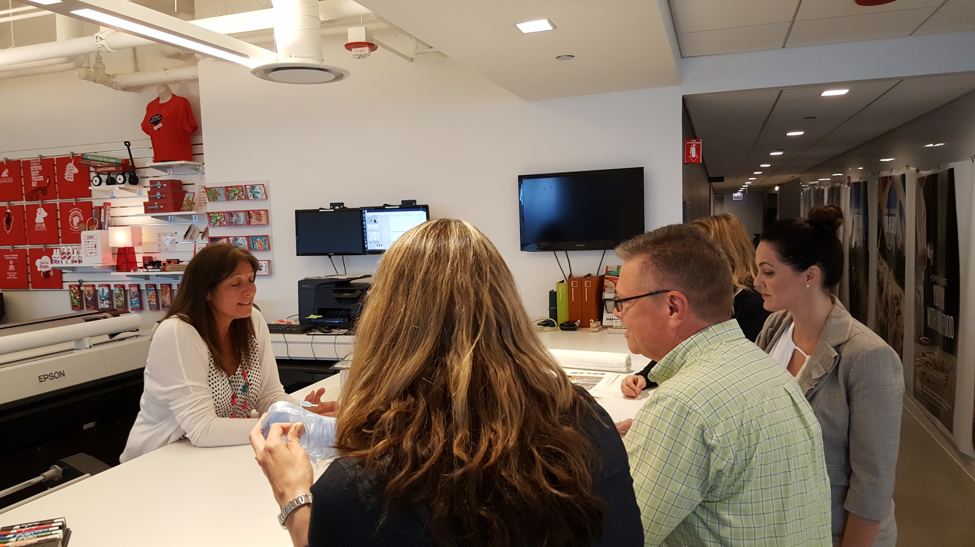
Deborah Corn • Print Media Centr

Slide 38
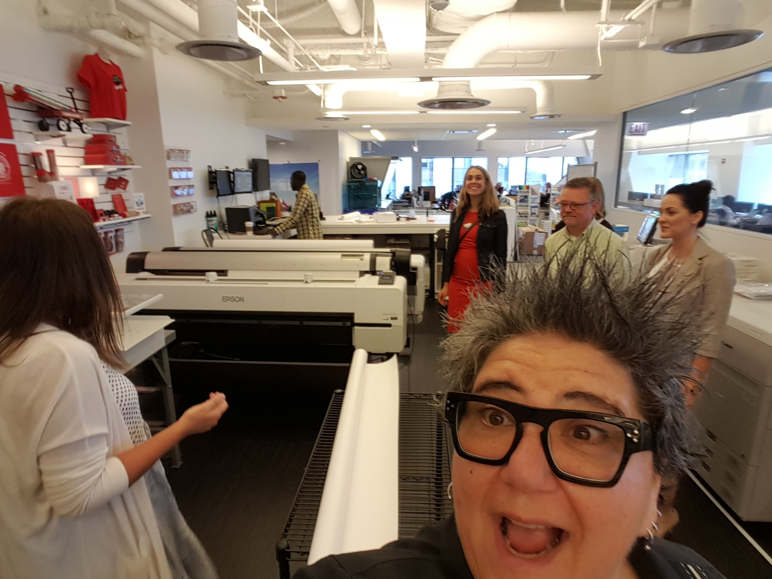
Deborah Corn • Print Media Centr

Slide 39
Deborah Corn • Print Media Centr

Slide 40
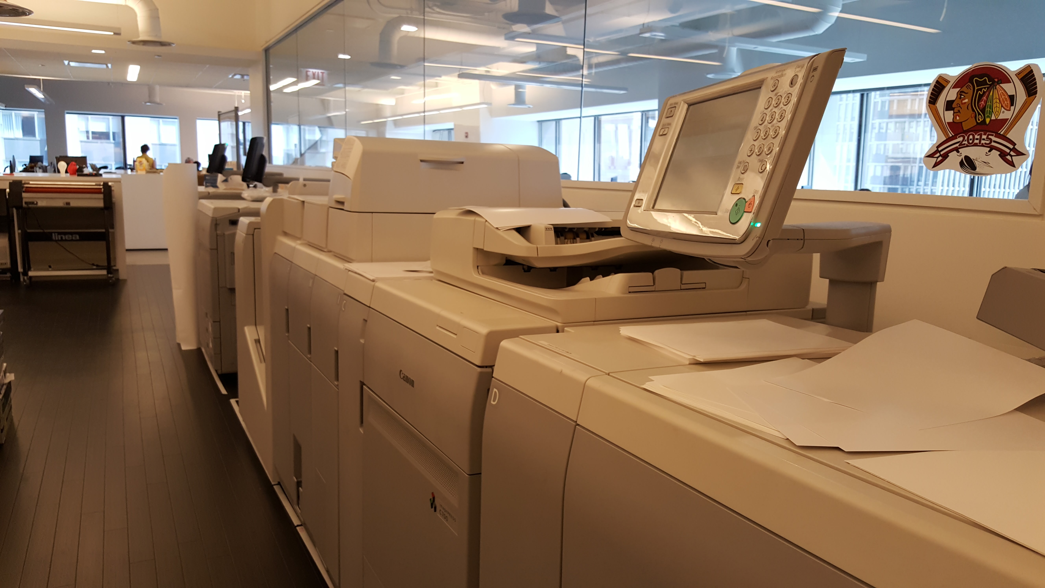
Deborah Corn • Print Media Centr

Slide 41
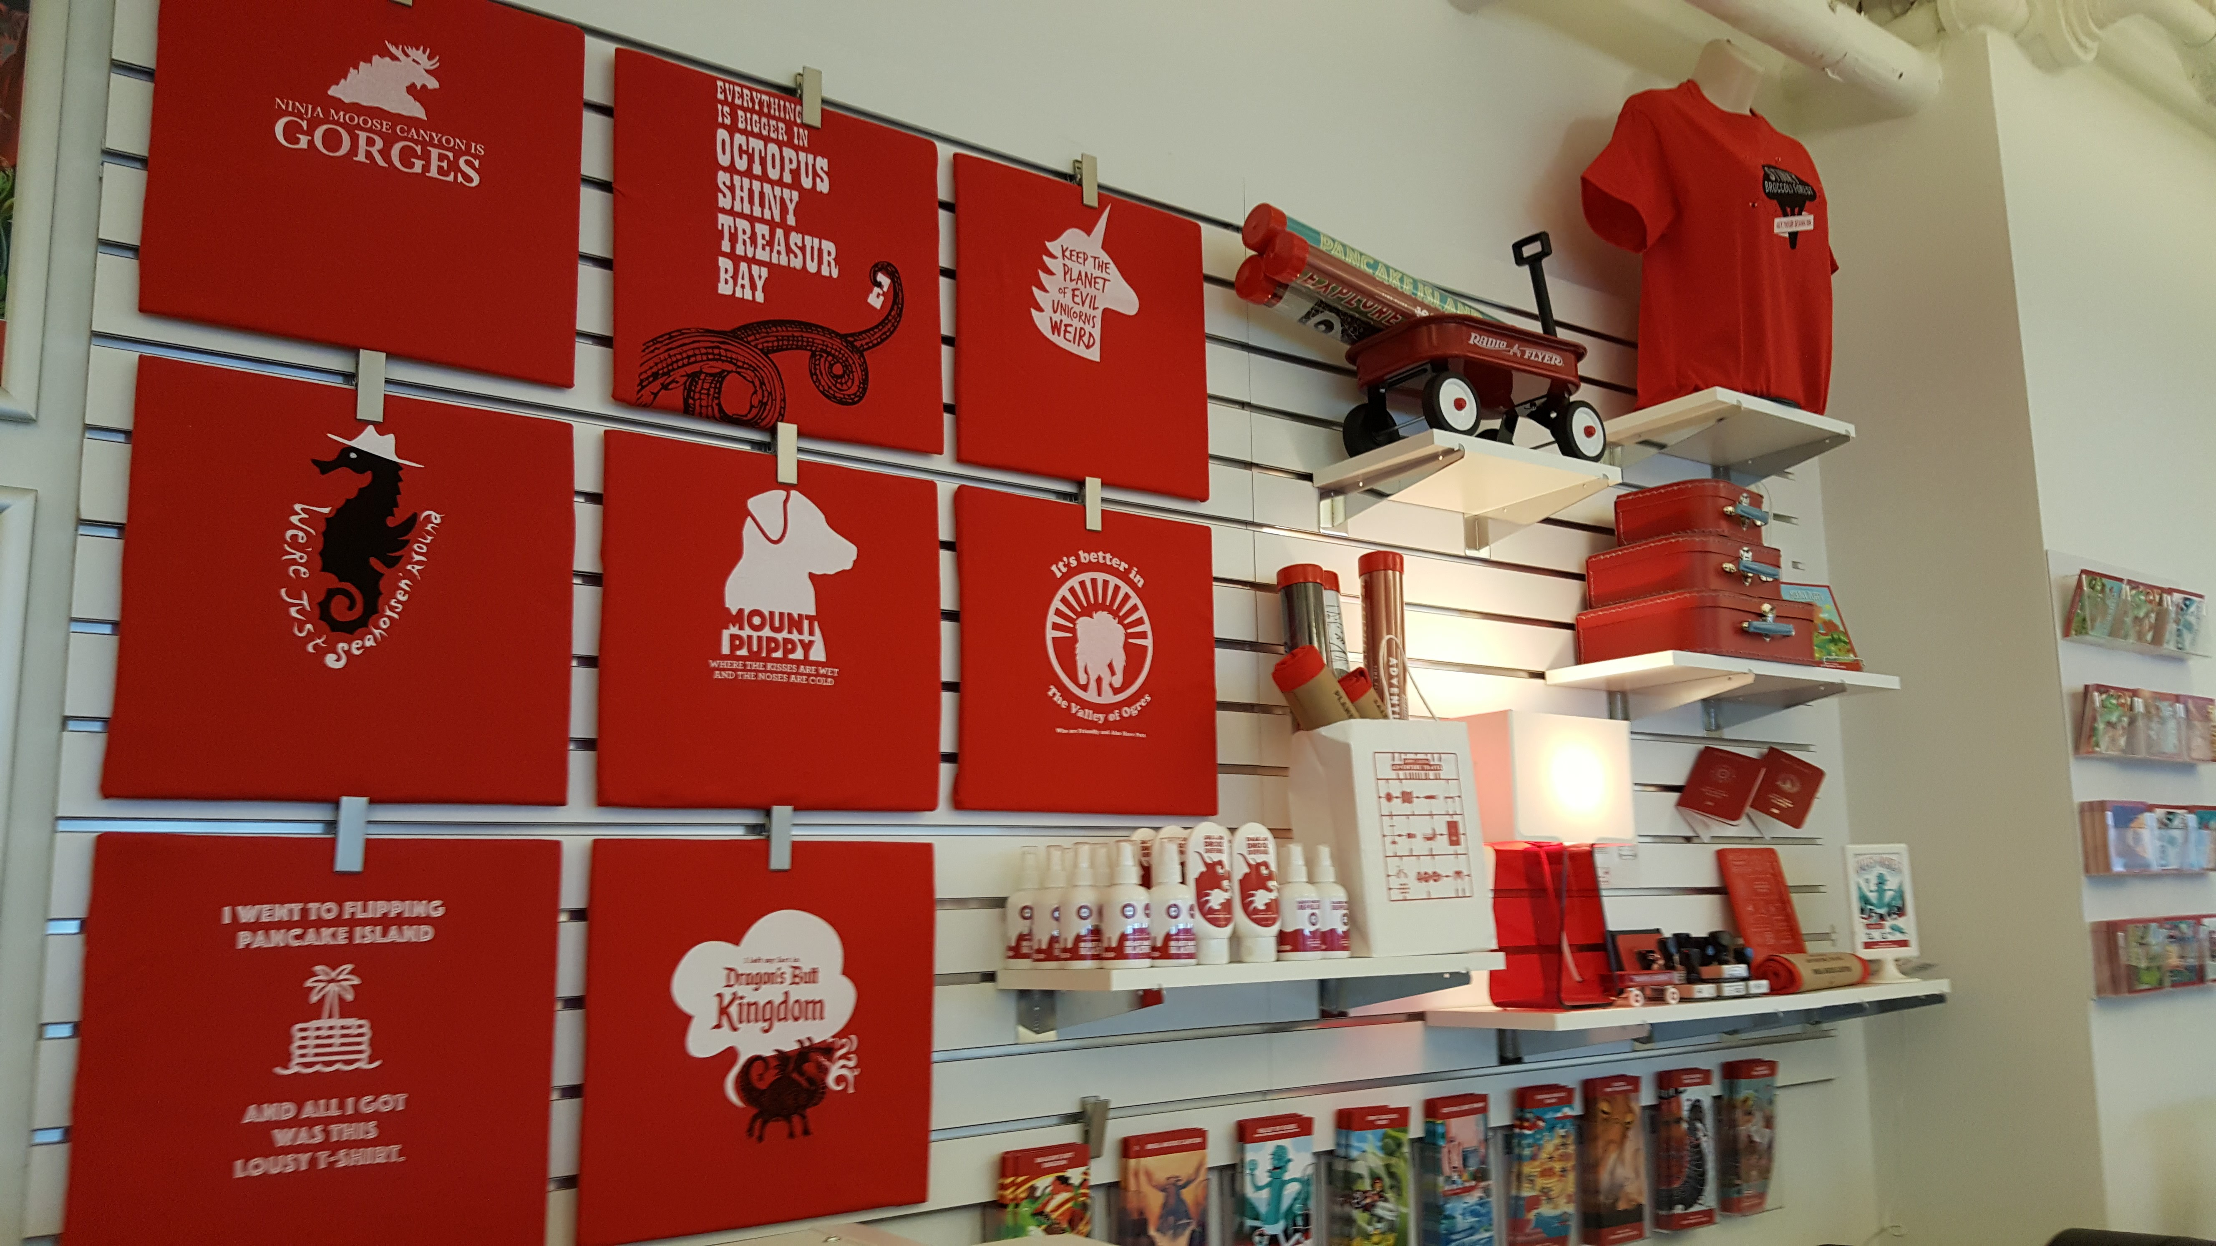
Deborah Corn • Print Media Centr

Slide 42
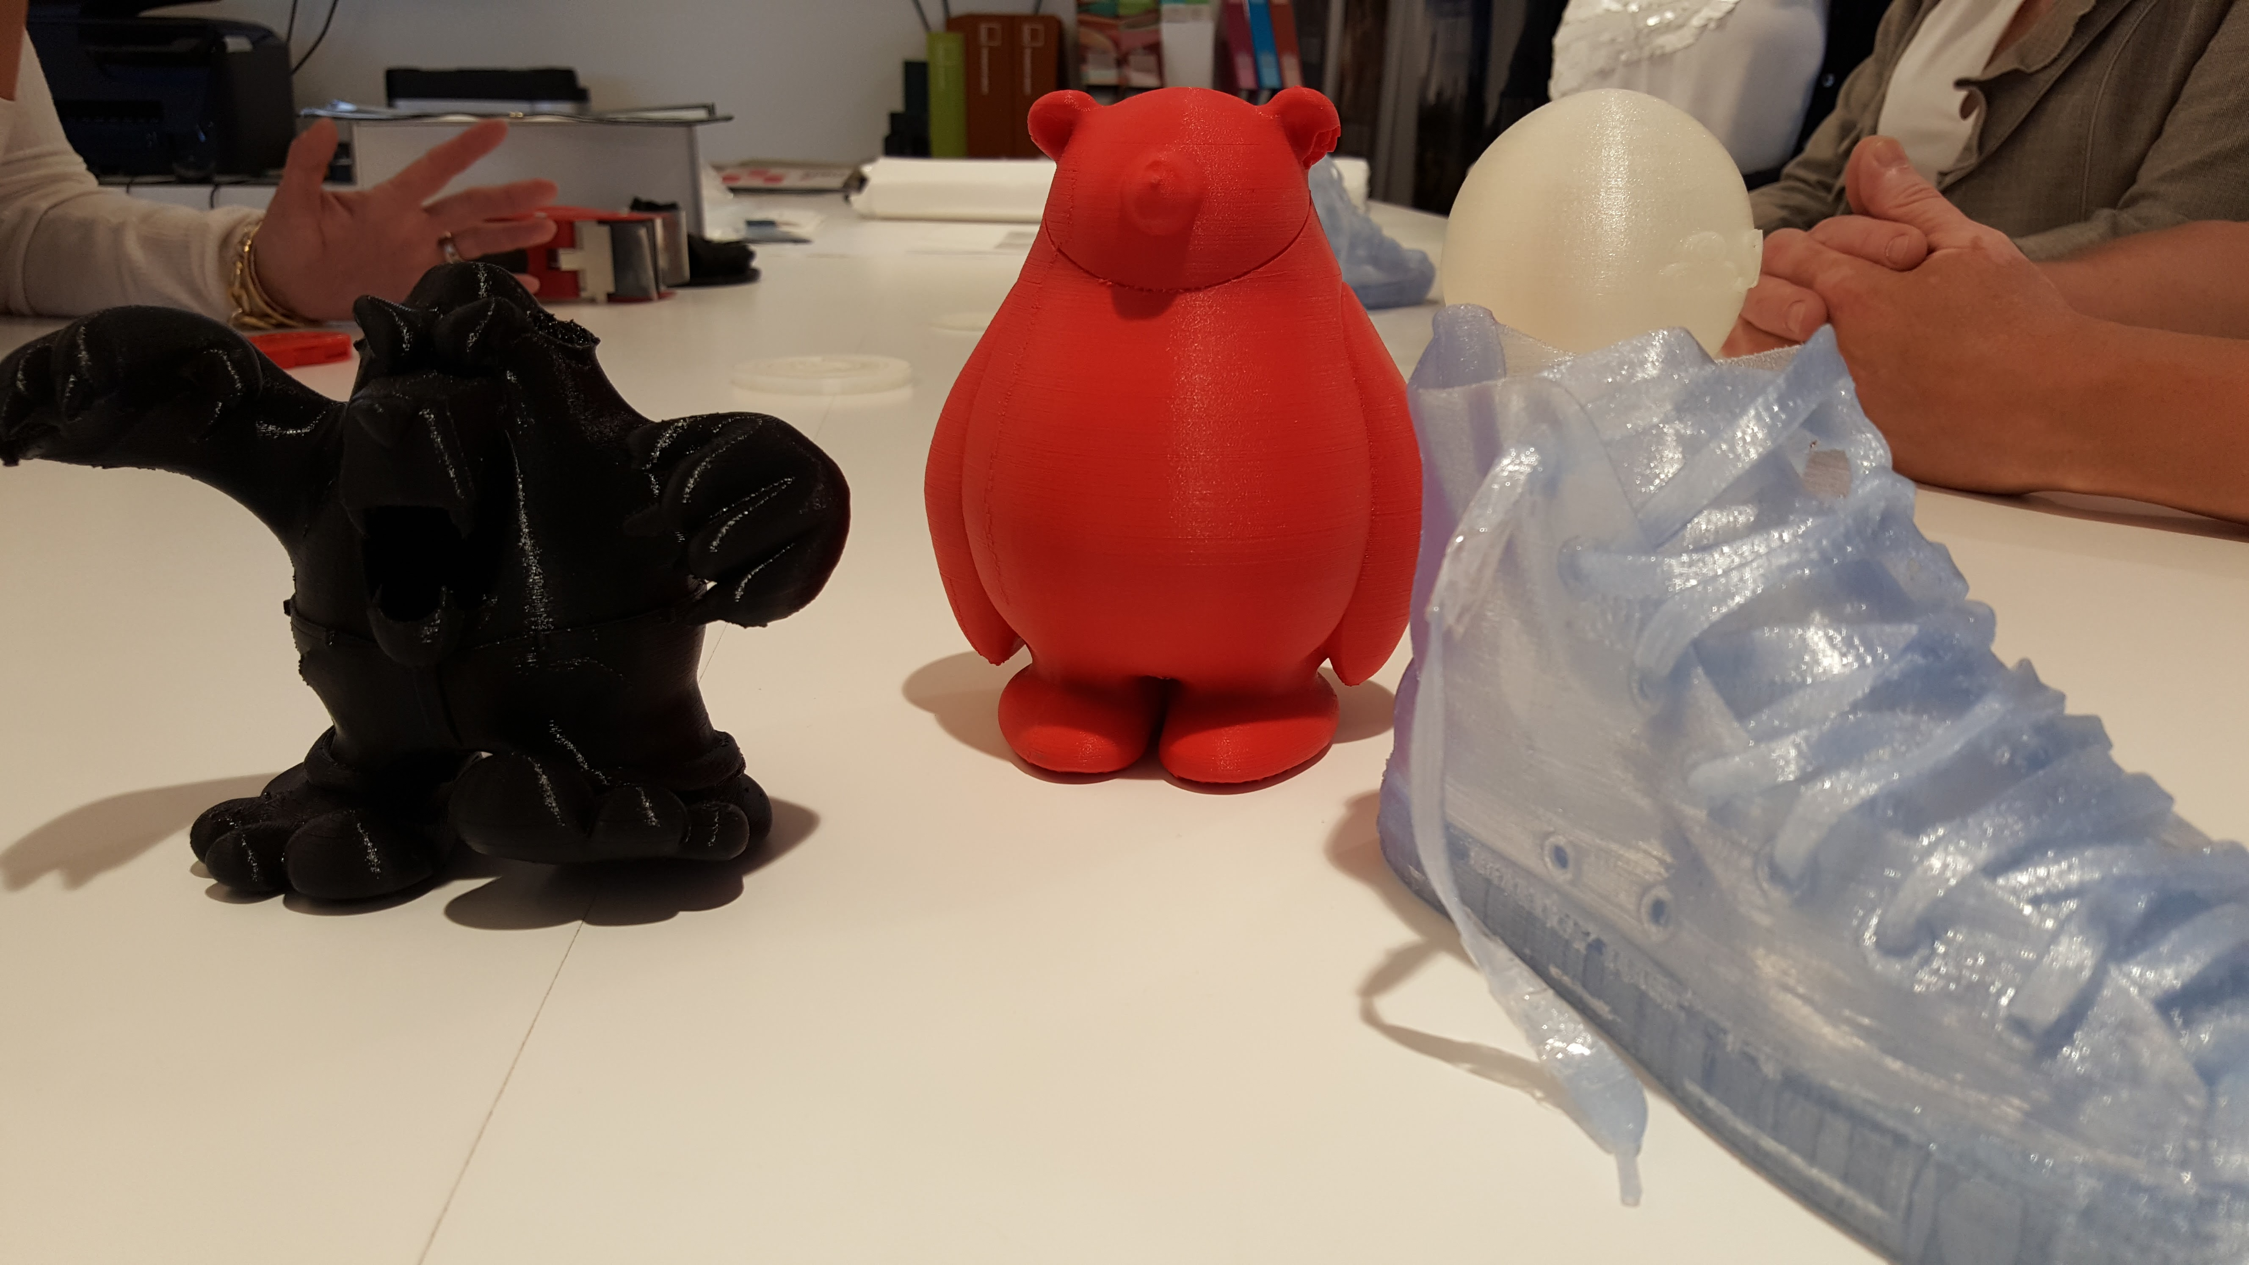
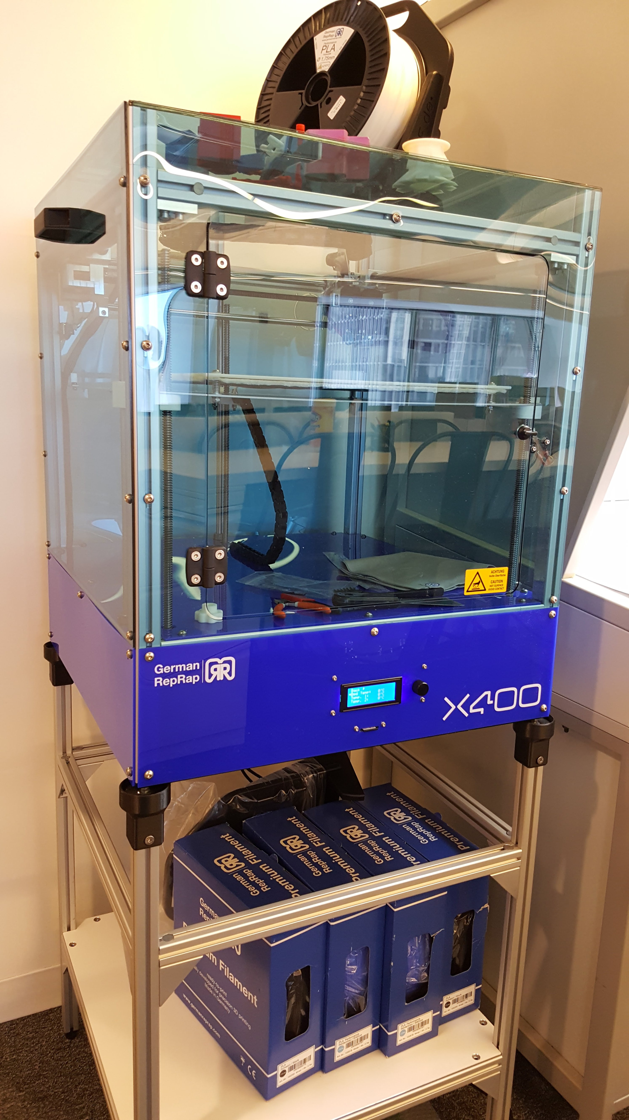
Deborah Corn • Print Media Centr

Slide 43
THE END-USER
AGENCY • BRANDS • SCHOOLS
REDUCE PROOFING AND PROTOTYPE COSTS
HELP REMOTE WORKERS
Deborah Corn • Print Media Centr

Slide 44
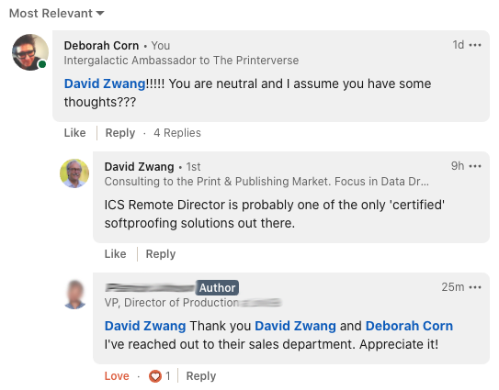
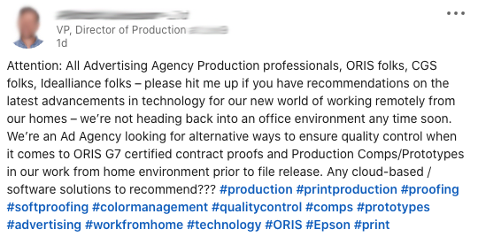
SEPT. 2020
Deborah Corn • Print Media Centr

Slide 45
SELLING THE
PRINTERS
Deborah Corn • Print Media Centr

Slide 46
THE PRINTERS ARE:
INVESTING IN AUTOMATION
INVESTING IN FINISHING
INVESTING IN WIDE FORMAT
INVESTING IN SOFTWARE
INVESTING IN ADDED-VALUE TECHNOLOGIES
Deborah Corn • Print Media Centr

Slide 47
THE PRINTERS ARE:
INVESTING IN SHORT RUNS
INVESTING IN CUSTOMIZATION
INVESTING IN PERSONALIZATION
INVESTING IN PRINT-ON-DEMAND
INVESTING IN REDUCING TIME / REDUCING COSTS
Deborah Corn • Print Media Centr

Slide 48
SELLING THE
NEW
OPPORTUNITY

Slide 49
MARKETING MATTERS
THOUGHT LEADERSHIP
PROVIDE DATA FOR DECISIONS
CONSISTENT COMMUNICATION
EXPLORE NEW CHANNELS
GET HELP!
Deborah Corn • Print Media Centr

Slide 50
EXPLORE NEW
WORLDS

Slide 51
GATHER
INTEL

Slide 52
CHART A NEW
COURSE

Slide 53
BOLDLY GO WHERE
NO DEALER
HAS GONE BEFORE!

Slide 54


Slide 55
QUESTIONS?
COMMENTS
DEBORAH CORN
PRINTMEDIACENTR.COM
DEBORAH@PRINTMEDIACENTR.COM

Slide 56


THANK YOU!
PRINT LONG AND PROSPER!

