Slide 1


Slide 2


Guidance In An
Uncertain Economy
Alex Chausovsky
Senior Business Advisor

Slide 3

Why Are We Maintaining Our
Onset of Recovery Forecast for the US Economy?
1. COVID-19 Trends
2. Leading Indicators of Economic Activity
3. Timing and Magnitude of the Stimulus

Slide 4

Watching the Rise in Cases
Daily New Confirmed Cases of COVID-19 (3-day rolling average)
Rolling 3-Day Average
Source: European CDC

Slide 5

The US Perspective
COVID-19, US Daily Deaths vs. Cumulative Deaths
Actual number of deaths per day
Source: European CDC

Slide 6
Influenza Positive Tests Reported to CDC by
US Clinical Laboratories
Source: CDC

Slide 7
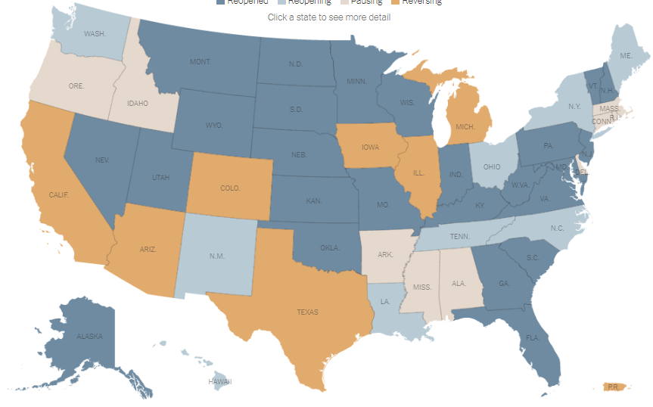
This is What Matters From an Economic Perspective
State Reopening Status
Reopened
Reopening
Pausing
Reversing
Note: Open states may still have capacity, protective gear, and social distancing restrictions
Source: New York Times

Slide 8

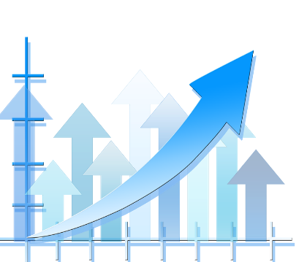
Economic Fundamentals

Slide 9
U.S. Economic Leading Indicators
Indicator | Trend | Comments
ITR Consumer Activity Leading Indicator | Rise | Tentative June 2020 1/12 low
ITR Financial Leading Indicator | Rise | April 2020 monthly low
JPMorgan Global PMI | Rise | April 2020 1/12 low
OECD Leading Indicator | Rise | April 2020 1/12 low
G7 Leading Indicator | Rise | April 2020 1/12 low
Purchasing Managers Index (PMI) | Rise | April 2020 1/12 low
ITR Leading Indicator | Rise | June 2020 monthly low
Wilshire Total Market Cap | Rise | April 2020 3/12 low
US Leading Indicator | Rise | April 2020 1/12 low
Single-Family Housing Starts | Rise | Tentative June 3/12 low
Total Industry Capacity Utilization | Rise | April 2020 1/12 low
US Exports, Goods – World | Rise | May 1/12 low
Sources: ITR Economics, Institute for Supply Management, OECD, Yahoo Finance, The Conference Board, US Census Bureau, FRB

Slide 10
Recent Trends
US Weekly Economic Index
Raw data to moving averages
Source: FRB New York

Slide 11
A Positive Sign for the Economy
Realtor.com Housing Market Recovery Index
Raw Data
Source: Realtor.com

Slide 12
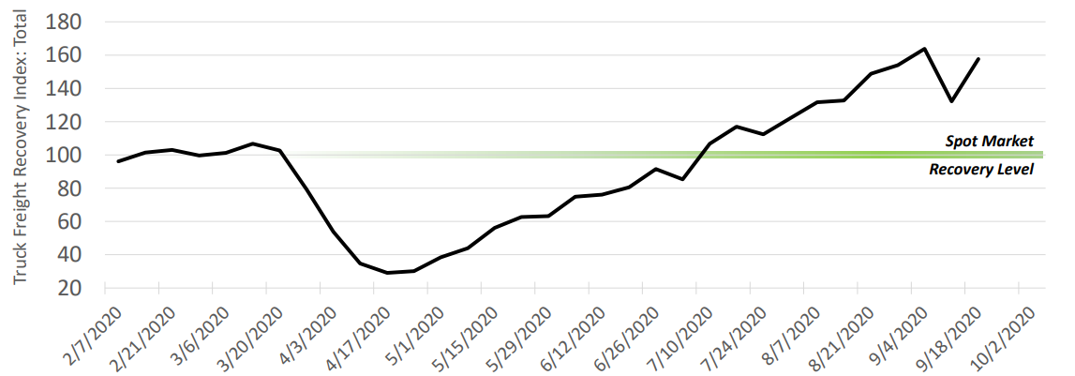
A Strong Indication of Demand
US Truck Freight Recovery Index
Total Spot (all truck types)
100 = Full recovery to pre-pandemic volumes
Sources: Truckstop.com Spot Market Insights, analysis by FTR Transportation IntelligenceTM

Slide 13
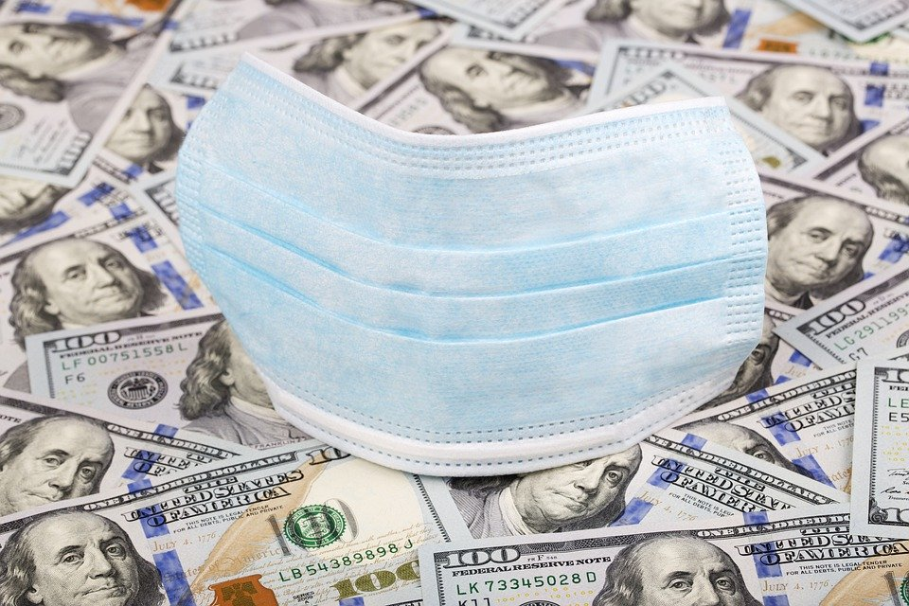
US STIMULUS MEASURES
Incredible in scope and dollars
Liquidity
Consumers
Businesses
Fed - Chairman Powell is
urging Congress to spend more
said there is ‘no limit’ on what the Fed can do
said the Fed is not considering negative interest rates
Source: Federal Reserve

Slide 14
FOMC Member Interest Rate Projections
September 2020
Fed Open Market Committee
Source: FRB

Slide 15


Management Objectives™
Separate near-term events
from fundamental economics
and determine which will
likely prevail
in your markets.

Slide 16
Party Affiliation is Not a Determinant in Economic Growth
US Real Gross Domestic Product
Eisenhower
3.1%
Kennedy
4.6%
Johnson
5.2%
Nixon
2.8%
Carter
3.4%
Reagan/Bush
3.5% 2.3%
Clinton
3.9%
Bush
2.2%
Obama
1.4%
Trump
3MMA Data Trends with Average Growth Rate by Presidency
Source: BEA

Slide 17
Recovery Begins Now
US Gross Domestic Product, SAAR, Chained 2012 $
3-Month Moving Average
Source: BEA

Slide 18
Positive Input from the 3/12 and the 3MMT
US Total Retail Sales
Trillions of Dollars
Source: US Census Bureau

Slide 19
Re-opening and Recovery
Johnson Redbook Weekly Retail Indexes for the US
Weekly Activity, Year-over-Year Percent Change
Sources: Johnson Redbook

Slide 20
Spending Power
US Disposable Personal Income
This doesn’t happen in a recession
Trillions of chained 2012 dollars, SAAR
Source: US Bureau of Economic Analysis

Slide 21
A Harbinger of Near-Term GDP Improvement
US Real Gross Domestic Product to US Disposable Personal Income
3/12 Rates-of-Change
Source: BEA

Slide 22

Housing: Positive Signal
US Single Unit Housing Starts
As seen in
2020 0.3%
Millions of Units
Source: Census Bureau

Slide 23
Longer-Term Fundamentals Are Still There
US Single-Unit Housing Starts to US Conventional Mortgage Rate (30-yr)
Rates-of-Change
Sources: US Census Bureau, WSJ

Slide 24
12/12 and 12MMA Lows in 1Q21
US Industrial Production Index
Dec ‘20 Dec ’21 Dec ’22
-8.0% 4.8% 2.5%
Full recovery in 2023
2012 = 100
Source: FRB

Slide 25
Recovery in Steel is Less Evident
US Raw Steel Production to US Raw Steel Capacity Utilization Rate
Production: Weekly-Raw Data, Utilization Rate: Percent
Source: American Iron & Steel Institute (AISI)

Slide 26
Upside Pressure on Commodities – What Are You Doing?
Commodity Prices
3/12 Rates-of-Change
Sources: Wall Street Journal, London Metal Exchange, Bureau of Labor Statistics

Slide 27


Your Markets

Slide 28
Prolonged Phase D, Recession, Reflects Industry Challenges
US Printing Production Index
2012 = 100
Source: FRB

Slide 29
More Cyclical Decline Expected Into Year-End 2020
US Support Activities for Printing
2012 = 100
Source: FRB

Slide 30
Negative ITR Checking Point™ Indicates Downside Pressure
US Photographic Equipment New Orders
Billions of Dollars
Source: US Census Bureau

Slide 31
Early Signs of Recovery Evident
US Printing and Related Support Activities Utilization Rate
1/12 Rates-of-Change
Source: FRB

Slide 32

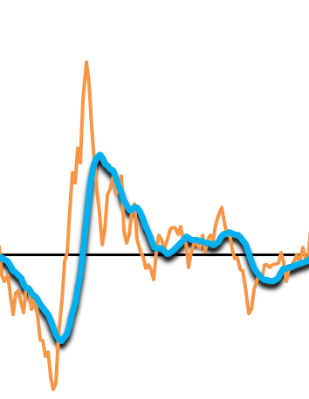
Rate-of-Change
A Management Tool
Decision Making

Slide 33
A Powerful Management Tool
Rate-of-Change
 | Monthly
Aug-18 | 5.260
Sep-18 | 4.875
Oct-18 | 5.378
Nov-18 | 4.991
Dec-18 | 4.866
Jan-19 | 4.684
Feb-19 | 4.391
Mar-19 | 5.024
Apr-19 | 5.050
May-19 | 5.266
Jun-19 | 4.969
Jul-19 | 5.061
Aug-19 | 5.099
Sep-19 | 4.956
Oct-19 | 5.295
Nov-19 | 4.875
Dec-19 | 5.032
Jan-20 | 4.816
Feb-20 | 4.515
Mar-20 | 4.914
Apr-20 | 4.031
May-20 | 4.164
Jun-20 | 4.815
Jul-20 | 4.857
1/12
8.2%
4.4%
8.5%
3.0%
1.2%
2.4%
1.8%
0.2%
5.1%
-0.6%
-2.6%
2.9%
-3.1%
1.7%
-1.5%
-2.3%
3.4%
2.8%
2.8%
-2.2%
-20.2%
-20.9%
-3.1%
-4.0%
3MMT
15.5
15.2
15.2
14.5
13.9
14.1
14.5
15.3
15.3
15.3
15.1
15.1
15.3
15.1
15.2
14.7
14.4
14.2
13.5
13.1
13.0
13.8
3/12
-1.0%
-0.8%
-0.2%
1.3%
3.0%
1.0%
-7.0%
-14.6%
-14.9%
-9.6%
12MMT
59.8
59.7
59.7
59.7
59.5
59.7
59.8
60.0
59.8
58.8
57.7
57.6
57.4
12/12
0.6%
0.6%
0.4%
-1.7%
-3.5%
-3.5%
-4.1%

Slide 34
Using Checking Points at the Low
Company A
#3 Waiting on a 12/12 low
#2 1/12 UP 12/12
#1 1/12 Low
Millions of Dollars

Slide 35
Rates-of-Change – A Management Tool
35

Slide 36




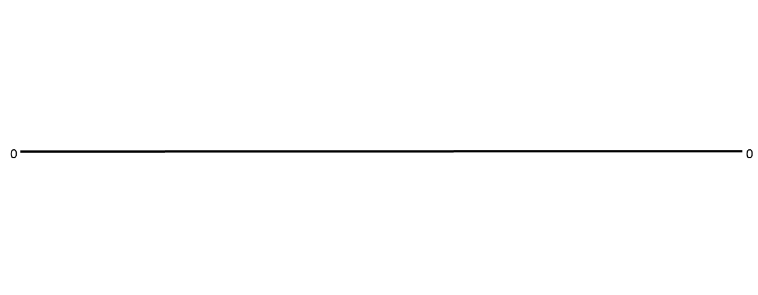
Business Cycles
2021
2022
2020
Phase A - Recovery
Annual Sales are BELOW Year-Ago Levels, but the Rate-of-Decline is SLOWING.
Phase B – Accelerating Growth (Best)
Annual Sales are ABOVE Year-Ago Levels, and are GROWING at a RAPID Pace.
Phase C – Slowing Growth (Caution)
Annual Sales are ABOVE Year-Ago Levels, BUT the Rate-of-Growth is SLOWING
Phase D - Recession
Annual Sales are BELOW Year-Ago Levels, and are DECLINING at a RAPID Pace.

Slide 37
Summary

Slide 38

The Road Ahead
It is important to know where you are relative to the general economic trend
2020 Black Swan-Driven Recession
2021 Recovery and Business Cycle Rise
2022 Backside of the Business Cycle

Slide 39


Stakes in the Ground Regarding the Economic Recovery
Governors don’t shut down their states again
Federal Government does not shut down the country
or otherwise hinder the recovery
5 of our leading indicators are “green” on our dashboard by the end of November
Retail Sales 3/12 Phase B persists through the rest of the year
Single-Family Starts 3/12 rise continues through the rest of the year

Slide 40

@achausovsky

Slide 41
Any Questions?

