Slide 1
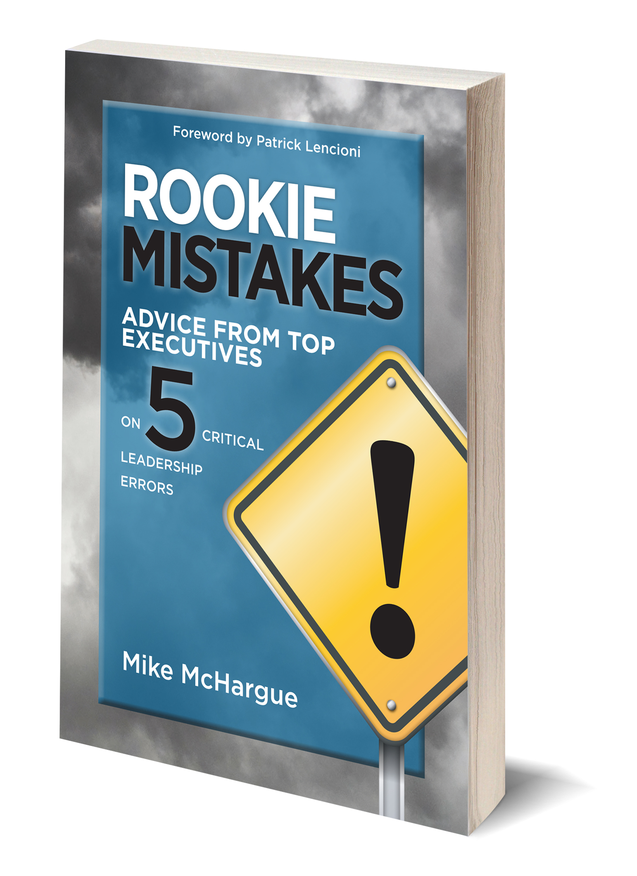
Healthy Organizations, High Performing Teams and Rookie Mistakes
Mike McHargue
Founder and President, Mike McHargue, LLC
Principal Consultant, The Table Group
July 23, 2020

Slide 2

Smart vs. Healthy
Smart
Sales
Marketing
Tools/Tech
Projects
Finance
Healthy
Confusion
Politics
Morale
Productivity
Turnover

Slide 3
THE FOUR
DISCIPLINES
1
2
OF A HEALTHY
ORGANIZATION

Slide 4


Slide 6
THE FOUR
THE SIX CRITICAL QUESTIONS
DISCIPLINES
OF A HEALTHY
1
WHY DO
WE EXIST?
4
HOW WILL
WE SUCCEED?
ORGANIZATION
2
HOW DO
WE BEHAVE?
5
WHAT IS MOST IMPORTANT,
RIGHT NOW?
1
3
WHAT DO
WE DO?
6
WHO MUST
DO WHAT?
2

Slide 7
OVERCMING THE
FIVE DYSFUNCTIONS
THE SIX CRITICAL QUESTIONS
1
WHY DO
WE EXIST?
4
HOW WILL
WE SUCCEED?
THE FOUR
2
HOW DO
WE BEHAVE?
5
WHAT IS MOST IMPORTANT,
RIGHT NOW?
DISCIPLINES
3
WHAT DO
WE DO?
6
WHO MUST
DO WHAT?
1
2
OF A HEALTHY
ORGANIZATION
4
3

Slide 8
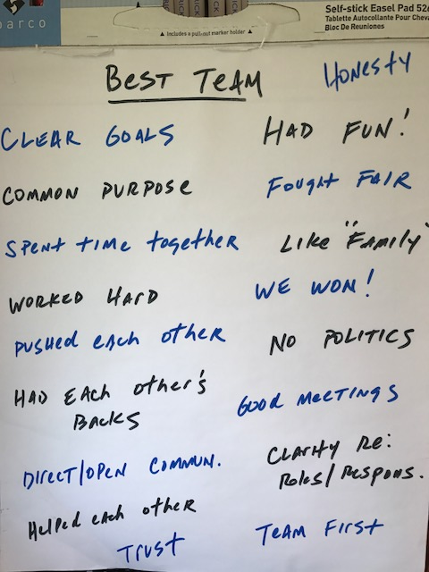
Best Team
What’s the best team you have even been on?
What made that team GREAT?
1
2
4
3

Slide 9
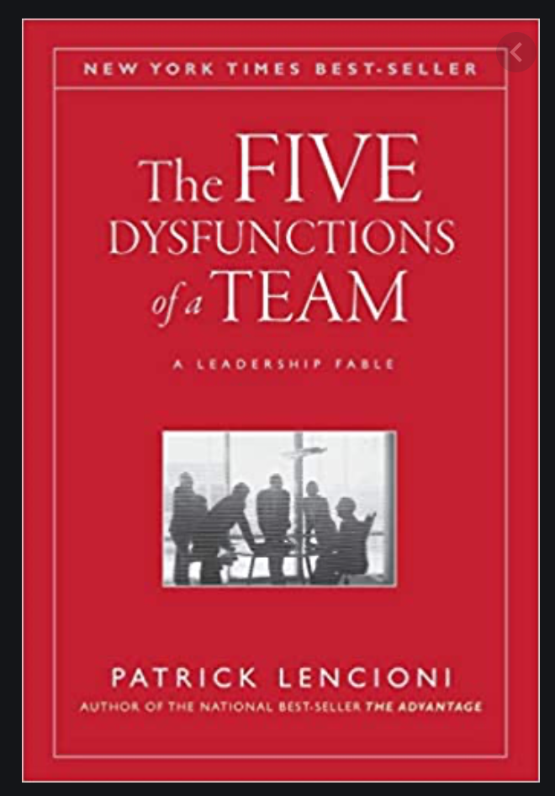
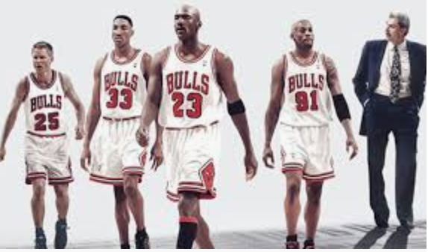



1
WHY DO
WE EXIST?
4
HOW WILL
WE SUCCEED?
2
HOW DO
WE BEHAVE?
5
WHAT IS MOST IMPORTANT,
RIGHT NOW?
3
WHAT DO
WE DO?
6
WHO MUST
DO WHAT?
OVERCOMING THE
FIVE DYSFUNCTIONS
1
2
4
3

Slide 10
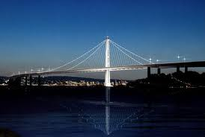
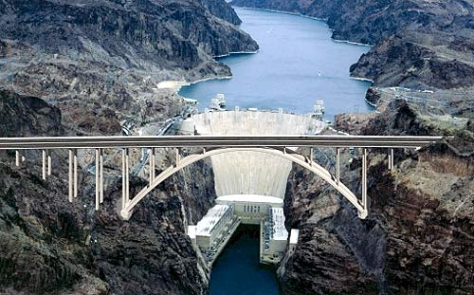
Collective Results
New Bay Bridge Span
Hoover Dam

Slide 11
Five Rookie Mistakes
1
2
3
ALLOWING CONFUSION
FAILING TO CONNECT
TRULY AWFUL MEETINGS
4
5
HIRING FAST, FIRING SLOW
FAILING AT FEEDBACK

Slide 12
Best Leader:
Your best leader?
What made him/her GREAT?

Slide 13
Rookie Mistake Number One: Allowing Confusion
Rookie Mistake #1: Allowing Confusion

Slide 14
THE FOUR
THE SIX CRITICAL QUESTIONS
DISCIPLINES
OF A HEALTHY
1
WHY DO
WE EXIST?
4
HOW WILL
WE SUCCEED?
ORGANIZATION
2
HOW DO
WE BEHAVE?
5
WHAT IS MOST IMPORTANT,
RIGHT NOW?
1
3
WHAT DO
WE DO?
6
WHO MUST
DO WHAT?
2

Slide 15

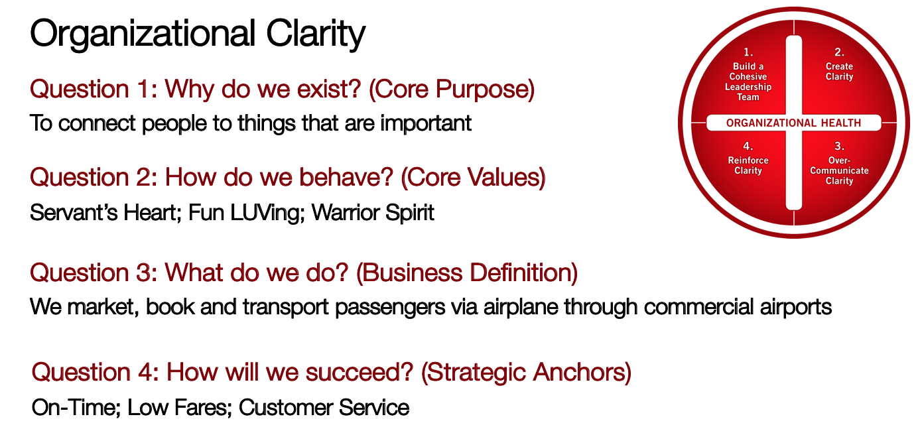

Slide 16
From Allowing Confusion to Insisting Upon Clarity
Answer the Six Clarity Questions
Make sure your leaders know them and own them
Overcommunicate the answers

Slide 17
Rookie Mistake Number Two: Failing to Connect
Rookie Mistake #2: Failing to Connect

Slide 18
1
WHY DO
WE EXIST?
4
HOW WILL
WE SUCCEED?
2
HOW DO
WE BEHAVE?
5
WHAT IS MOST IMPORTANT,
RIGHT NOW?
3
WHAT DO
WE DO?
6
WHO MUST
DO WHAT?
OVERCOMING THE
FIVE DYSFUNCTIONS
1
2
4
3

Slide 19
From Weak Connections to Strong Connections
Be Vulnerable
Personal Histories (leader goes first)
5@5 Personal Recognition

Slide 20
Mistake Number Three: Truly Awful Meetings
Rookie Mistake #3: Truly Awful Meetings

Slide 21
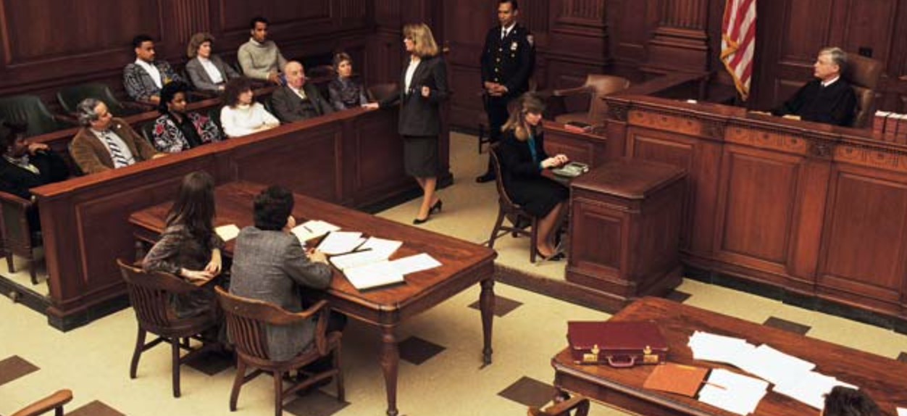

Slide 22


Slide 23
From Truly Awful Meetings to Truly Great Meetings
Start with Clarity
Talk about the Most Important Things
End with Clarity (Discussed, Decided, Who needs to know)

Slide 24
Rookie Mistake #4: Hiring Too Fast/Firing too Slow
Rookie Mistake Number Four: Hiring and Firing

Slide 25



Slide 26
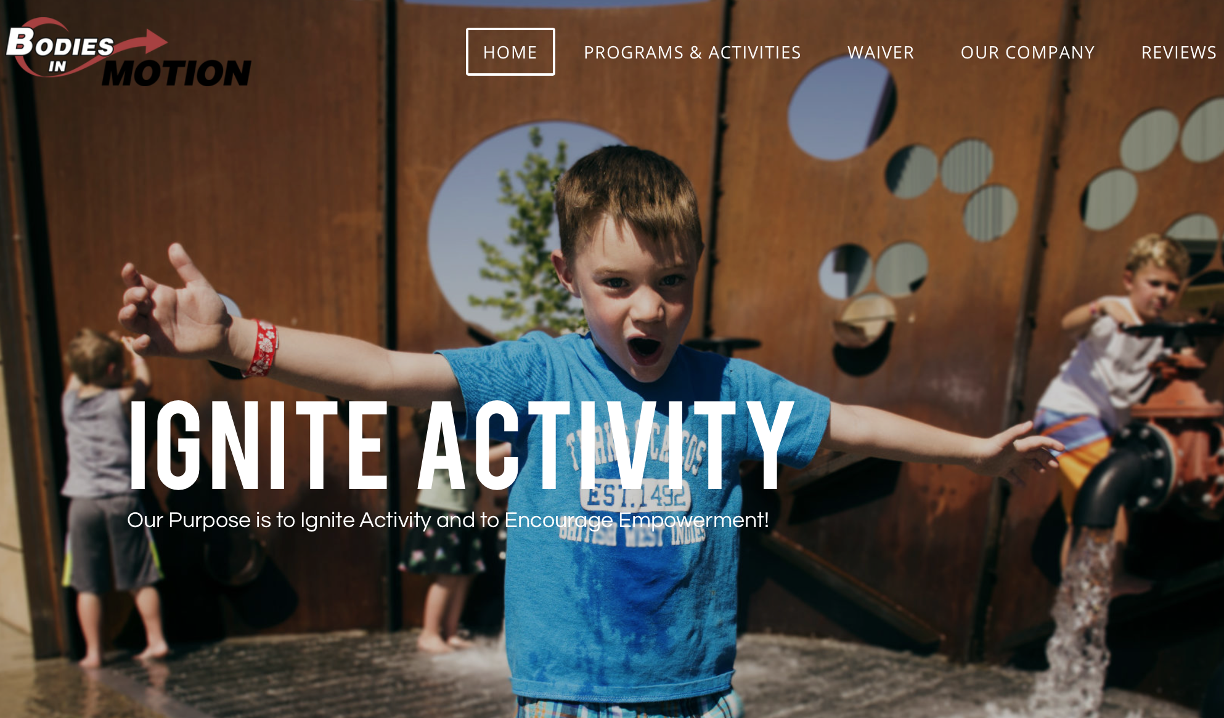

Slide 27
From Hiring Fast/Firing Slow to Hiring Slowly/Firing Faster
Hire with Values and Culture in Mind – no compromises
Use Non-traditional Hiring Methods
Move People out of the business who are not a fit – don’t be a chicken

Slide 28
Rookie Mistake Number 5: Giving and Receiving Feedback
Rookie Mistake #5: Failing to Give & Receive Feedback

Slide 29
From Failing at Feedback to Frequent, Timely Feedback
Practice public rather than private feedback
Insist upon peer to peer feedback
Ask for feedback…

Slide 30
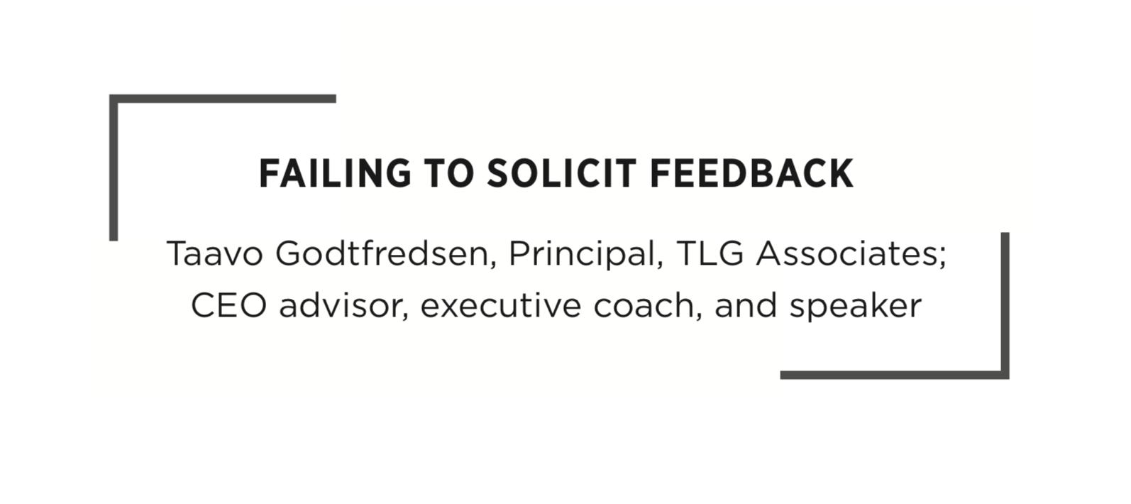

Slide 31
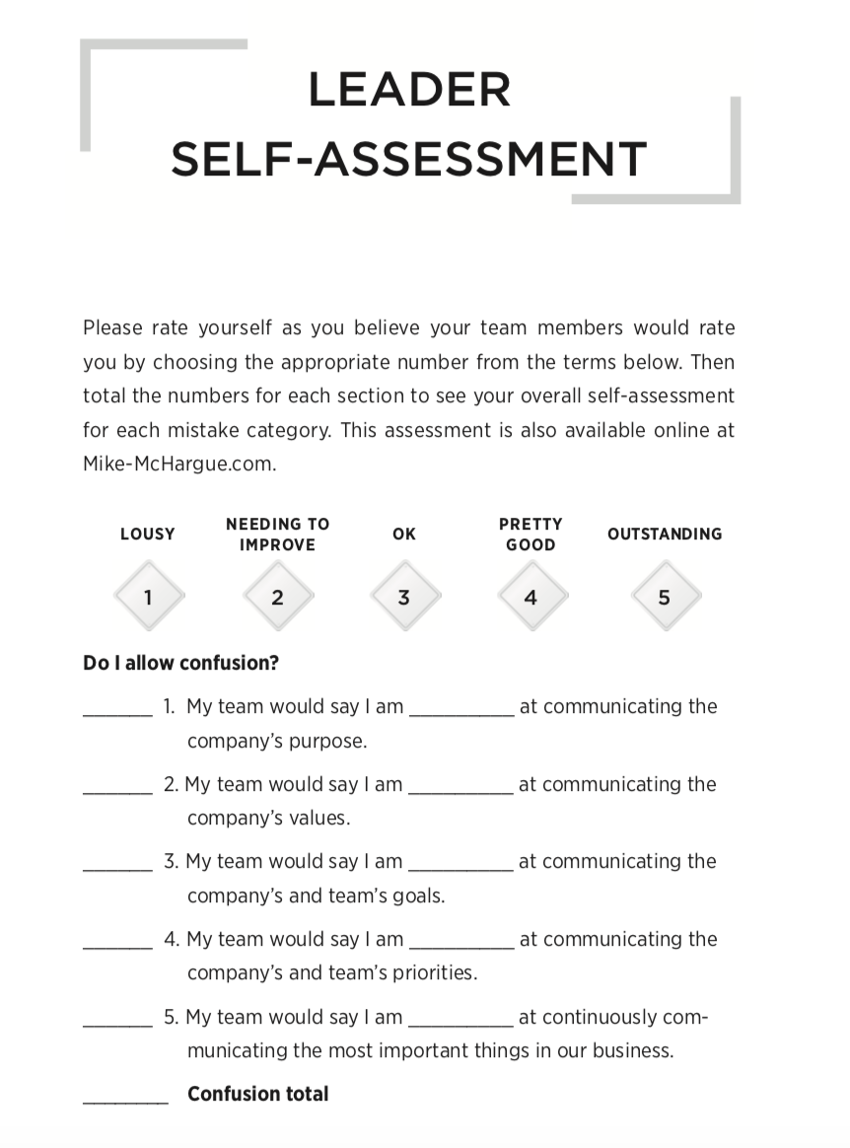
The Rookie Mistakes Self-Assessment (page 167)

Slide 32
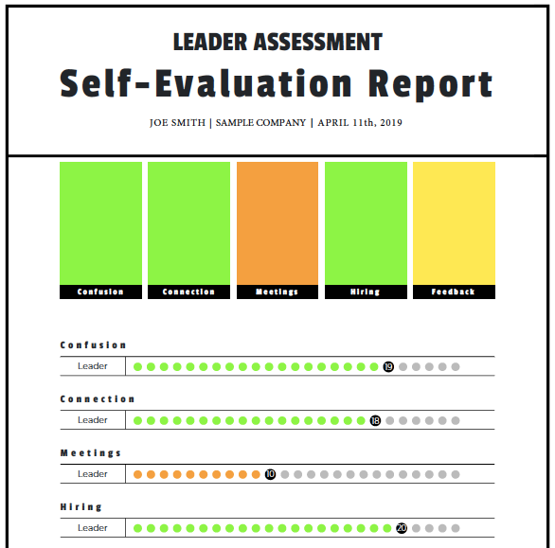
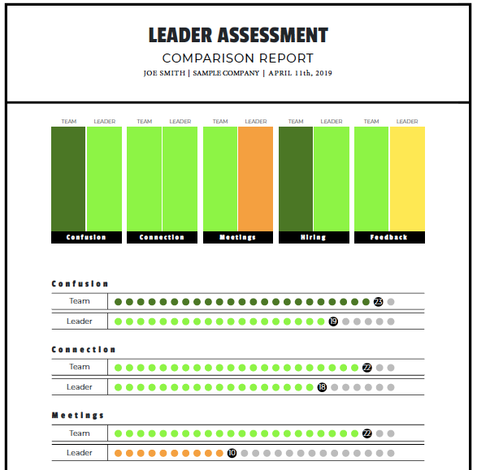
The Rookie Mistakes On-Line Self-Assessment

Slide 33
Five Rookie Mistakes
1
2
3
ALLOWING CONFUSION
FAILING TO CONNECT
TRULY AWFUL MEETINGS
4
5
HIRING FAST, FIRING SLOW
FAILING AT FEEDBACK

Slide 34
Thank you!
Mike McHargue
Founder and President, Mike McHargue, LLC
Principal Consultant, The Table Group
mike.mchargue@tablegroupconsulting.com
mike-mchargue.com

