Slide 1

Presented by : Josh Peterson, CEO
Bering McKinley
Notes:
NOTE – Need a white logo

Slide 2


We know you.
We know your tools.
We know your people.
“you will not find a better wealth of applicable knowledge and the ability to implement those solutions”

Slide 3

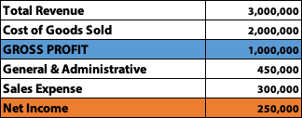
Define Gross Profit
Revenue – Cost of Goods Sold = Gross Profit
Gross Profit – Expenses = Net Profit

Slide 4
We must understand the WHY
of our financials
Why do we have the GROSS profit we have?
    What impacted that number this month/quarter?
    What behavior should we continue?
    What behavior should we correct?
Why do we have the NET profit we have?
    What impacted that number this month/quarter?
    What behavior should we continue?
    What behavior should we correct?

Slide 5
Two primary types of Revenue
Product (includes resold cloud services)
Service
  Project
  Hourly
  Recurring
REVENUE = MONEY IN

Slide 6
Two types of COGS
Product
Service (we might call those Cost of SERVICES Sold)
  Technician salaries
  Dispatch salaries
  Service manager salaries
  Reimbursed mileage
  Portion of the PSA invoice
  RMM
  Other tools
COGS = MONEY OUT

Slide 7
Two types of Gross Profit

Slide 8

Combine and we have
OVERALL GROSS PROFIT
Once we reach this section of the P & L we hit a glass wall. This is the end of the road for mandatory spend and the end of the revenue. What ever is left here is ALL WE HAVE to spend on the two types of expenses.
All these expenses are subject to CHOICE
  Sales Expense
  General and Administrative
Now we can calculate NET PROFIT

Slide 9
Two types of EXPENSES
1. Sales Expense – sales salaries, sales commissions, sales tools, marketing expenses, marketing staff, marketing tools​
2. General and Administrative Expense – Everything else
EXPENSES = MONEY OUT

Slide 10
Real-life Application
Company A sold $800,000 of Product during the trailing 12 months.
Their Cost of Goods Sold was $650,000.
What was their Product Gross Profit Margin?
$800,000 - $650,000 = $150,000 = $150,00/$800,000 = 18.75%
A: 18.75%

Slide 11
Real-life Application
During the same period, Company A sold $1,300,000 of Services.
Their Cost of Goods Sold was $560,000.
What was their Service Gross Profit Margin?
$1,300,000 - $560,000 = $740,000 = $740,000/$1,300,000 = 56.9%
A: 56.9%

Slide 12
Real-life Application
What was Company A’s overall GP Margin?
(Service GP + Product GP) / Service Revenue + Product Revenue
$150,000 + $740,000 / $1,300,000 + $800,000 = $890,000/$2,100,000 = 42%
A: 42%

Slide 13
Define a Target
What is it today?
What has the trend been for the last 36 months?
How does Net Profit trend compare to your Gross Profit
  Don’t be fooled, they are not perfectly correlated. You can make CHOICES in Sales and General Expenses to change out come of Net Profit
Depending on your CHOICES in S G & A, you will select different GP targets

Slide 14
How to define the target
Know what it is today
Know how to consistently report
SET A NET PROFIT TARGET
Work your way UP the P & L ladder
Identify your G & A percentage of revenue spend
Identify your Sales Expenses percentage of revenue spend
Add those 3 numbers together, that is your Gross Profit TARGET

Slide 15
Real-life Application
Company A has a goal of achieving 15% Net Profit.
Over the last 12 months they have been spending 21% of revenue on G & A Expenses.
Over the same period they spent 7% of revenue on Sales Expenses.
What Gross Profit Target must Company A achieve in order to meet their Net Profit goal?
A: 43% (15%+21%+7%)

Slide 16
So why is GROSS PROFIT King?

Slide 17
  Gets to the core of your effectiveness in converting resources into profit
  If you can’t achieve a high level of effectiveness you won’t be able to “save your way to profitability”
  Gross Profit is the RETURN on your investment
    You’re going to invest in product, can you convert that to reasonable rate of return
    You’re going to invest in personnel, can you convert that spend into profit?
  Is not subject to your temporary shifts in spending patterns
    Having sales people or no sales people
    Spending on amazing class A office space or not
    Running personal expenses through the business or not

Slide 18

When Bering McKinley is hired to review your business for acquisition, we start RIGHT HERE.
If you can’t achieve 43% or greater in overall GPM we know we are going to be discounting your offer price

Slide 20
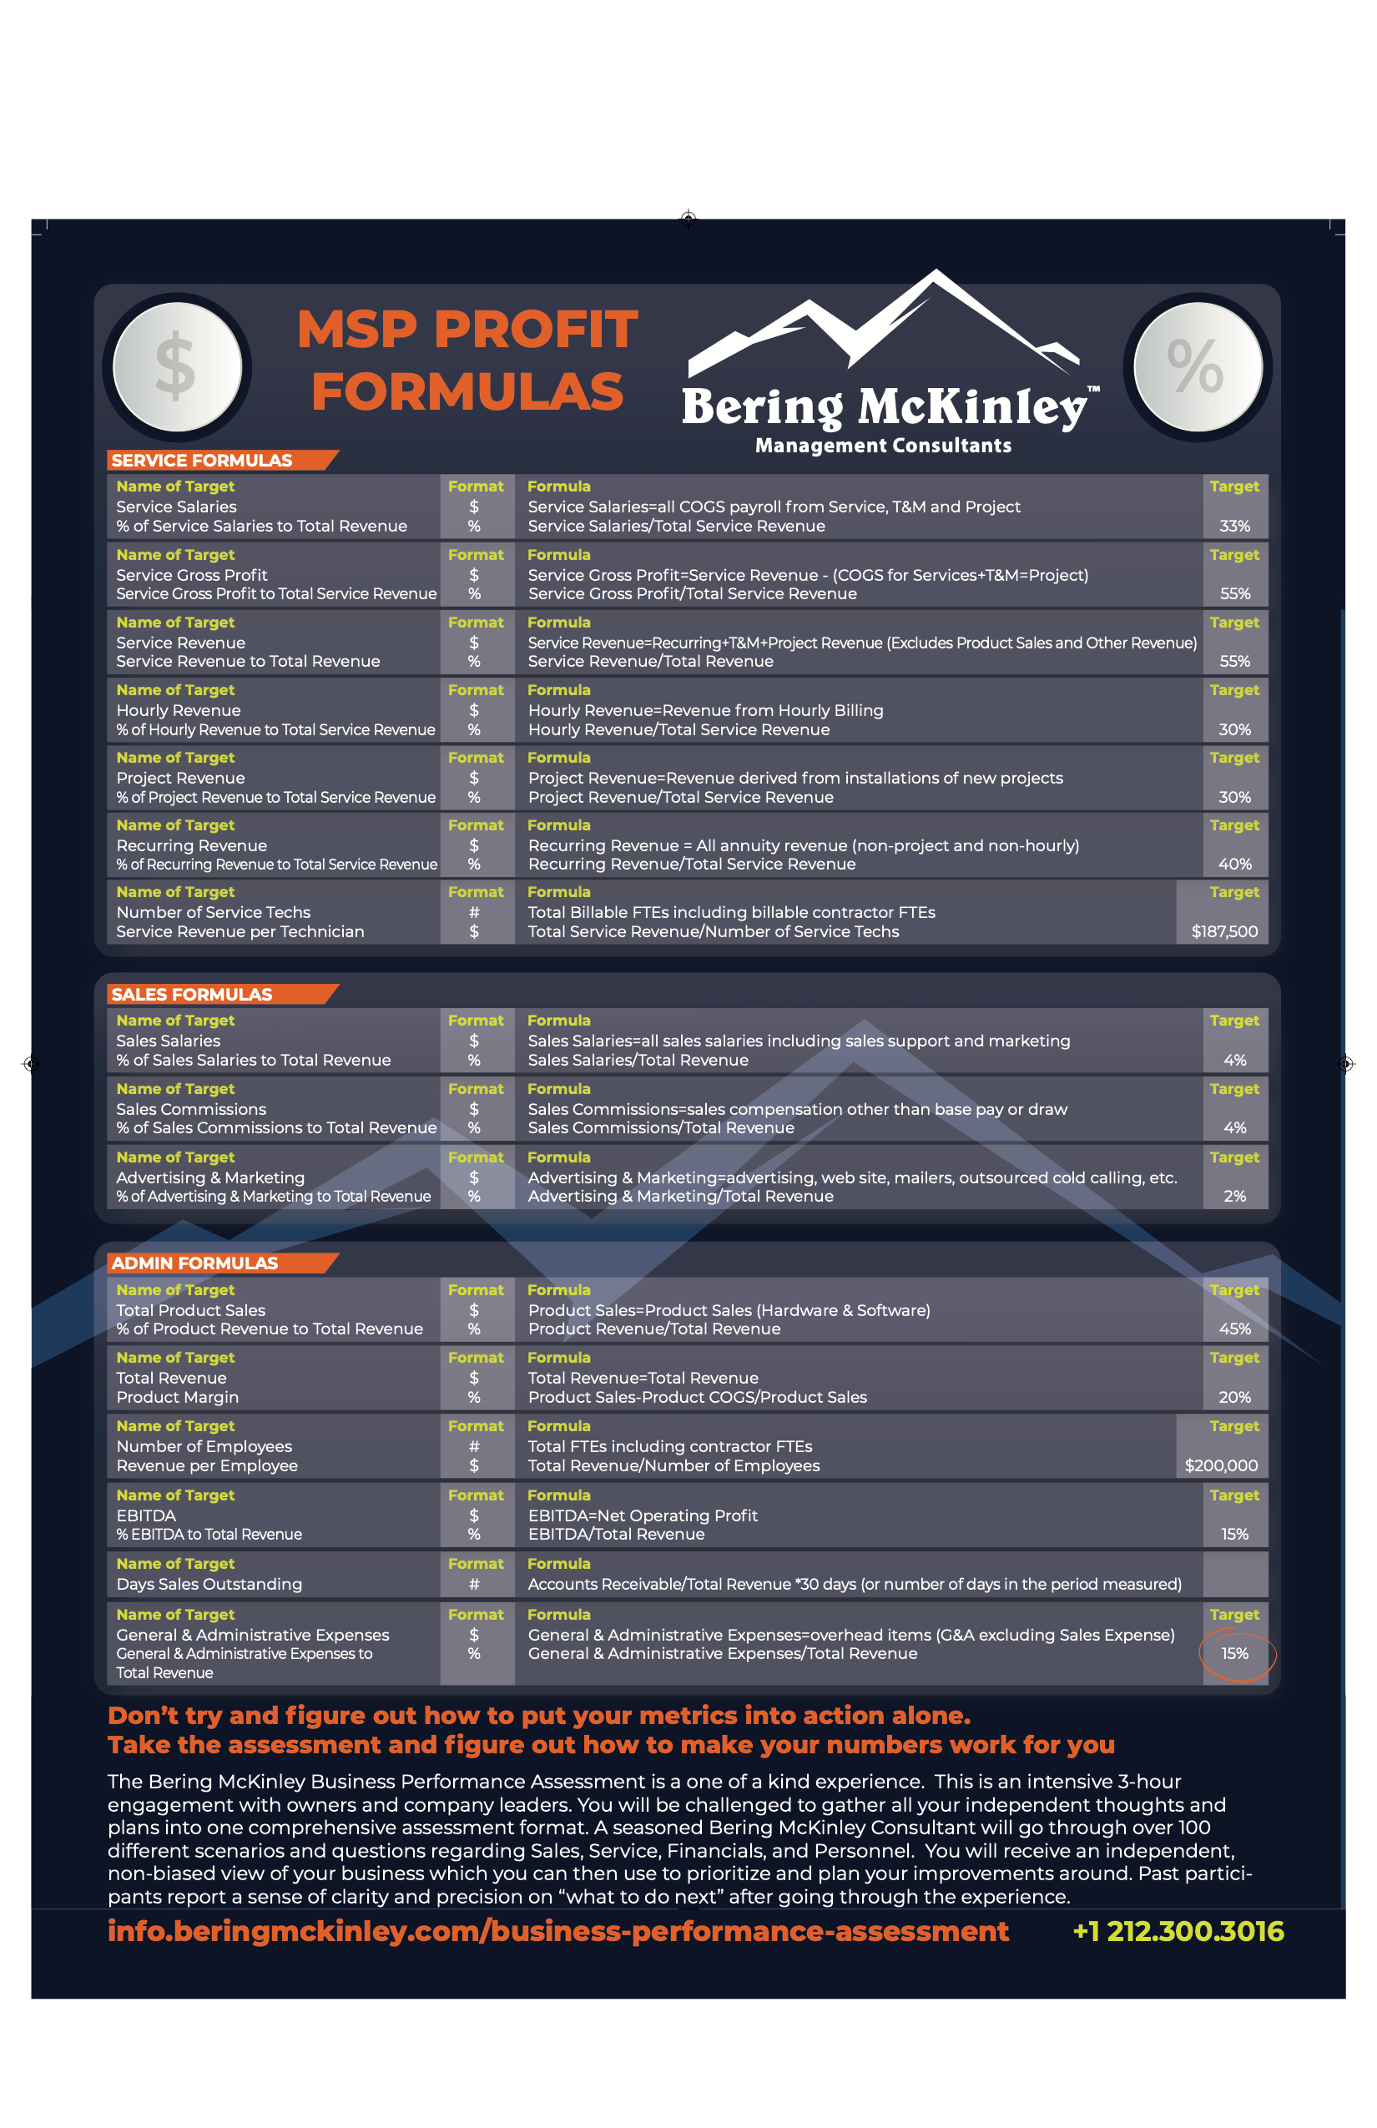
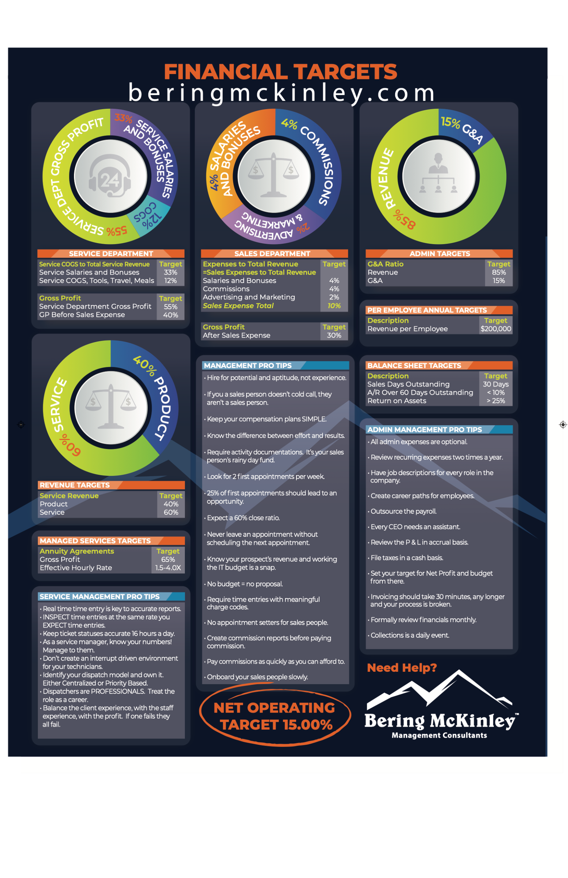

Slide 21


