Slide 1


2020 Survey Results
July 2020
JOHN HEY TODD JOHNSON

Slide 2

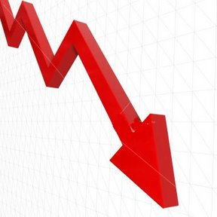
THE NEW NORMAL ???
The only constant is change
All of business is about making changes before changes are shoved down your throat.
The NEXT Normal

Slide 3
2020 Benchmark Model
Presented by
July 2020

Slide 4
2020 MFP PROFITABILITY MODEL
MIX of Sales 48% 18% 32% 2%
Category
Sales
- Cost of Goods
= Gross Profit
- Sales Exps
= Contribution
- Admin / Overhead
= Operating Profit
Service
100.0%
(45.0%)
55.0%
(0.0%)
55.0%
(17.2%)
37.8%
Rental
100.0%
(50.0%)
50.0%
(0.0%)
50.0%
(17.2%)
32.8%
TOTAL
100.0%
(51.9%)
48.1%
(16.3%)
31.7%
(17.2%)
14.5%
Hardware
100.0%
(54.0%)
46.0%
(34.0%)
12.0%
(17.2%)
(5.2%)
Supplies
100.0%
(59.0%)
41.0%
(0.0%)
41.0%
(17.2%)
23.8%
Weighted Profit (2.5%) 4.3% 12.1% 0.67% 14.5%

Slide 5
2020 MPS PROFITABILITY MODEL
MIX of Sales 6% 61.1% 32.9% 0%
Category
Sales
- Cost of Goods
= Gross Profit
- Sales Exps
= Contribution
- Admin / Overhead
= Operating Profit
Service
100.0%
(37.0%)
63.0%
(16.0%)
47.0%
(17.2%)
29.8%
Rental
TOTAL
100.0%
(52.4%)
47.6%
(16.0%)
31.6%
(17.2%)
14.4%
Hardware
100.0%
(80.0%)
20.0%
(16.0%)
4.0%
(17.2%)
(13.2%)
Supplies
100.0%
(58.0%)
42.0%
(16.0%)
26.0%
(17.2%)
8.8%
Weighted Profit (0.8%) 5.4% 9.8% 0.0% 14.4%

Slide 6
2020 MFP / MPS COMBO (80/20 Blend)
SBA Recommended Default!
MIX of Sales 39.6% 26.6% 32.2% 1.6%
Category
Sales
- Cost of Goods
= Gross Profit
- Sales Exps
= Contribution
- Admin / Overhead
= Operating Profit
Service
100.0%
(43.4%)
56.6%
(16.3%)
40.3%
(17.2%)
23.1%
Rental
100.0%
(50.0%)
50.0%
(16.3%)
33.7%
(17.2%)
16.5%
TOTAL
100.0%
(52.0%)
48.0%
(16.3%)
31.7%
(17.2%)
14.5%
Hardware
100.0%
(54.8%)
45.2%
(16.3%)
28.9%
(17.2%)
11.7%
Supplies
100.0%
(58.5%)
41.5%
(16.3%)
25.2%
(17.2%)
8.0%
Weighted Profit 4.6% 2.1% 7.4% 0.3% 14.5%

Slide 7
2020 MFP / MPS COMBO (80/20 Blend)
SBA Recommended Default!
MIX of Sales 39.6% 26.6% 32.2% 1.6%
Category
Sales
- Cost of Goods
= Gross Profit
- Sales Exps
= Contribution
- Admin / Overhead
= Operating Profit
Service
100.0%
(43.4%)
56.6%
(16.3%)
40.3%
(17.2%)
23.1%
Rental
100.0%
(50.0%)
50.0%
(16.3%)
33.7%
(17.2%)
16.5%
TOTAL
100.0%
(52.0%)
48.0%
(16.3%)
31.7%
(17.2%)
14.5%
Hardware
100.0%
(54.8%)
45.2%
(16.3%)
28.9%
(17.2%)
11.7%
Supplies
100.0%
(58.5%)
41.5%
(16.3%)
25.2%
(17.2%)
8.0%
Weighted Profit 4.6% 2.1% 7.4% 0.3% 14.5%

Slide 8
2020 Survey Summary
Presented by
July 2020

Slide 9
2020 UNIVERSE DATA
  135 Dealers Completed Surveys - $2.93B
  2020 Size Groups:
  24 - Group A Dealers (Rev below $5 Million)
  51 - Group B Dealers (Rev $5–$12 Million)
  30 - Group C Dealers (Rev $12–$25 Million)
  11 - Group D-1 Dealers (Rev $25-$40 Million)
  9 - Group D-2 Dealers (Rev $40-$70 Million)
  10 - Group D-3 Dealers (Rev $70+ Million)
  32 – Imaging High Profit Dealers (>14%)
  26 – Imaging High Revenue Growth Dealers (>10%)
  16 – MNS/IT High Profit Dealers (>7%)

Slide 10
INDUSTRY DATA ORGANIZATION
Imaging – 86.8%
  Traditional MFP business – 85.5%
  Managed Print Services – 14.5%
Managed Network Services / IT – 9.9%
  Hardware / Software / Other products
  Insourced or Outsourced Managed IT Services
  Traditional IT Service & Support
Other – Furniture, Water, Office Supplies, Internal Leasing, etc. – 3.3%

Slide 11
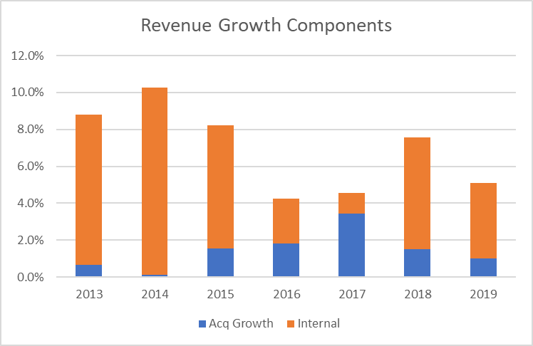
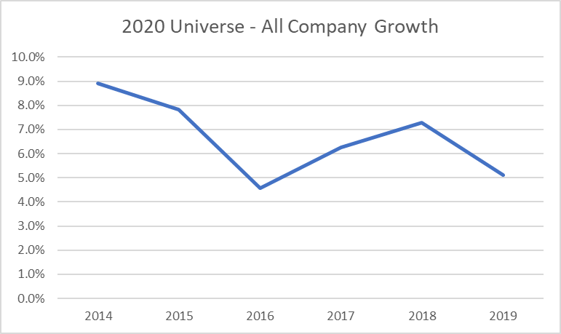
Survey Revenue Growth

Slide 12
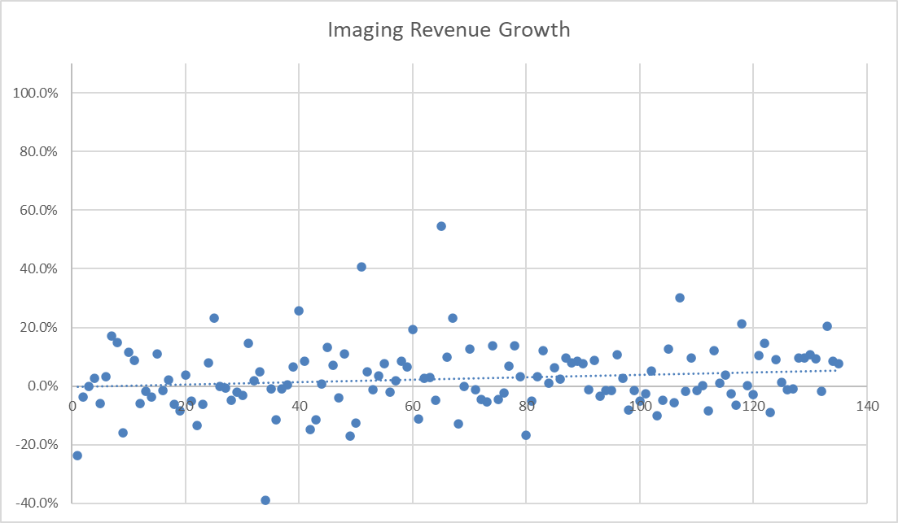
2020 UNIVERSE KEYS

Slide 13
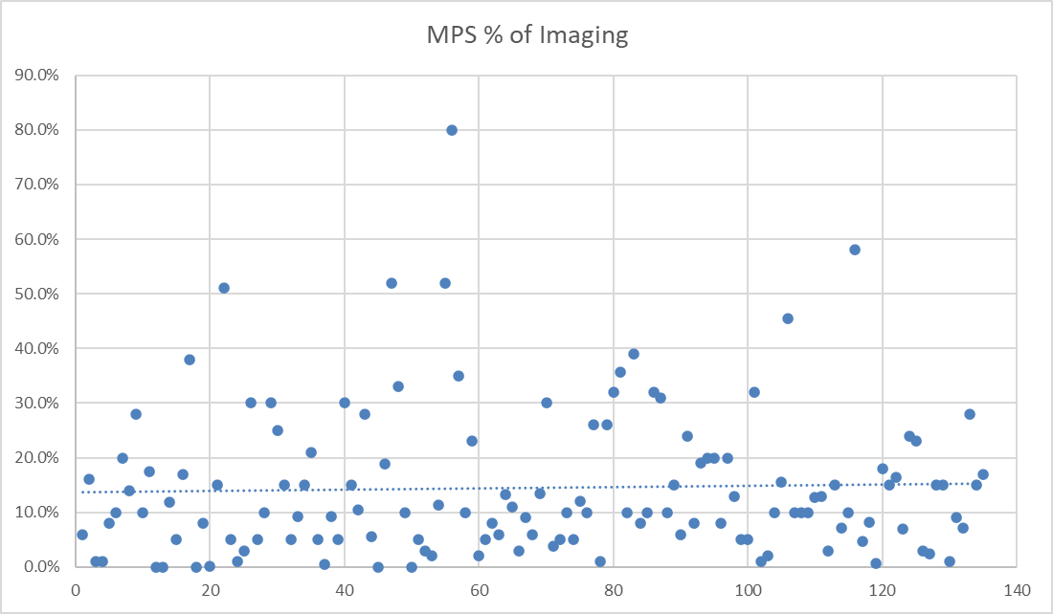
2020 UNIVERSE KEYS

Slide 14
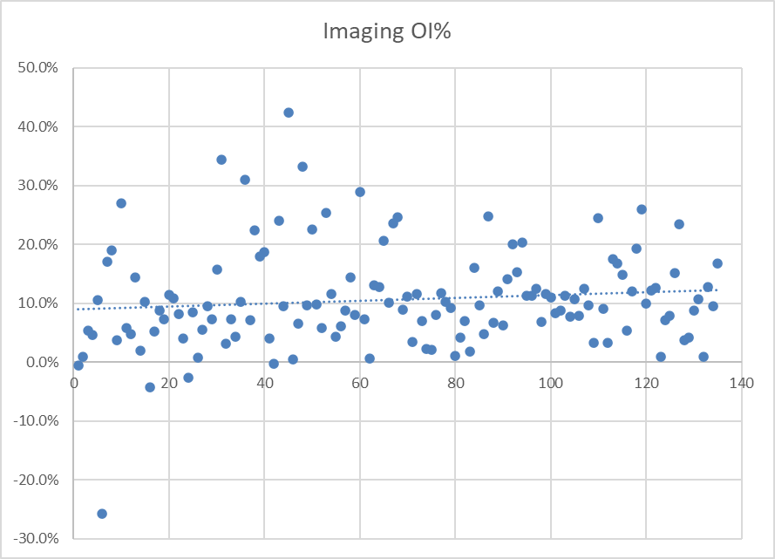
2020 UNIVERSE KEYS

Slide 15
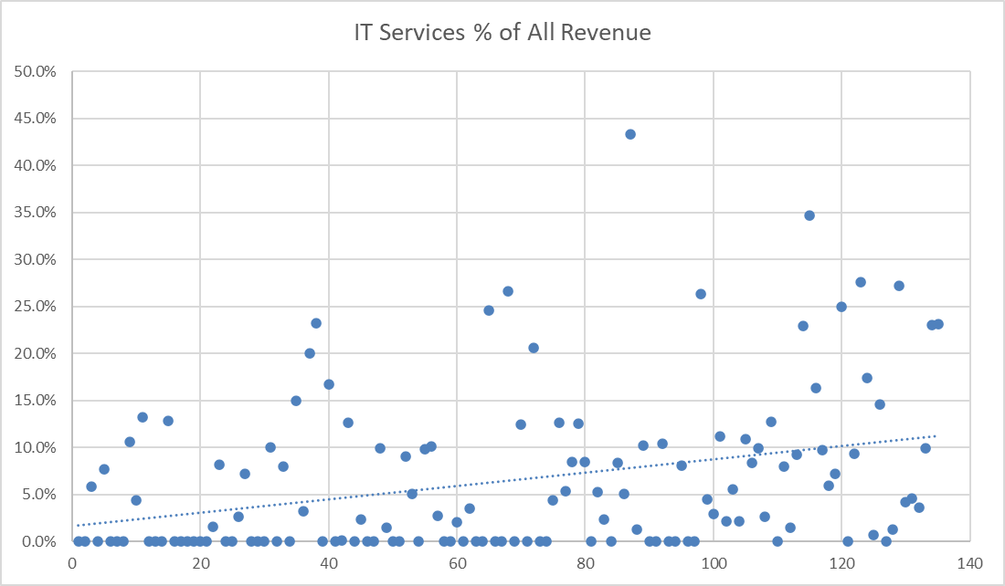
UNIVERSE KEYS

Slide 16
2020 UNIVERSE SURVEY MISC
Still plenty of Acquisition Activity
22 dealers (16%) reported 39 acquisitions with $52M in combined run rate revenues.
  Avg deal even smaller than last year at $1.3M in sales.
  Most were same product line.
  Almost all were asset purchases.
  Valuation techniques still all over the board.
  13 other acquisitions attempted or not finished during the year.

Slide 17
2020 UNIVERSE SURVEY MISC
SALES REP COMPENSATION STRATEGY
Salaries – 98%, (25% of those recoverable = draw)
Draw/Comm – 40% have this too (generally top perf)
Entry level salary $35K
Avg monthly quota for basic Geo rep - $36,600
Comp plan mechanisms:
  % of Eq GP 94% Bundling bonus 31%
  % of Eq Rev 63% Net New bonus 81%
  % of Aftrmkt Rev 34% Out of Territory penalty 33%
  % of Aftrmkt GP 12% Solutions bonus 31%
  Annuity type 18% Lease term bonus 29%
  Quarterly Bonus 67% Below Pub Svc penalty 62%
  Annual Bonus 45% Volume Band bonus 8%

Slide 18
2020 CDA GROUP
  55 CDA Dealers Submitted Surveys
  2020 CDA Size Groups:
  6 - Group A Dealers (Rev $0–$5 Million)
  15 - Group B Dealers (Rev $5–$12 Million)
  12 - Group C Dealers (Rev $12–$25 Million)
  22 - Group D Dealers (Rev over $25 Million)
  13 - High Profit Dealers
  Imaging Op Income > 14.5%

Slide 19
IMAGING REVENUES
Imaging still 87% of our business (Universe)
CDA Imaging rev up $67 million or 4.5%
23 of 55 (42%) reported decreasing imaging revenue
9 dealers reported double digit increases
4 dealers reported double digit decreases
Separation of Performance Continues or “Haves” and “Have Nots”

Slide 20
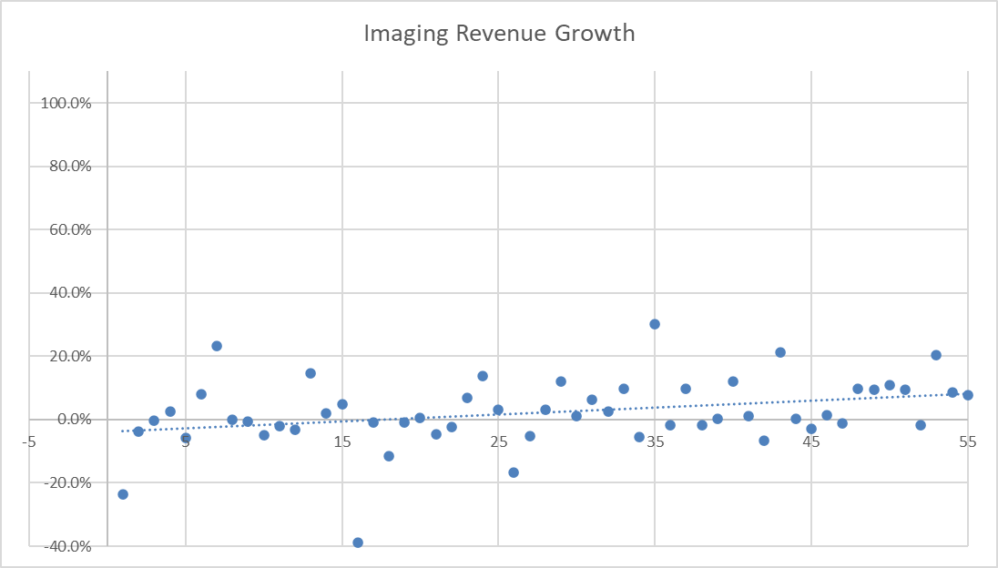

Slide 21
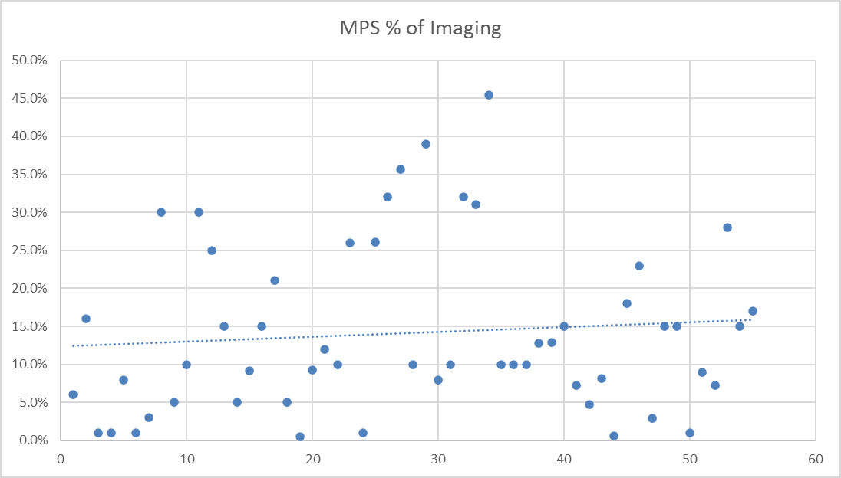
IMAGING REVENUES
Still an opportunity for many of us

Slide 22
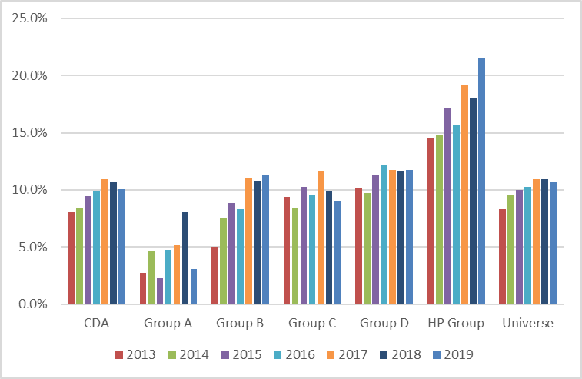
IMAGING OPERATING INCOME

Slide 23
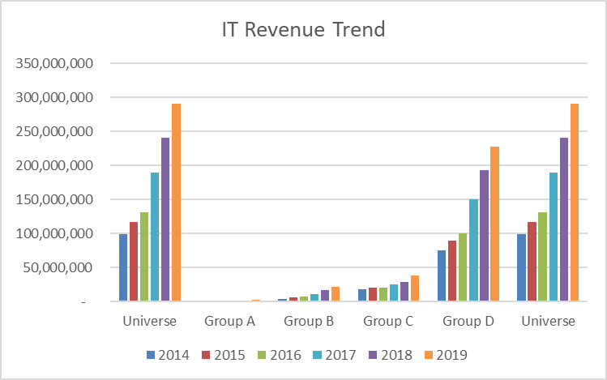
MEASURING MANAGED SERVICES – (U)

Slide 24
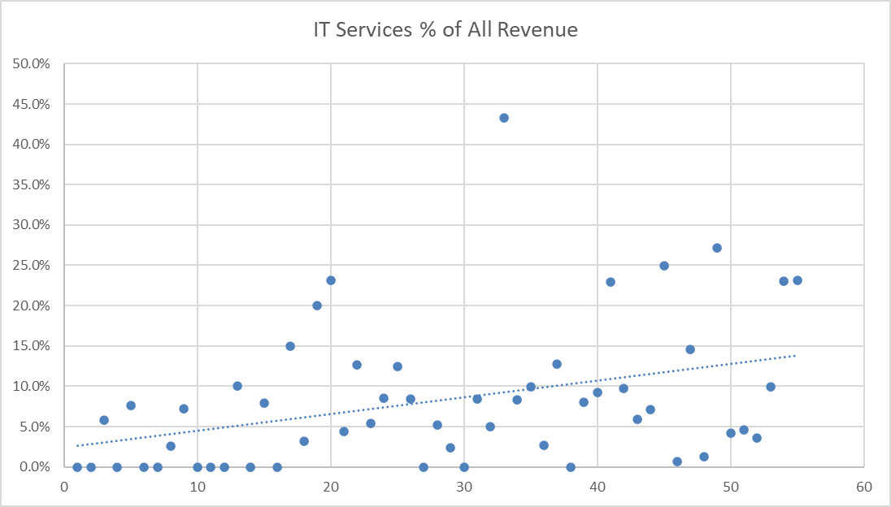
MEASURING MANAGED SERVICES - CDA

Slide 25
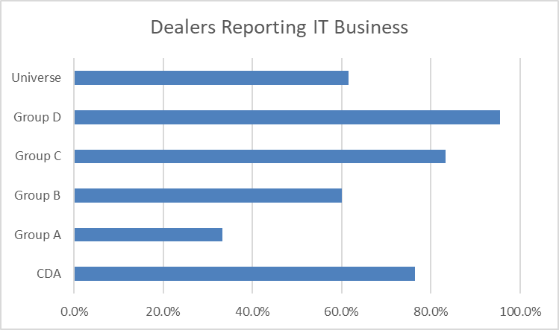
MEASURING MANAGED SERVICES - CDA

Slide 26
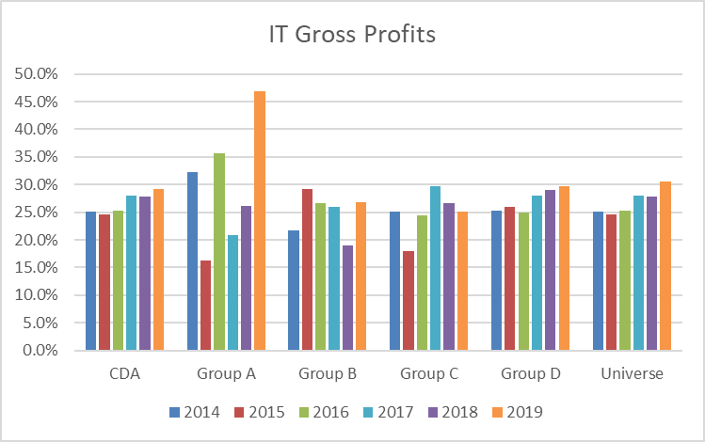
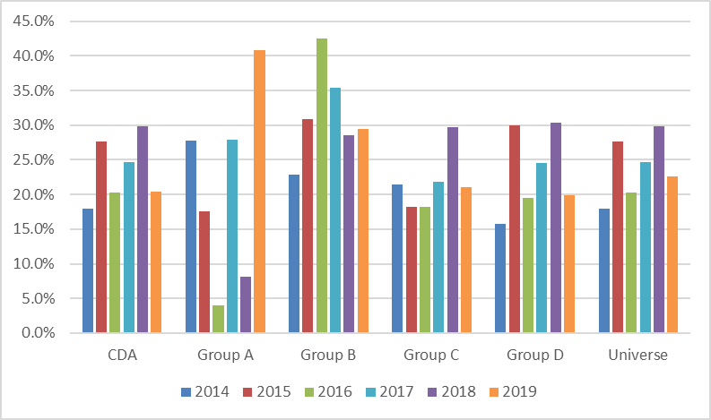
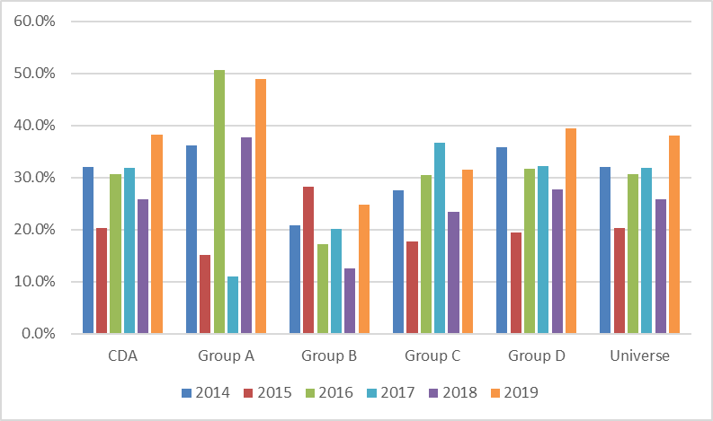
Universe Trends
Product Trend
Service Trend

Slide 27
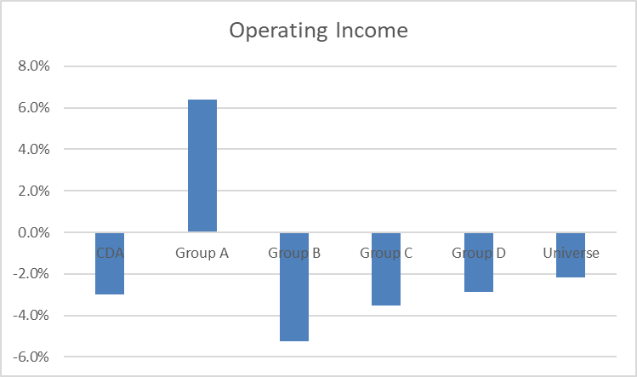
MEASURING MANAGED SERVICES-CDA

Slide 28
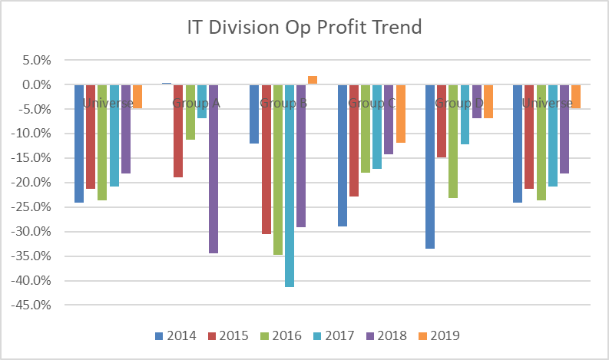
MEASURING MANAGED SERVICES-(U)

Slide 29
COMPENSATION SURVEY NOTES
  130 Companies, 11,550 Employees
  90 Positions, 4 comp types each
  Sorted by Dealer Size Groups including split out of D company subsets
  Sorted by Geography
  Sorted by Market Type
  2 different views of the Universe Totals…

Slide 30
2020 Survey
Profitability Focus Areas
Presented by
July 2020

Slide 31
PROFITABILITY DRIVERS
Imaging:
Equip GP
Aftmkt GP
Sales Exp
Admin Exp
Avg Rev
Avg Op Inc
MNS/IT:
Product GP
Service GP
Sales Expense
Avg Rev
Avg Op Inc
Univ HP
51.4%
50.5%
14.8%
16.0%
$20.4M
20.1%
27.7%
47.0%
8.6%
$1.1M
15%
Universe
44.2%
45.3%
15.5%
18.5%
$18.9M
11.0%
22.6%
38.1%
13.9%
$3.5M
-2.2%
CDA
44.1%
44.8%
15.9%
18.3%
$28M
10.5%
20.4%
38.2%
13.7%
$5.0M
-3.0%
1% impr = $82m
.5% impr = $7.7m
2% impr = $2m

Slide 32
IMAGING AFTERMARKET METRICS
Aftrmkt:
Rev/MIF/Mth
Tot Rev/Svc EE
Aftm Rev/Svc EE
COGS
Supplies
Comp
Parts
Auto
Training
Total
GCPD
NCPD
Tech Acct Time
Clicks/Tech/Mth
Univ HP
$98.26
$660K
$345K
18.8%
16.6%
11.6%
1.6%
1.0%
49.5%
4.2
3.2
83.6%
1,739K
Universe
$83.07
$564K
$304K
23.9%
17.3%
10.2%
1.9%
1.5%
54.7%
3.9
3.0
76.1%
1,755K
CDA
$82.68
$549K
$292K
24.8%
17.2%
10.0%
1.7%
1.5%
55.2%
3.9
3.1
76.6%
1,828K
Revenue seems to be a significant contributor, not only from average but from the opportunity. Why?
Supplies costs trail the average and the HP group significantly. Why?

Slide 33
FIXED vs VARIABLE COSTS
PROFITS

Slide 34
FIXED vs VARIABLE COSTS

Slide 35
FIXED vs VARIABLE COSTS

Slide 36
Acquisition Environment
And the New Normal
Presented by
July 2020

Slide 37
ACQUISITION LANDSCAPE - Old Normal
We were already at the back half of an extended peak in cyclical acquisition activity through February 2020
Revenue Transfer to Independent Dealers is an opposing cycle at a low (From Manufacturers)
Private Equity has been driving much of the activity, but not higher valuations
Independent Dealers were desirable because:
  High Profits = Strong cash Flow
  Recurring Revenues = Predictable returns
  Strong Customer Relationships = Tangent business growth opportunities

Slide 38
ACQUISITION LANDSCAPE - New Normal
Stutter in acquisition cycle:
  Uncertainty for future of Imaging?
  What portion of volume drop off will be permanent?
  How to value with confidence?
Private Equity re-evaluating:
  Will the planned returns be achievable?
  Finish build to critical mass OR sell and move on?
  Who will they sell to?
  Makes more sense to merge?

Slide 39
ACQUISITION PLAYERS - Consolidators
VISUAL EDGE – Privately funded
FLEX TECHNOLOGIES GROUP – Oval Partners
MARCO – Norwest Equity Partners
UBEO – Sentinel Capital Partners
NOVATECH – Trivest Partners

Slide 40
ACQUISITION PLAYERS - Corporate
DEX– Staples
Xerox Business Services – Xerox
SHARP – Foxconn
Konica Minolta
Toshiba
Kyocera

Slide 41
ACQUISITION PLAYERS - Dealer
INDEPENDENT DEALERS
Together represent more transactions than all other buyers combined.
Supplement growth challenges
Geographic expansion
Eliminate low tier players
Using Seller financing / Augmented by manufacturers
Often small companies
POA, ImageNet, Loffler, RJ Young, Gordon Flesch, Kelley, Atlantic, etc.

Slide 42
ACQUISITION VALUATION TRENDS
Multiple of 2019 Earnings might be referenced but will not be basis of value.
‘Clearly everyone’s value is impaired in the new normal. If our value is lower, so is the value of target acquisitions.’ – PE Buyer
For the near term (balance of 2020):
  Values to be more forward looking than historical based
  Buyer to take ‘virus impacted’ months and extrapolate forward
  Multiple scenarios and assumptions to develop forecasts
  Monkey throws some darts / Magic 8 Ball
  Reasonable (but conservative) offer based on those
  Type of service contracts will make a big difference (no mins vs. base + overage)

Slide 43
2020 Survey
Leadership / Culture
Presented by
July 2020

Slide 44

STRATEGIC THINKING
Vision
Mission
Culture
Financial Model
Implementation
Accountability
Continuous Improvement
Leadership

Slide 45

CLIENT SERVICE CULTURE
The Purpose of Business
Client Focused Behavior

Slide 46

MISSION
A shared set of values that get reflected in behavior and under the best of circumstances further everyone’s pursuit of a common goal.

Slide 47

CULTURE
Everyday behavior
How people treat each other
How people treat the client
Life and work have meaning
Shared Values

Slide 48
HIGH PERFORMING CULTURES
ABC’s
Activating Event
Beliefs
Consequences
Feelings
Behavior

Slide 49
HIGH PERFORMING CULTURES
Beliefs (feelings = behavior)
In business to serve clients Failing forward – a learning team Collaborative work environment Action oriented Preserve and protect the aftermarket Cost per page/month Sharing information – The Model Profit – The purchase of future employment

Slide 50

STRATEGIC THINKING
Vision
Mission
Culture
Financial Model
Implementation
Accountability
Continuous Improvement
Leadership

Slide 51
LEADERSHIP – WHY PEOPLE WORK
Cause
Leader
Money

Slide 52

Great Place to Work Institute
Founded in 1980
Worldwide research indicates that the quality of a workplace rests on the strength of relationships, and at the very best workplaces, relationships are grounded in TRUST.

Slide 53


Trust Busters
Seven Behaviors that Break Trust
  Gossip – speaking ill
  Judging – assuming vs. questioning
  Negativity – half full
  Complaining – viral misery
  Excuses – the blame thrower
  Lying - exaggeration
  Dogmatic – confusing opinion with fact

Slide 54

FINAL THOUGHTS
Journey vs. Destination
Money
Four Keys to Happiness
Capture the Opportunity

Slide 55
2020 Survey Review
Final Thoughts
Presented by
July 2020

Slide 56

GOOD PERFORMANCE IS:
Not Based on:
  Size
  Product line
  Geography
  Location
Based on:
  Management skill
  Exceptional leadership
  High capacity teams and people

Slide 57
QUESTIONS
DISCUSSION
THANK YOU
Presented by
July 2020

