Slide 1


THE RULES HAVE CHANGED
Bob Goldberg
bob.goldberg@sfnr.com
847/226-3254

Slide 2

CLICKS ON VACATION IN DEALERSHIPS
Business Has Changed and You Must Too!
This Photo by Unknown Author is licensed under CC BY-SA

Slide 3

MARKETPLACE
End Users Business Changes
Remote Workers
Digital Communications
Reliance On Relationships
End User Survey/Census
Address “Way End User Works”
Physical Locations Risky
Reduced Clicks Accelerated
Devices v. Workflow Solutions

Slide 4

PARADIGM SHIFT
Reducing Costs
Specialized Training
Problem Solving
Will OEM’s Need You?
Employee Compensation
Unaffected Verticals
Telemarketing

Slide 5

REOPENNING
OSHA-Safe Work Environment
Safety-Workers, Customers, Vendors
Hazard Assessment
Appoint A Point Person
OSHA 3 Phases For Opening
Outbreak-3 Confirmed 2 Week
Temperature Checks
Diagnosis Confidential Medical Info-ADA
Protocol Following Positive
Communicate Terms Opening
Stay Home With Symptoms
Personal Protection Equipment
Hand Washing
Guidelines: OSHA, EEOC, SBA, CDC

Slide 6

WORKPLACE
Hygiene, Distancing, Identify and Isolate Sick Employees, Controls, Training
Teleworking
Shields/Partitions
Limit Number Returning
Frequent Cleaning
Enhanced Cleaning After Positive
Employee Health
Temperature Screening (100.4)
Daily Questionnaires/Symptoms/Contacts
High Risk Employees
Privacy/Confidentiality/Separate
Do Not Disclose Infected Individuals
Refuse Screening-PTO/Sick/Vacation
No Retaliation/Discrimination Re Concerns
Families First Coronavirus Response Act-School/Camp- 10 of 12 Weeks

Slide 7

POSITIVE RESULT
Business Close Contacts-14 Days
Areas Worked
Incubation Period 14 Days
Do Not Disclose Identity
Contact Each Co-Worker Exposed
Contact Local Health Department
Notify OSHA
Advise Last Day In Workplace
Not Obligated To Notify Customers
Deep Sanitization
Not Required To Shutdown
Contact Trace (15 Minutes)
Fitness For Duty/Return To Work

Slide 8

NOTIFICATION
Employee Notification
Customer Notification--Advise you have closely followed CDC requirements. Anyone with symptoms has been sent for testing. Anyone testing positive has remained at home and quarantined. You provide Personal Protection Equipment, Social Distancing, and exceed all standards.
Review Employee Policies
  Sick Leave, Family Leave,
  Teleworking, Vacation Leave, Reporting Illness
Monitor Daily For Official Updates, “Opening Up America Again”

Slide 9
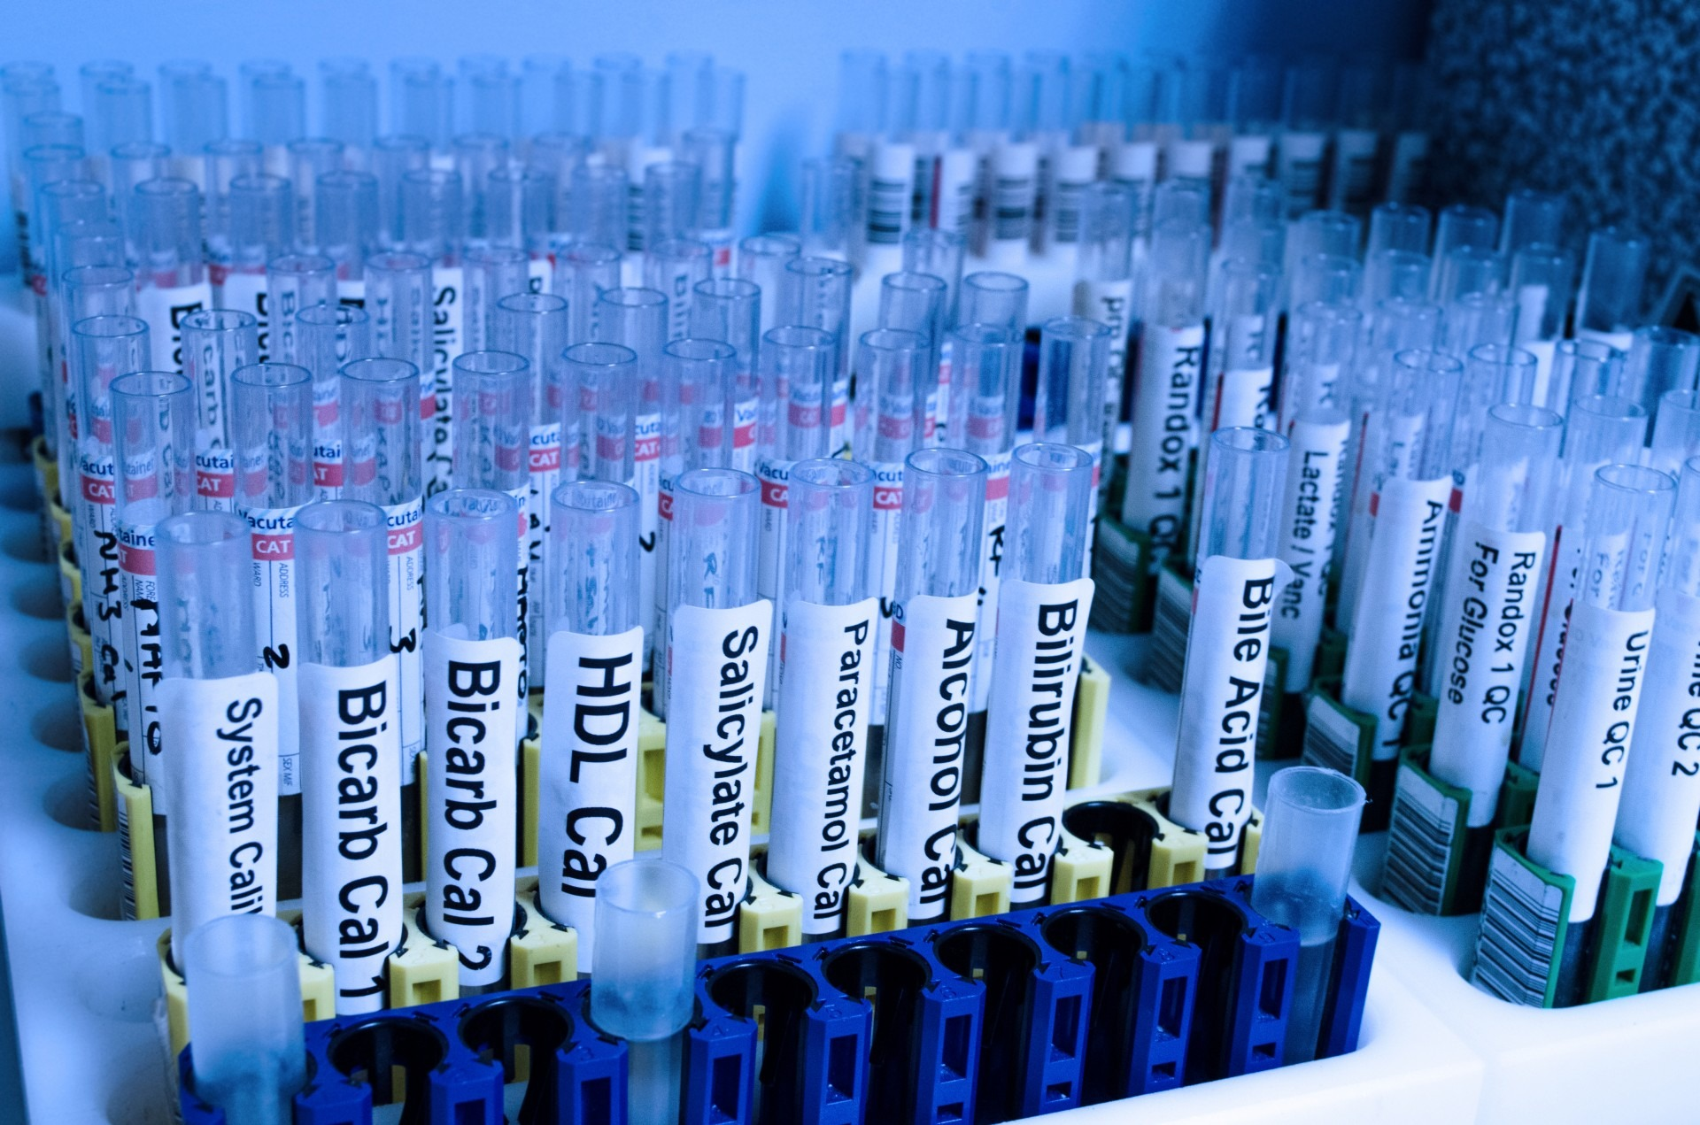
TESTING
Viral Tests Permitted
Cannot Require Antibody Testing To Return
Antibody Test “Medical” ADA
May Not Preclude Return Due To Age
May Not Preclude Return Due To Pregnancy

Slide 10

FORGIVENESS
Application PPP Certification “Buy American” To Extent Feasible
“Current Economic Uncertainty Makes This Loan Request Necessary To Support The Ongoing Operations Of the Applicant”
Audit > $2 Million
PPP Flexibility Act
Forgiveness based on 8 -24 weeks following the date of the first disbursement of PPP funds.
EIDL advance/grant comes off the forgiveness.
60% of the forgiveness must be for payroll related expenses.
40% can be for rent, utilities and mortgage interest.
FTE 12/31-Wait to Seek Forgiveness?
Notes:
EIDL Economid Injury Disaster Loan

Slide 11

FORGIVENESS
Reductions May Be Waived if Headcount and Pay Levels are Restored by December 31, 2020.
Model Forgiveness Out In Advance.
Document Everything.
Forgiveness Decision Must Be Made Within 60 Days of Supplying Data to the Lender.
EZ Application- Not Reduced Headcount; Salary Reduction<25%

Slide 12

FORGIVNESS DOCUMENTATION
Bank Statements
Payroll Service Provider Report
Tax Filings (941)
Unemployment Insurance Tax Filings
Payment Receipts
Cancelled Checks
Amortization Schedule
Lease Agreement
Worksheets: Job Offers, Firings, Resignations, Request Reduction In Hours, (Maintain 6 Years)

Slide 13

OPPORTUNITIES
Temperature Scanning
Sanitization Equipment
Security Solutions
Cloud Services
Personnel Kiosks-Temp, Mask, Questionnaire
Shields/Partitions
Documentation “AS IS”

Slide 14
QUESTIONS ????
Bob Goldberg
bob.goldberg@sfnr.com
847/226-3254

